Slide 1
Water!

Slide 2
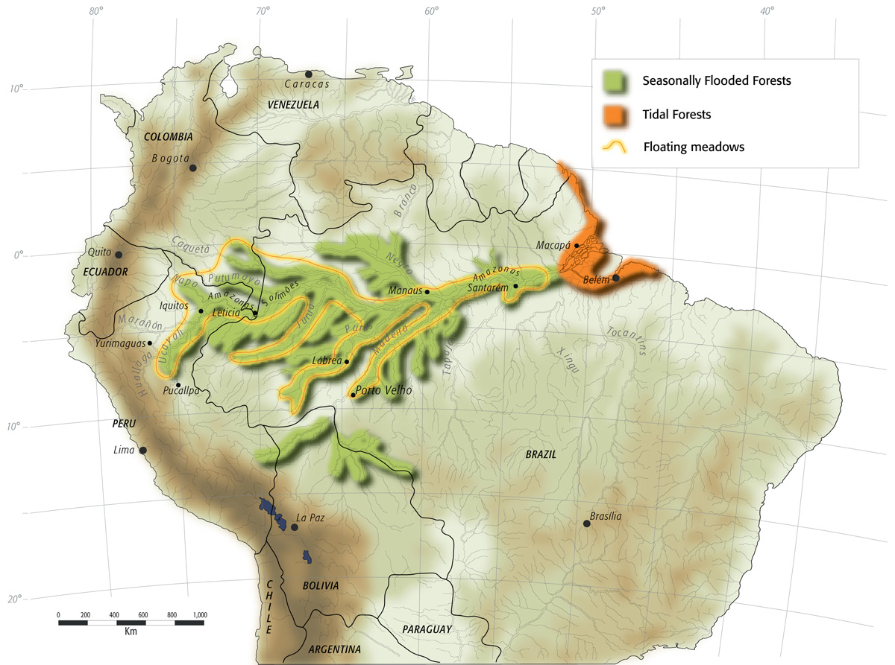
Water is everywhere!
71% of Earth’s Surface is covered in water
Large portions of Earth undergo regular flooding
  https://enviroatlas.epa.gov/enviroatlas/interactivemap/

Slide 3
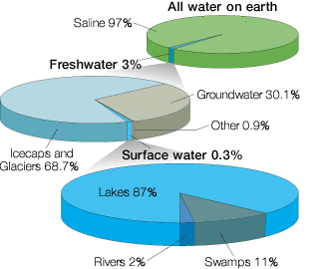
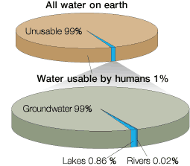
So… why are we worried about water then?

Slide 4
A calculation:
The Earth has a radius of 6 million meters
The average depth of the ocean is about 4000m.
How much available, non-saline, surface water is there?

Slide 5
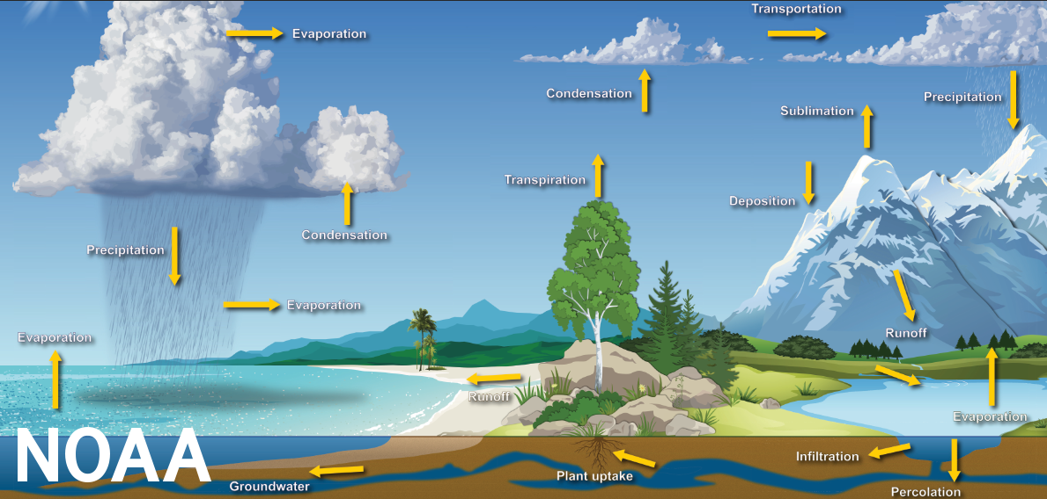
The water cycle

Slide 6
Drought
Period with abnormally low rainfall
May make water scarce locally

Slide 7
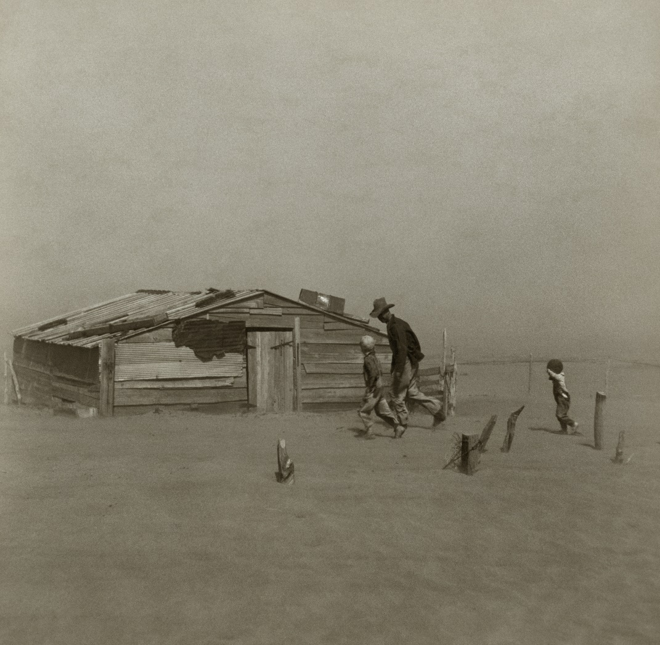
The dust bowl (image credit: Arthur Rothstein)

Slide 8
Flood
River
  Overflow
Seawater
  storm surge / storm tide
  Tsunami
Other
  Flash flood
  Rainfall

Slide 9
Is flooding always bad?
Blank: it’s thinking time!

Slide 10
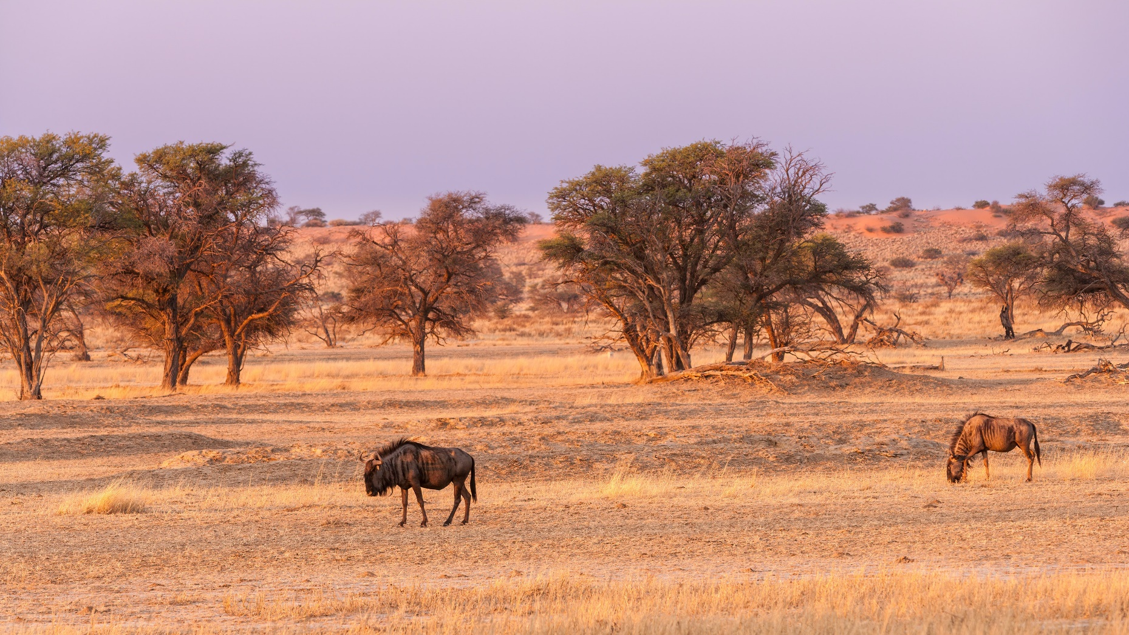
Kalahari (image credit: Chris Stenger)

Slide 11
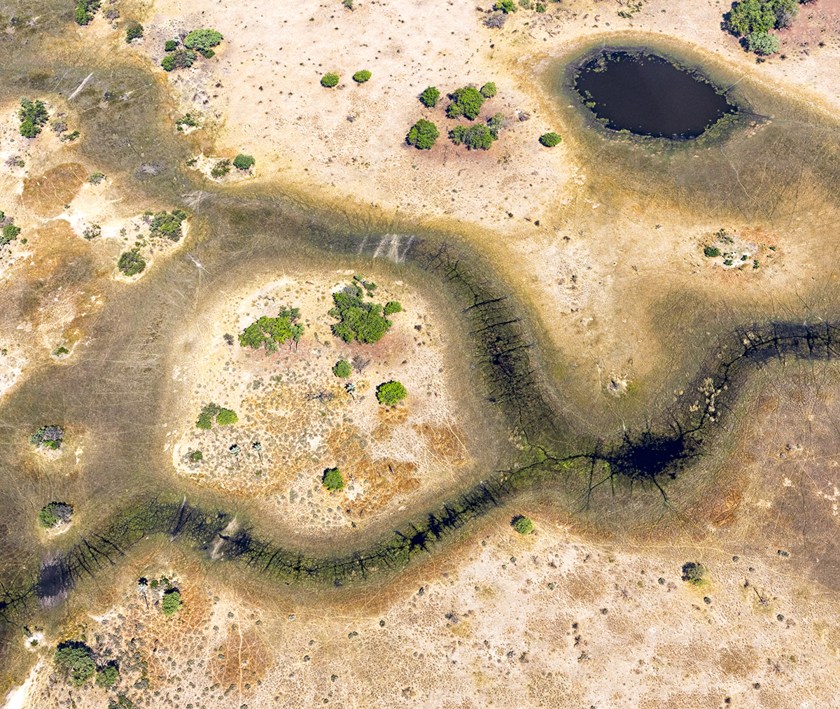
Okavango, dry season (image credit: Dick Keeley)

Slide 12
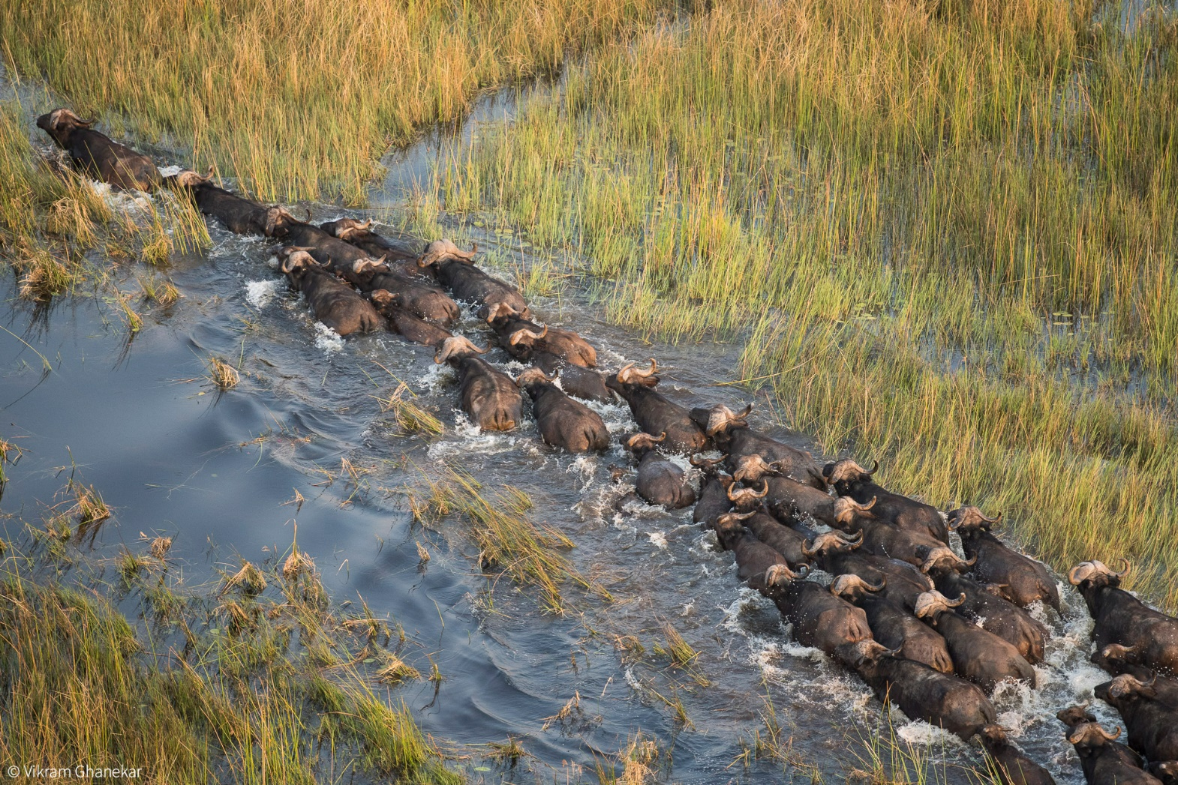
Okavango, wet season (Vikram Ghanekar)

Slide 13
Human and water

Slide 14
Dikes and Levees
Textbook is slightly wrong according to NOAA.
Dike: Protects land that would otherwise normally be underwater or would be tidally submerged. The water is not required to be saline as the textbook implies.
Levee: Protects land that would otherwise lie in the floodplain or a river or stream, but would not normally be submerged.

Slide 15
Dams
Hydroelectric power
Recreation
Flood Control
Water storage
Damage to fish populations
Changes in river conditions

Slide 16
aqueducts
Divert water from one location to another
Traditionally above ground, but modern aqueducts may also be underground

Slide 17
Consequences
What might be the consequences of building a new aqueduct?

Slide 18
Colorado river
Supplies much of the water for (among other places) Los Angeles, Phoenix, Los Vegas, and Baja California
Involves several major agreements between several US states and Mexico
https://earthobservatory.nasa.gov/images/148758/lake-mead-drops-to-a-record-low

Slide 19
Groundwater
Most regions have substantial amounts of ground water (even desert regions like Phoenix)

Slide 20
Types of aquifers
An aquifer is confined if it is surrounded by layers of rock on both sides
Shallow aquifers are usually unconfined
Deep aquifers are frequently confined
Deep, confined, aquifers are replenished on relatively long timescales (~10 thousand years)
Unconfined aquifers are replenished much more rapidly

Slide 21
Desalinization
Mostly in very dry regions
Energetically expensive
Reverse osmosis uses less energy but produces brine
Potentially lower energy using methods available soon.
https://news.mit.edu/2020/passive-solar-powered-water-desalination-0207

Slide 22
Water usage
Global water usage (from textbook)
  70% agriculture
  20% industrial
  10% household
USA water usage (from USGS data as of 2015)
  Thermoelectric: 41% (31% of fresh water)
  Industrial: 5%
  Irrigation: 37% (42% of fresh water)
  Public Supply: 12% (14% of fresh water)
  Livestock: 1%
  Aquaculture: 2%
  Mining: 1%

Slide 23
Irrigation methods
Flood irrigation
  Furrow: Dig trenches between crops and fill them
  Basin: Flood whole field
  Surge: Intermittently release water
  Border: flood channels around the crops
Sprinkler Irrigation
  May be fixed, automated, or manually moved
Microirrigation
  Line source: The tube is the delivery device
  Point source: Spcific emitters are placed along the line

Slide 24
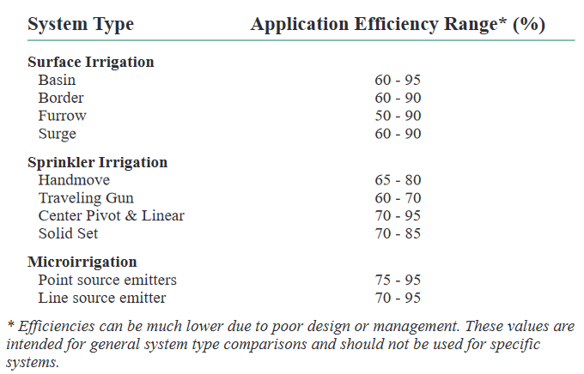
Agricultural efficiency (credit: Kansas State University)

Slide 25
Water conservation (how can we use less?)
Grey water recycling
Drought resistant plants (xeriscaping)
Incentive structures

Slide 26
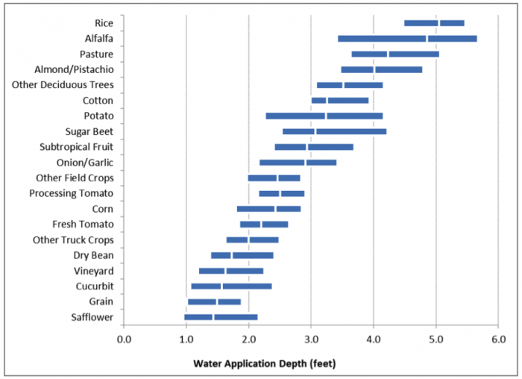
Grow the right crops (source Heather Cooley, Pacific Institute)

Slide 27
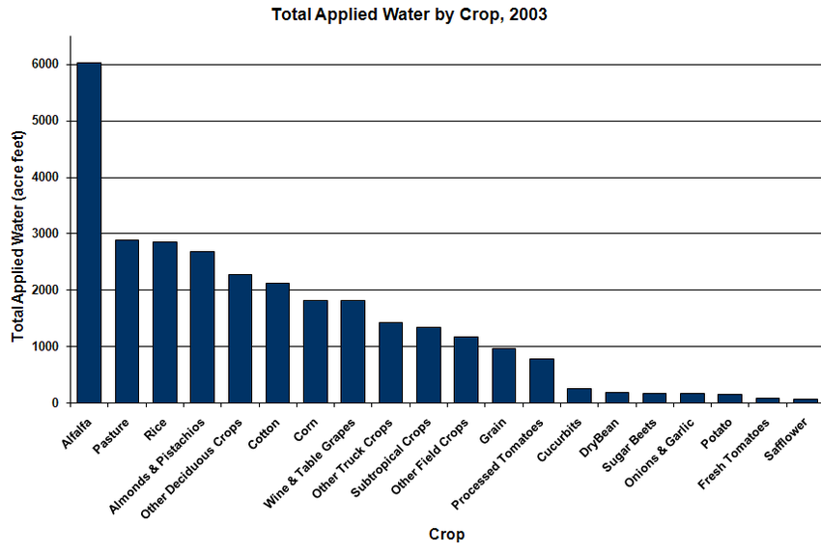
We aren’t growing the right crops (source CA Department of Water Resources)

Slide 28
Seminar Day
How might you make farmers use water more efficiently. What would be the consequences of each action?
You are interested in the effect of increasing elevation on species diversity.
  What would you hypothesize the relationship to be and why?
  How would you test your hypothesis?
  What would be some confounding variables
What would the growth of a forest look like on a newly exposed rocky slope? How would this differ from regrowth of a forest following a large fire?

