Slide 1
Water Pollution (Ch 14)

Slide 2
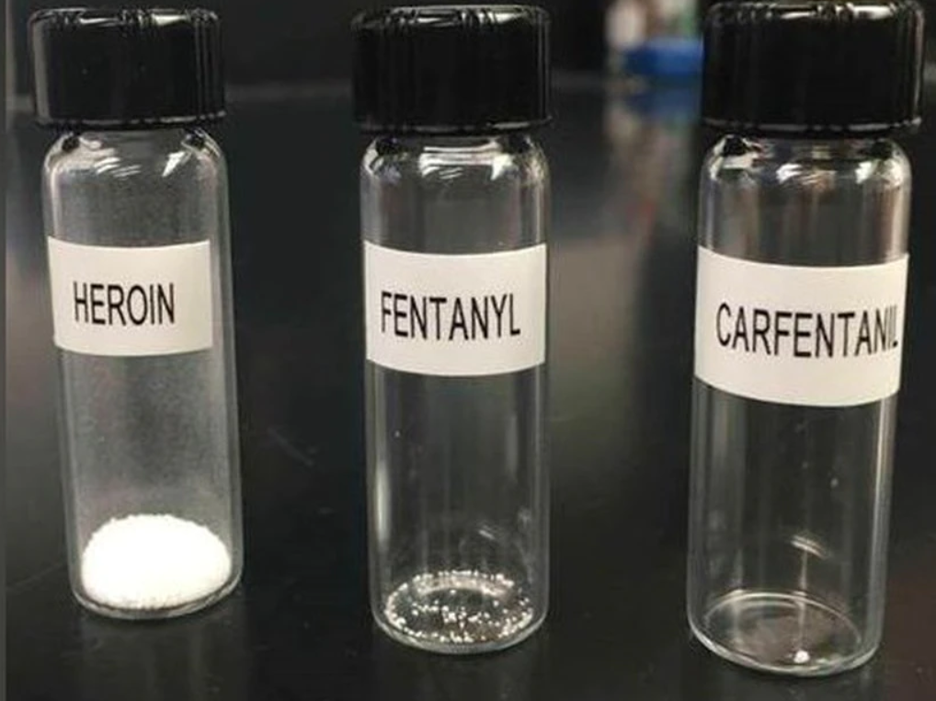
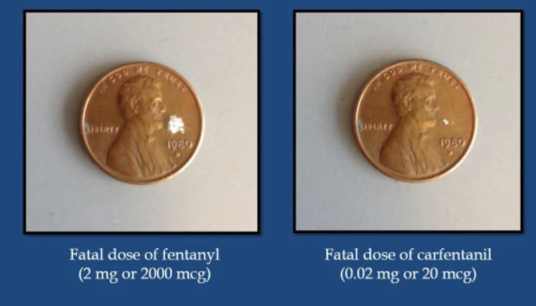
What 20 micrograms looks like

Slide 3
Pollution from organic waste
All creatures produce waste (feces, fallen leaves…)
Waste contains nutrients that other organisms can use

Slide 4
Biochemical Oxygen Demand
Microorganisms in water break it down
  Requires oxygen
More organic matter means more to break down
  Increase in BOD (Biochemical Oxygen Demand)
High BOD means less dissolved oxygen remaining
  Can kill fish and other aquatic life
  Results in a ‘dead zone’

Slide 5
Eutrophication
Waste contain nitrogen and phosphorus, which add nutrients to the water
  Called eutrophication
  When human caused, called ‘cultural eutrophication’
    Usually either raw sewage or fertilizer
Algae respond to the sudden nutrient influx with rapid growth
Some algae produce substances that are directly toxic to humans and animals
Algae die, and decomposers start to break them down
Dead zone (nearly always human caused)

Slide 6
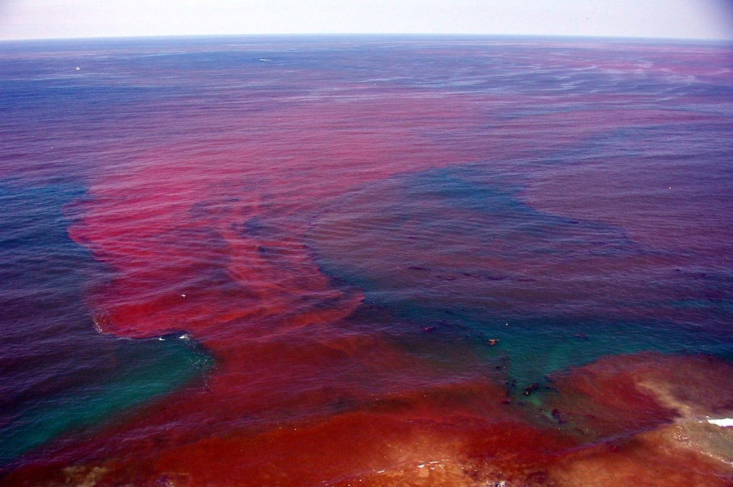
A red tide (red algae produces a neurotoxin)
Photo: Kai Schumann

Slide 7
Disease Causing Organisms
Sewage has harmful bacteria (duh)
Can end up in ground water (usually shallow wells with porous soils)
Causes disease
  Hepatitis A (viral liver infection that last about 8 weeks)
  Typhoid fever (moderately serious bacterial illness)
  Dysentery (bacterial illness that causes extreme diarrhea)
Presence of harmless fecal coliform bacteria (often e. coli) serves as an indicator for the possibility of harmful strains

Slide 8
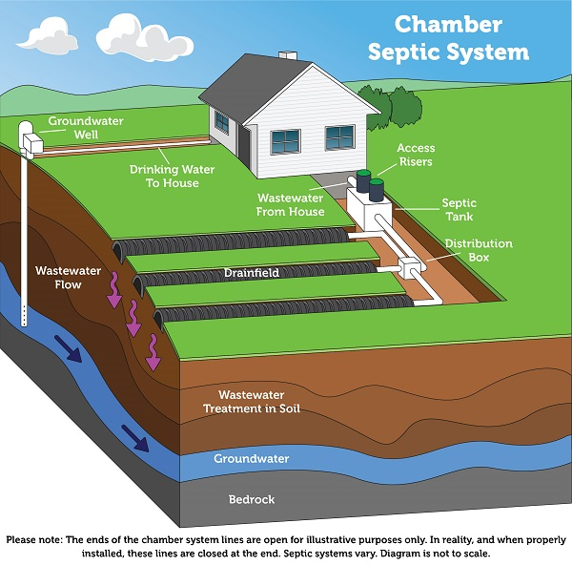
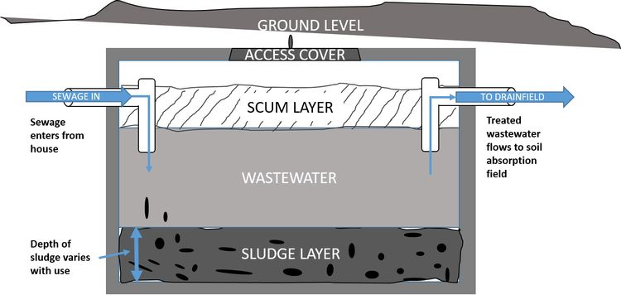
Septic system (images: US EPA, Beth Clawson MSU)
Tank allows solids to settle and oils to float
Microbes break down oil (scum) layer
Solid (sludge) layer needs to be pumped out
Wastewater goes to drainfield (aka leechfield)
Slowly released into soil and broken down

Slide 9
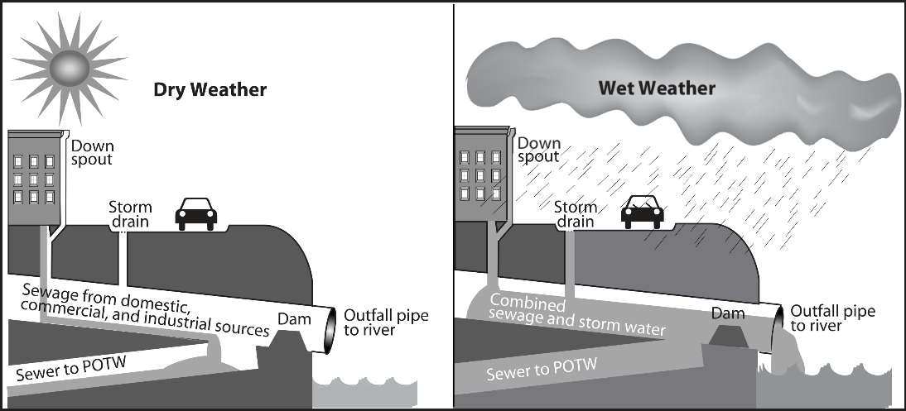
Combined Sewer System (Mostly 1930s and earlier)
Wastewater and storm water collected together
When there is excess rain, can overflow, leading to water pollution
  Can also back up in this case, flooding homes with sewage

Slide 10
Sanitary Sewer system (Modern design)
Only wastewater
Must also have dedicated storm drains
  Overflows of dedicated storm drains are less harmful
Overflows of sanitary sewer are much less common
  Can result from stormwater or from blocked pipes
Main advantage is that treatment of un-diluted waste is much easier

Slide 11
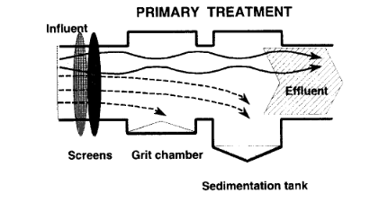
Treatment plants (image: US EPA).
Clean water act lays out minimum standards for wastewater
  Sometimes raw sewage is still discharged during flooding (mostly from combined sewers).
Modern system (Primary)
  Screen: filter out rags, diapers, etc.
    Don’t flush these sorts of things…
  Grit chamber: allow sand and pebbles to fall to the bottom
  Sedimentation tank: allows lighter solids to fall out (ie sludge or ‘primary biosolids’)

Slide 12
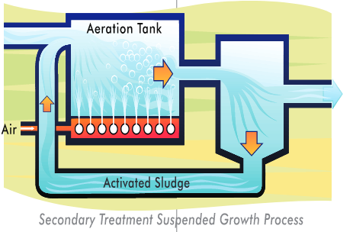
Treatment plants, cont. (Image: US EPA)
Secondary treatment
  Wastewater goes to either a trickling filter (porous media with lots of microbes) or to an aerator (air injected tank with lots of microbes) to be further processed
  Generally removes 70-90% of material
  Sanitized with chlorine or ozone
    May be removed before dumping
Some Cities have more advanced treatment
  Read more: https://www3.epa.gov/npdes/pubs/primer.pdf

Slide 13
Wastewater
https://unesdoc.unesco.org/ark:/48223/pf0000247553

Slide 14
Chemical Water Pollution
Heavy metals
  Lead from pipes
  Mercury from industrial waste
  Cadmium from batteries
  Arsenic from natural sources
  All are not particularly acutely toxic, but chronically neurotoxic
  Relatively difficult to remove
Pharmaceuticals
  Birth control
  Steroids
  Anti-biotics

Slide 15
Chemical water pollution
PCBs
  Used to make plastic before 1980
  Very hydrophobic
  Very long environmental half life and biological half life
  Endocrine disruptor (blocks thyroid function, mimics estradiol)
  Mutagenic, carcinogenic
  Also acutely toxic to the liver
Perchlorates
  Moderately strong oxidizing agents used in rocket fuels
  Toxic to most life
  Low level toxic effects not well studied

Slide 16
Oxygen toxicity
Oxygen causes cell necrosis, other oxidative species cause apoptosis
  https://www.jbc.org/article/S0021-9258(18)37304-6/fulltext
Oxidative species damage DNA, among other things
  https://www.ncbi.nlm.nih.gov/pmc/articles/PMC5927356/
Oxidative stress is likely a major contributor to telomere shortening
  https://www.ncbi.nlm.nih.gov/pmc/articles/PMC6162185/

Slide 17
Oil pollution
When crude oil is spilled, it floats
Very toxic to seabirds and marine mammals
Options for removal/cleanup
  Plastic floating walls can isolate the spill
  Absorbent materials can suck up the spill
  Surfactants and solvents can be used to allow the water to mix with water
    Makes the spill worse for life under the surface
  Burn it
    Massive air pollution
    Leaves residue behind that is somewhat toxic

Slide 18
Discussion Questions
What can be done with wastewater?
What options exist for increasing access to clean water in impoverished countries?
This paper found that the Ogallala aquifer showed signs of localized pollution in the vicinity of fracking operations. Should fracking near the aquifer be banned?
Should new restrictions on wastewater cleanliness be imposed?
Should the Ogallala aquifer continue to be used as a major water source?

