Slide 1
Atmospheric Physics!

Slide 2
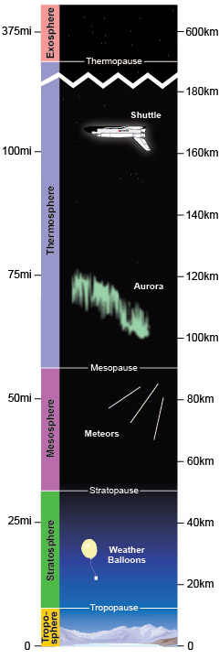
The layers

Slide 3
Key features
Troposphere
  Ground, mountains, planes...
  Weather occurs here (mostly…)
  You will probably never leave the troposphere
Tropopause
  Boundary between troposphere and stratosphere
Stratosphere
  Weather balloons, high altitude aircraft
  Ozone layer

Slide 4
Key features continued
Stratopause
  Boundary between stratosphere and mesosphere
Mesosphere
  Layer that causes things to burn up on entry (due to density)
  Last layer where gasses are mostly mixed rather than stratified by molecular mass.
Thermosphere
  Ionized, reflects radio waves
Exosphere
  Ionized, extremely low density

Slide 5
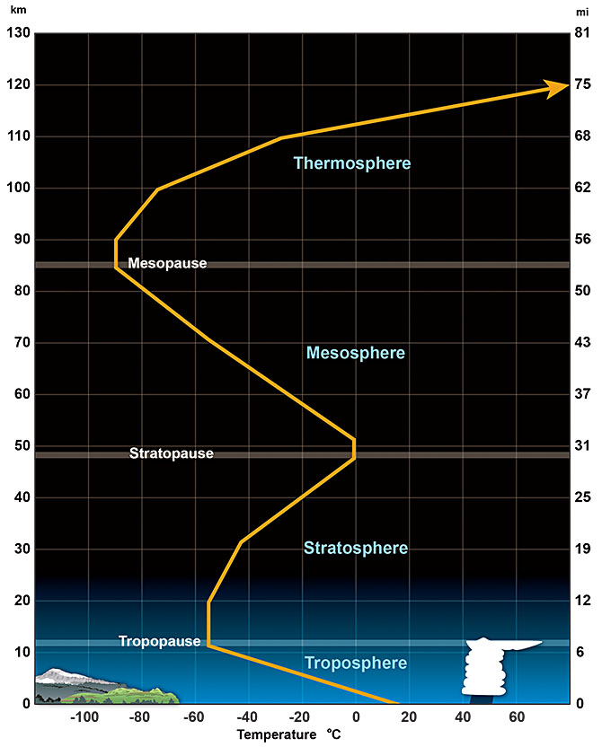
The temperature lapse function
Environmental Lapse Rate (ELR)
Altitude Region | Lapse rate | Lapse Rate
(m) | (°C / km) | (°F / 1000 ft)
0.0 – 11,000 | 6.50 | 3.57
11,000 – 20,000 | 0.0 | 0.0
20,000 – 32,000 | −1.0 | −0.55
32,000 – 47,000 | −2.8 | −1.54
47,000 – 51,000 | 0.0 | 0.0
51,000 – 71,000 | 2.80 | 1.54
71,000 – 85,000 | 2.00 | 1.09

Slide 6
Reasons for temperature gradients
Troposphere
  Ground is heated by solar radiation. The atmosphere provides some amount of insulation. The gradient is made less steep by convection.
Stratosphere
  Ozone production involves substantial conversion of energy into heat. Thermal convection is impossible here because the temperature gradient points the wrong direction.
Mesosphere
  Hard to answer. Non-local equilibrium and hard to study because it is too dense for satellites and to diffuse for aircraft/balloons.

Slide 7
Reasons for temperature- Upper atmosphere
Thermosphere: The upper part of the thermosphere is heated by highly energetic solar radiation. Temperature then falls as we move lower in the atmosphere due to shielding from the atmosphere above. The thermosphere is largely ionized, resulting in an ability to bounce EM waves off of this region.

