Slide 2
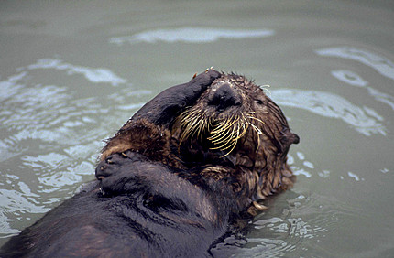
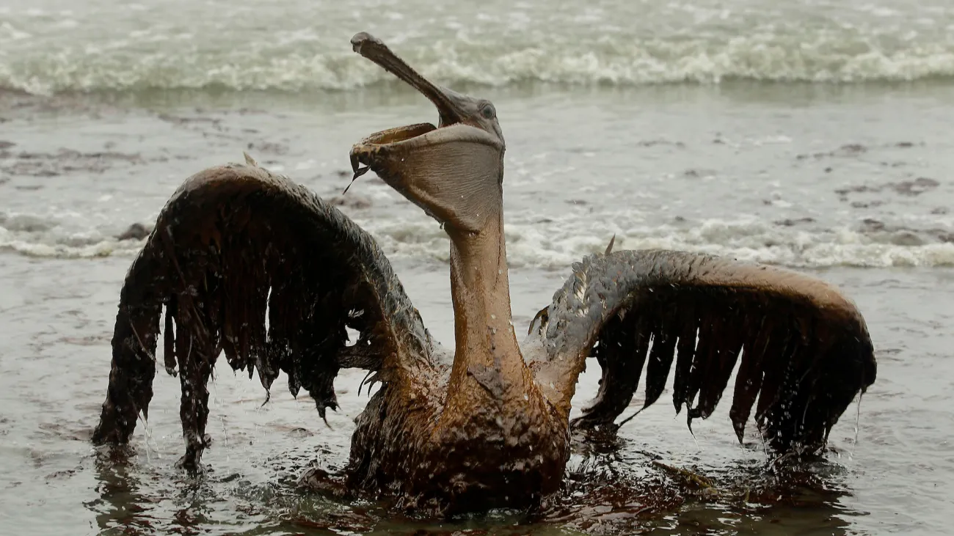
Sea Otter after Exxon Valdez (Brad Hunt) and pelican after deepwater horizon (Charlie Riedel)

Slide 3
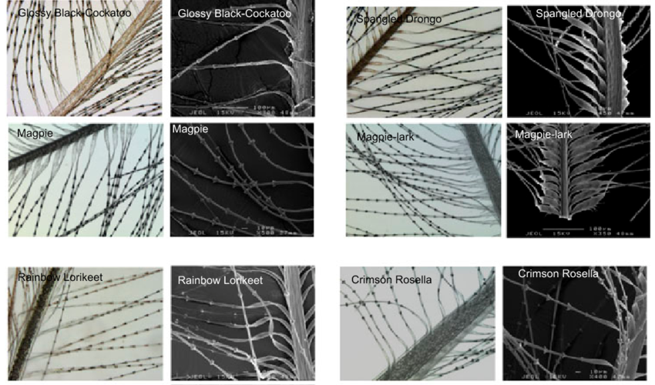
Bird feathers (Joannah Lee, 2015)

Slide 4
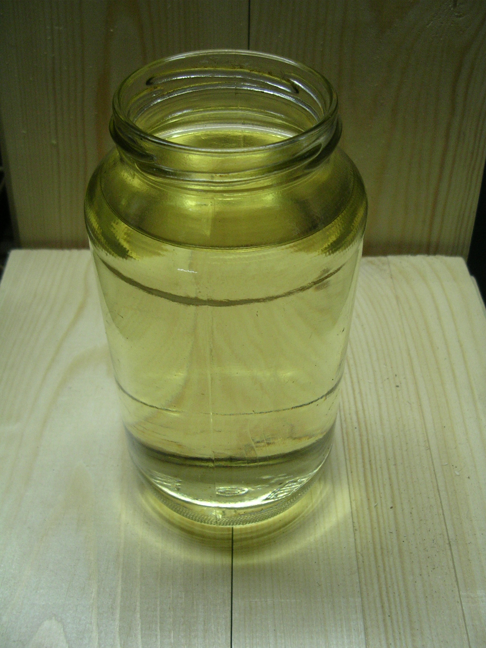
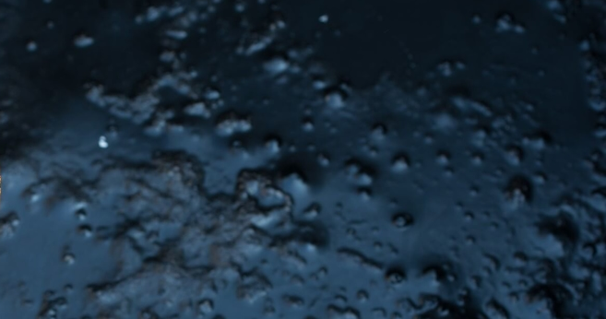
Different petroleum products (crude oil and gasoline shown)

Slide 5
Effects of particular petroleum products
Less refined products (crude, bunker oil…)
  Tend to be sticky
  Tend to evaporate slowly
  Some become hard after a week or two, reducing further damage
  Less acutely toxic, but some animals (eg birds) will ingest relatively large quantities
  Most large spills have been crude oil
More refined products (gasoline, kerosene, diesel…)
  Most are volatile and evaporate quickly
  Act as solvents, easily penetrate skin and tissue
  Generally relatively poisonous

Slide 6
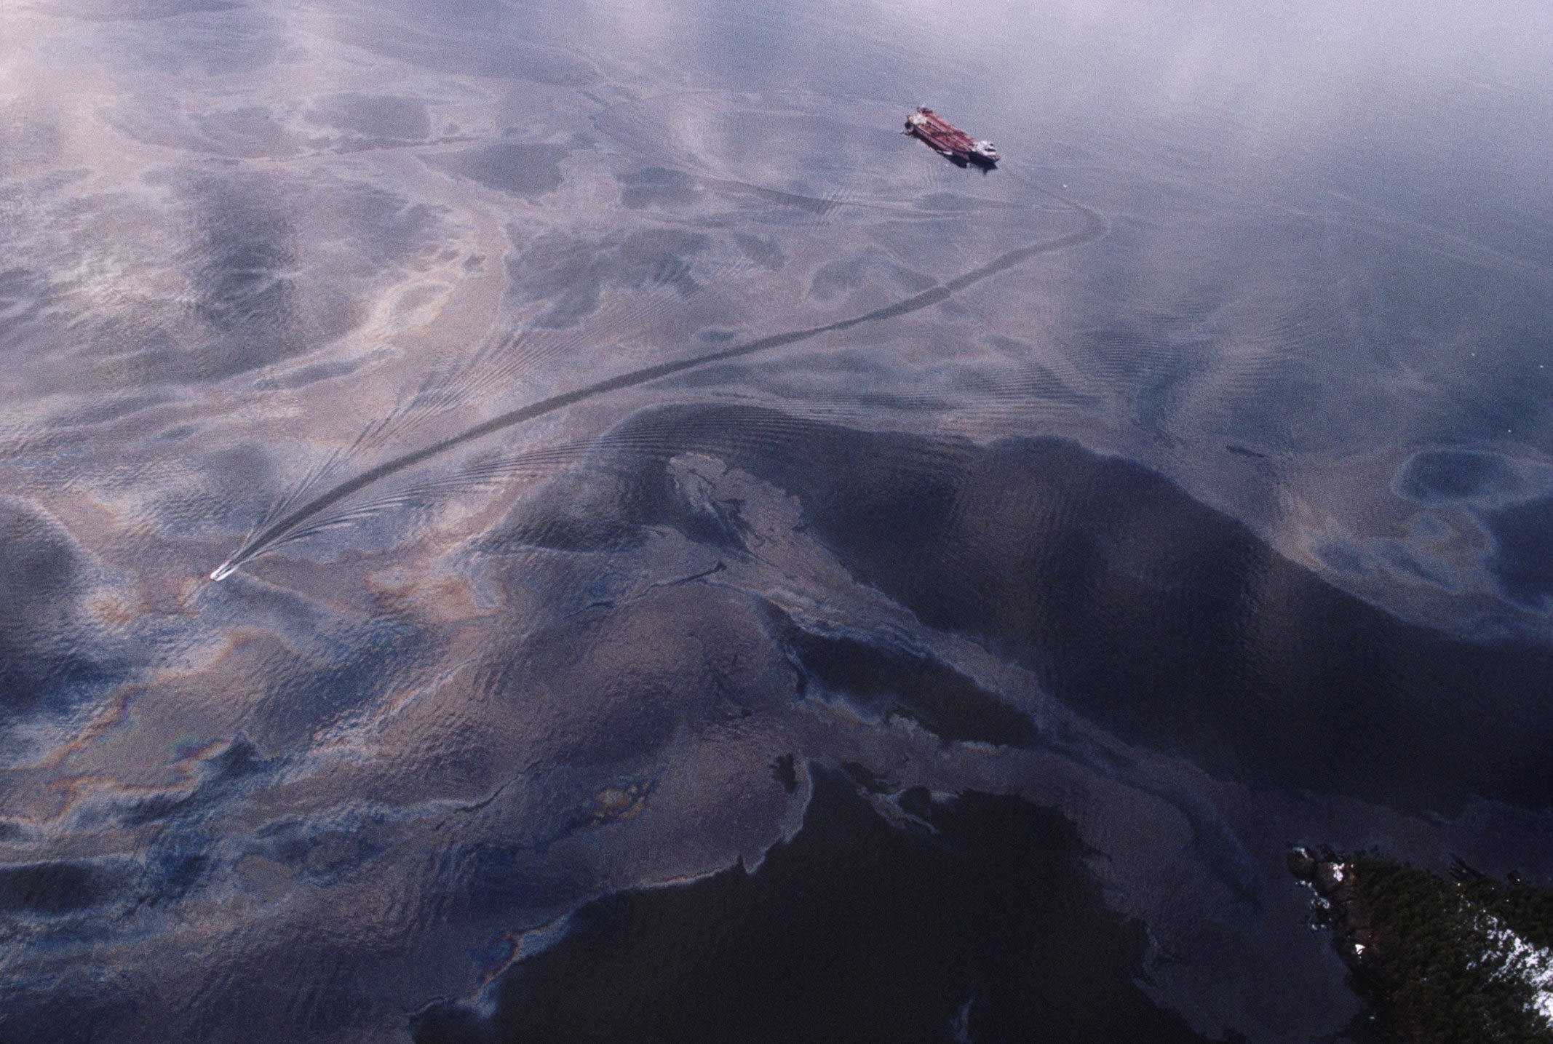
Exxon Valdez (Natalie Forbes)

Slide 7
Oil Spill Effects
Otters and seabirds are among the worst affected due to their tendency to spend lots of time on the surface.
Otter fur loses its insulating properties when oiled
Bird feathers tend to clump together when oiled, affecting both flight and insulation ability
Whales can end up breathing in large quantities of oil when they surface to breathe

Slide 8
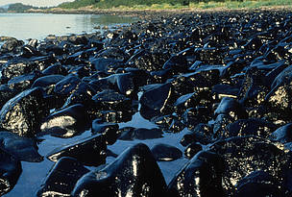
Oil spill effects continued (ARLIS-ADFG)

Slide 9
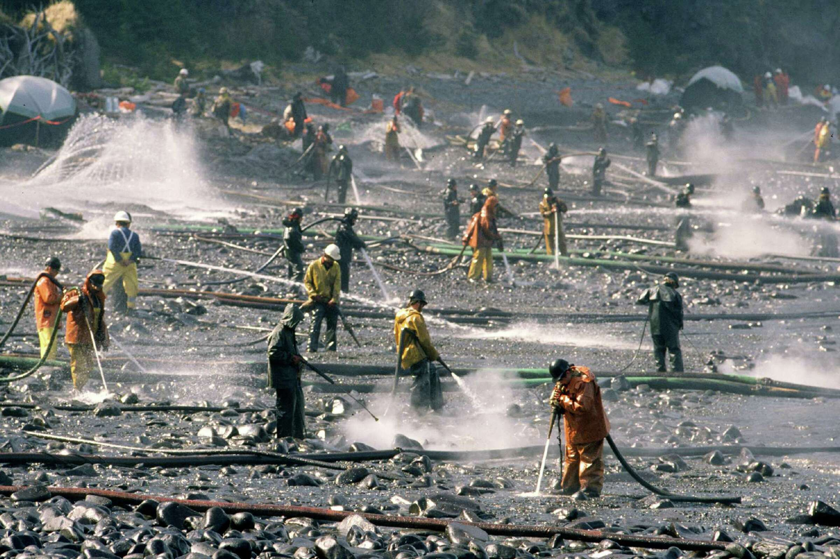
Cleanup- Beaches

Slide 10
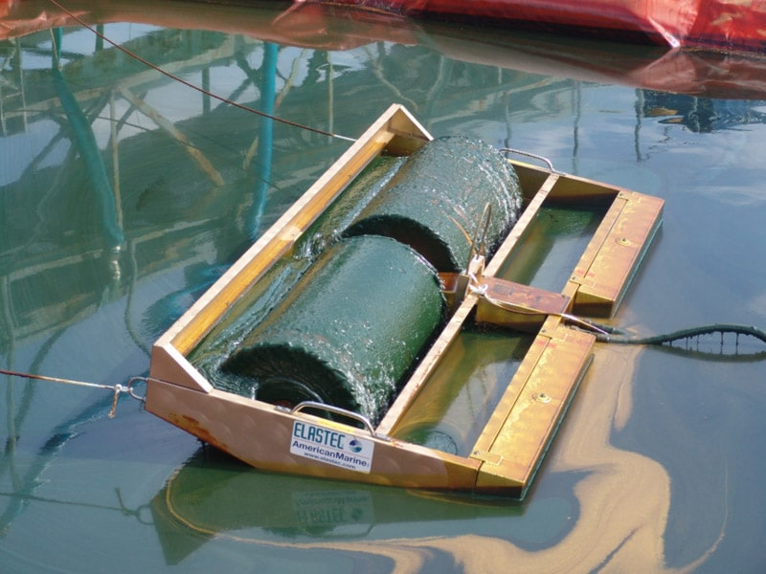
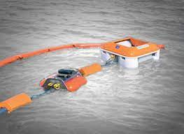
Cleanup- Skimming
Used in virtually all oil spills

Slide 11
Cleanup- Surfactants (aka dispersants)
Act to break oil slick into very small beads that then disperse into the volume of water
Have both substantial benefits and substantial drawbacks
  https://www.pwsrcac.org/wp-content/uploads/A-Review-of-Literature-Related-to-Oil-Spill-Dispersants-September-2017.pdf
  Benefits:
    Reduces toxicity to surface organisms
    Increased breakdown rate by microorganisms
  Drawbacks
    Toxicity to underwater species is dramatically increased for a short time
    The dispersed oil is likely genotoxic

