Slide 1
Thermal, Light, Noise Pollution

Slide 2
Sensitivity to temperature
Water ecosystems are highly sensitive to temperature changes
  Plants/algae grow much faster with warm temperatures
  Dissolved oxygen decreases with higher temperature
  Larger changes will denature proteins
  Heavy metals are much more soluble in warm water
Some animals are benefitted from warmer waters
  Manatees are classic example, artificially warm water increases their geographical range
  This isn’t necessarily good because those species are often invasive
Most animals are sensitive to about 2 degree Celsius change

Slide 3
Sources of thermal pollution
Power plants
  Also can kill species when they are suddenly shut off
  Large temperature increase (10 Celsius is common)
Runoff in warm weather
Dams
  Water stays in place longer, thus more solar heating on surface
  Cold water settles to the bottom, so bottom may be artificially cold

Slide 4
Reducing thermal pollution
Power plants can switch to closed loop cooling or cooling towers
Dams can release water more evenly
Runoff can be collected

Slide 5

Light pollution (image darksky.org)

Slide 6
Issues with excess light
Interferes with animal behavior, particularly for nocturnal organisms
Insects are attracted to light
Birds are disoriented by lights on tall structures, resulting in collisions
  Appears to be improved if lights are shut off at night
Turtles use the light reflection to find the ocean, cities disorient them

Slide 7
Non-ecological
Interferes with astronomical observation
Human circadian rhythm is governed by light
  Melatonin levels drop dramatically in the presence of any light, but especially blue light
New research is linking bright nights to negative health effects potentially beyond sleep deprivation

Slide 8
What can be done
Shut lights off at night
Direct lights downwards
Make less lights (eg Tucson)
Actually pretty hard to deal with

Slide 9
Noise pollution
Many animals rely on sound and vibration
  Bats for echolocation
  Whales for communication
  Birds for mating and communication
  Many invertebrates for predator/prey detection
    Hermit crabs…
    Squid will ink when loud noises occur, but they appear to desensitize with time.

Slide 10
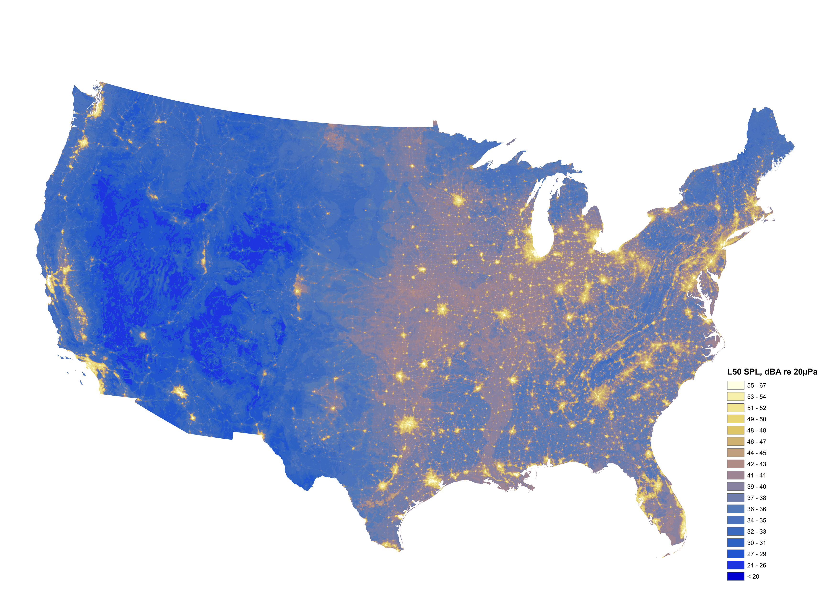

Slide 11
