Slide 1
Heating and circulation

Slide 2
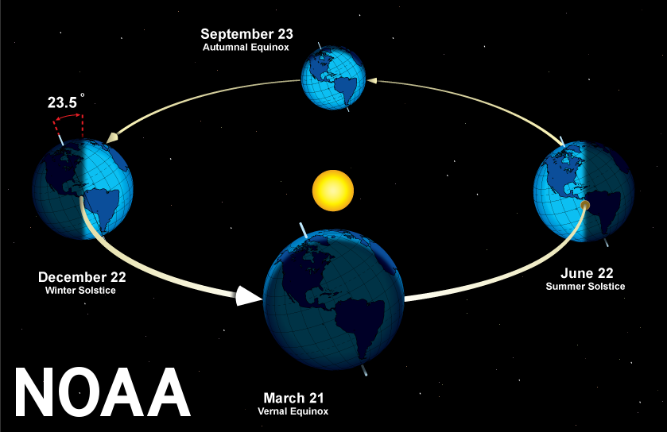
The seasons

Slide 3
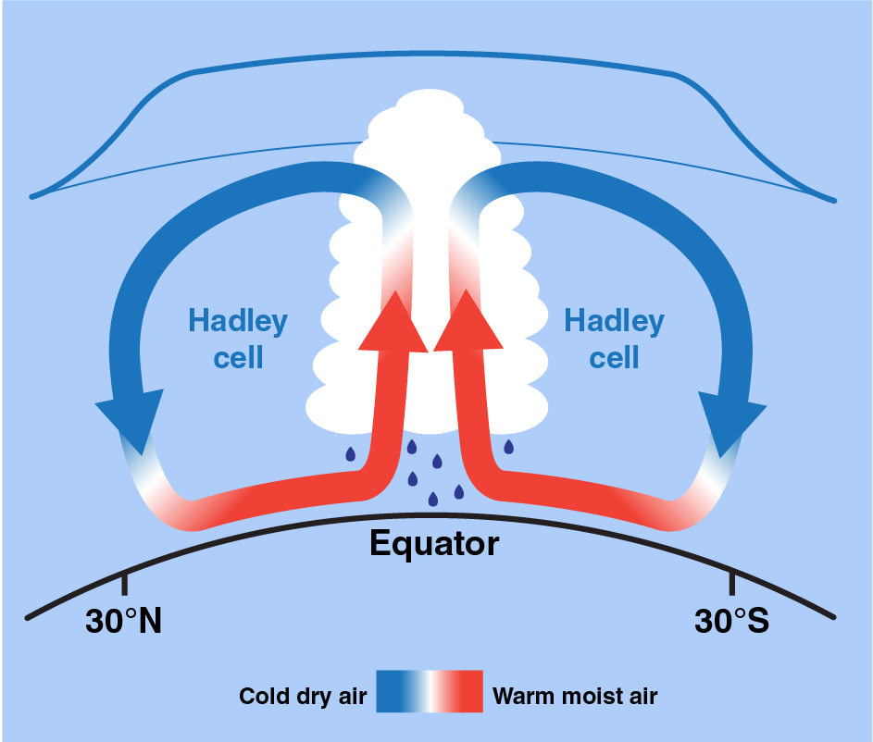
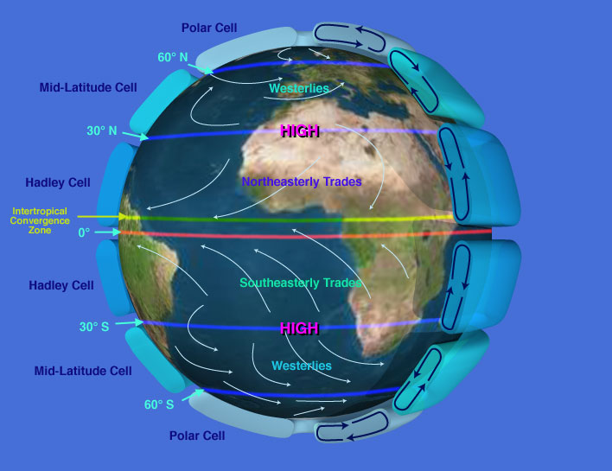
Convective cells (image: NASA)

Slide 4
The Coriolis effect
Comes from rotation of Earth.
Equator has higher linear velocity.
An object launched from the equator keeps that high velocity, which carries it Eastward.
This idea is responsible for the trade winds.

