Slide 1
Climate Change

Slide 2
What no atmosphere looks like
Mercury
  Daytime temperature 740 K
  Nighttime temperature 90 K
Mars
  Daytime temperature (equator) 300 K
  Nighttime temperature (poles) 120 K
  Average surface temperature 210 K

Slide 3
What too much atmosphere looks like
Venus
  Min surface temperature: 710 K
  Max surface temperature: 755 K
  Average surface temperature: 735 K

Slide 4
Earth with no atmosphere
Average about 390 K
Would be expected to have large variations

Slide 5
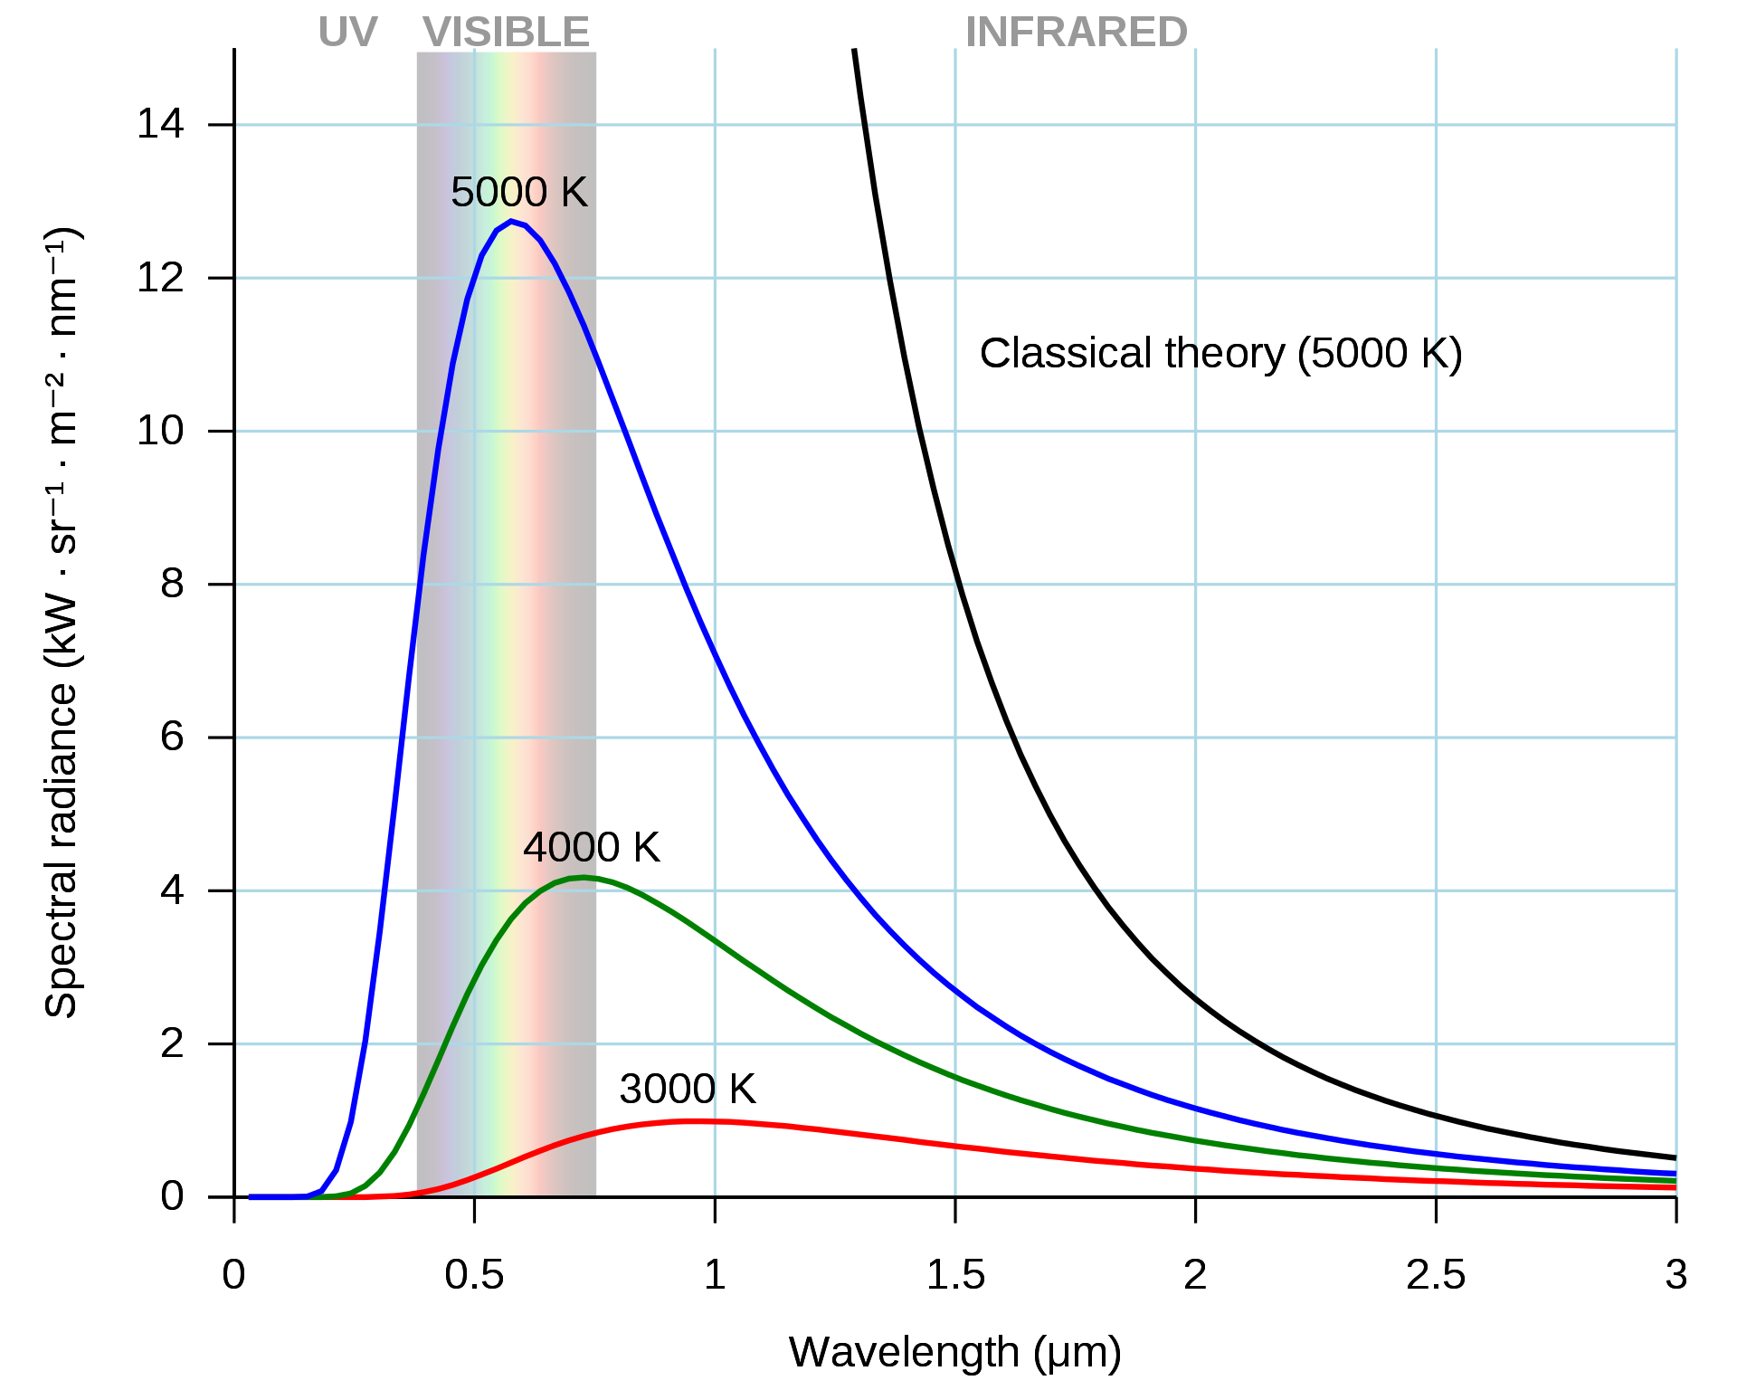
Radiation physics as quickly as possible (image: Wikipedia)
Collisions can lead to excited states in atoms and molecules
Every object emits radiation due to de-excitations
If we approximate a mixture of stuff to have infinite possible excitation energies, we get an ideal black body

Slide 6
Important points
Increasing temperature results in more emission at all wavelengths
  A bit more at long wavelengths
  A LOT more at short wavelength
Recall that short wavelength is high energy

Slide 7
Atmospheres
Atmospheres are composed of many gasses
Each will absorb specific frequencies and not others

Slide 8
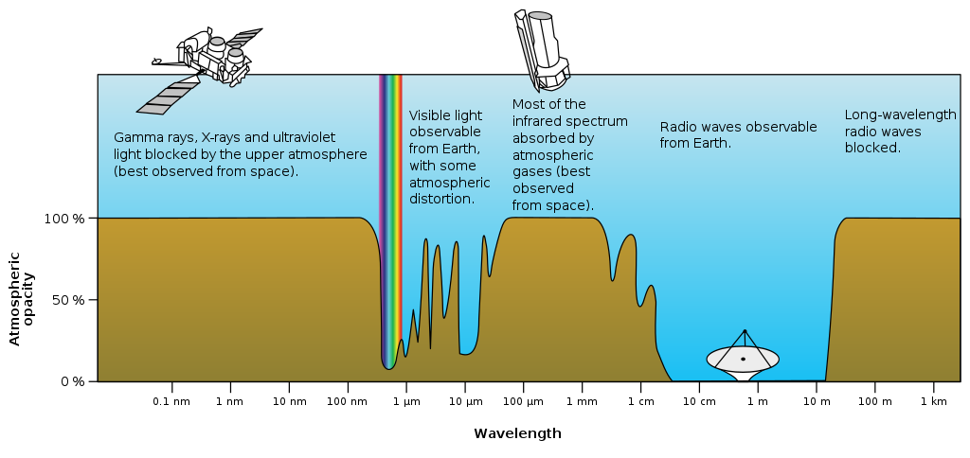
Atmospheres and opacity (image NASA)

Slide 9
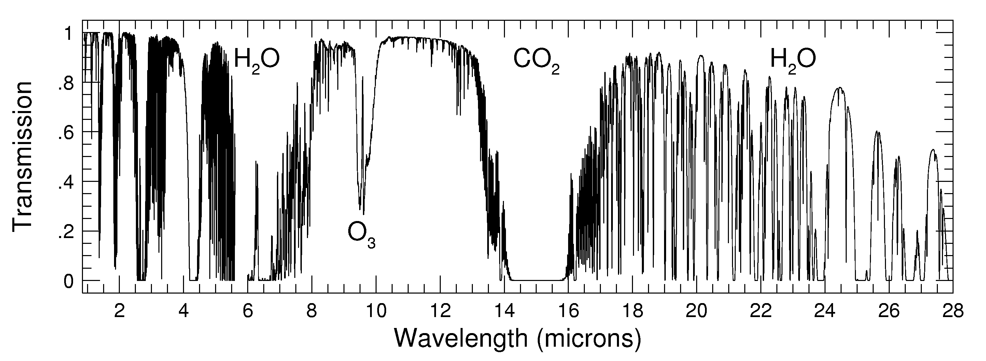
Why those frequencies? images: ohio state astronomy

Slide 10
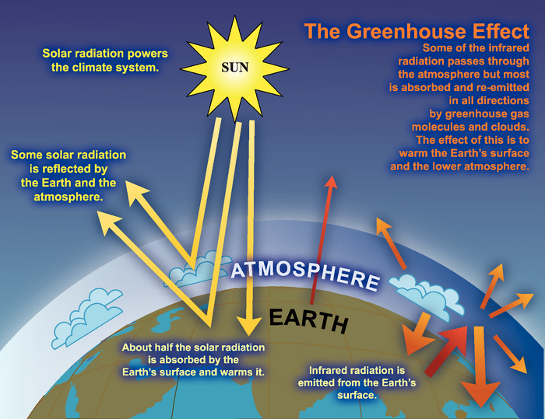
Why should we care: the greenhouse effect (image: IPCC)

Slide 11
Some more detail
http://funnel.sfsu.edu/courses/metr104/F13/summaries/AbsorptionSpectra_Atmosphere.pdf

Slide 12
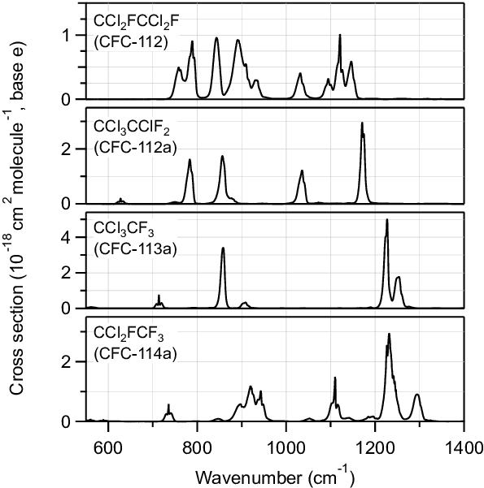
What about really potent greenhouse gases (image: Davis et al, 2016)
Note, wavenumber is inversely proportional to wavelength
  800cm^-1=12.5 micrometers
  1200cm^-1=8.3 micrometers

Slide 13
The Earth is warming
https://climate.nasa.gov/interactives/climate-time-machine

Slide 14
Positive feedback loops
Variable A increases
An increase in variable A causes variable B to increase
An increase in variable B causes variable A to increase
Repeat…

Slide 15
Melting permafrost
Warming temperatures melt permafrost
Allows microbes to multiply and break down organic materials
Microbes release methane and carbon dioxide
Earth warms…
Total carbon content of permafrost regions is estimated to be about twice the atmospheric total
https://link.springer.com/article/10.1007/s11600-019-00276-4/figures/6
https://www.nature.com/articles/d41586-021-00659-y

Slide 16
Albedo changes
Snow is white and reflects most light
Snow melts, reducing albedo
Earth warms, melting snow
https://agupubs.onlinelibrary.wiley.com/doi/10.1029/2021GL094888

Slide 17
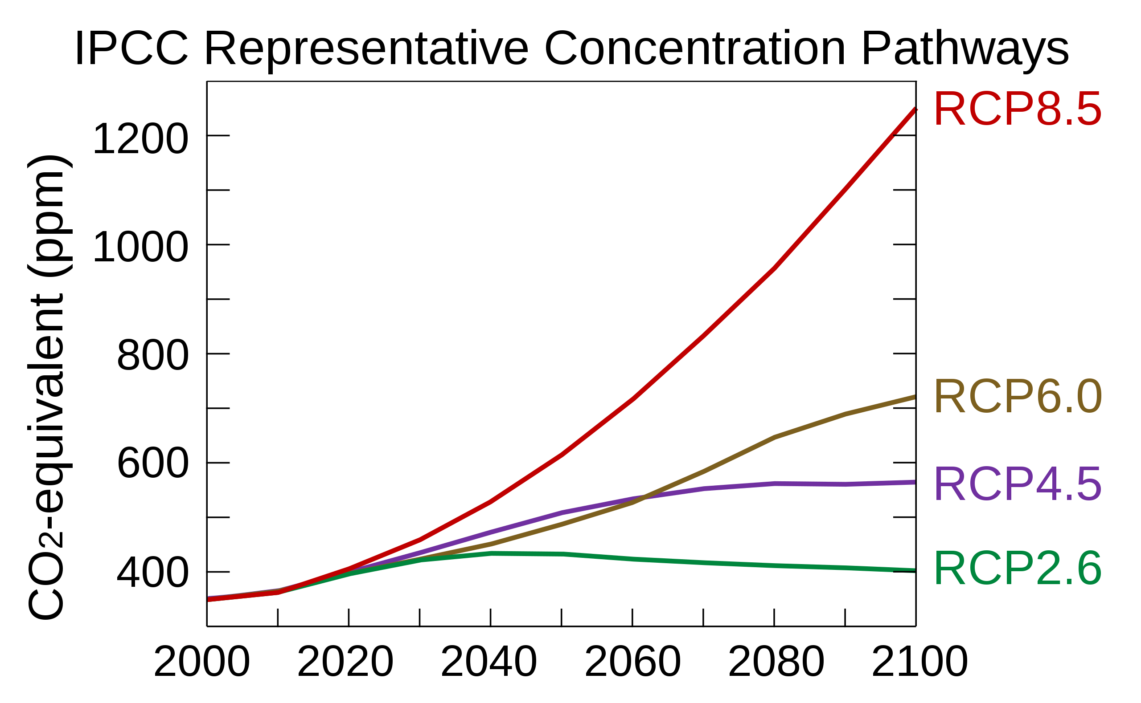
Uncertainty in climate models (image: Wikipedia, from IPCC data)
https://www.carbonbrief.org/major-correction-to-satellite-data-shows-140-faster-warming-since-1998

Slide 18
1 model’s predictions (Lyon et al, 2021)

Slide 19
Other predictions
The USA gets much hotter
  https://impactlab.org/map/#usmeas=absolute&usyear=2080-2099&gmeas=change-from-hist&gyear=2020-2039&usvar=tas_ann&usrcp=rcp85&tab=united-states&gvar=energy
Sea levels rise, destroying coastal communities
  https://climate.nasa.gov/interactives/climate-time-machine
Deserts get drier, rainforests get wetter, likelihood of abrupt change increases, change continues for thousands of years, even if warming stopped today…
  https://www.ipcc.ch/site/assets/uploads/2018/02/WG1AR5_Chapter12_FINAL.pdf

Slide 20
Discussion questions
What might be some social and economic changes that result from climate change?
What is the best way to mitigate the damage caused by climate change?
The EPA and international treaties regulate the amount of sulfur that is allowed to be in diesel fuel, but high sulfur in diesel fuel is substantially cheaper and the sulfur acts to cool the plant. How should clear air be balanced against economic effects and global warming?

