Slide 1
Feeding 8 Billion People

Slide 2
Starvation
According to the UN, about 800 million people did not have enough food to eat in 2020 (slightly higher than previous years)
Most undernutrition is due to chronic poverty.
Occasionally some specific area will have a dramatic drop in food availability. This is called a famine.

Slide 3
So we don’t have enough food?
According to WHO, around 2 billion people in the world are overweight. About 600 million are obese.
We have both a problem with too much to eat (overnutrition) and not enough (undernutrition).

Slide 4
The Earth as a finite system
A quick estimate of the theoretical ceiling on the carrying capacity of earth for humans would be if we clear cut all forests and planted crops, then ate every calorie produced. This would give something around 300 billion (to a factor of 5 or so).
Obviously this isn’t feasible. A more reasonable estimate for the carrying capacity is 10-30 billion depending on what technological improvements come along.

Slide 5
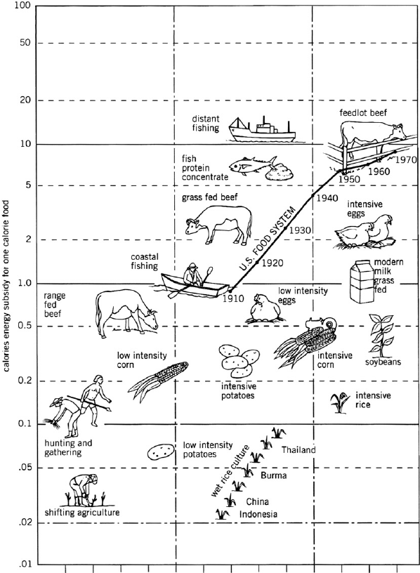
Producing 1 calorie

Slide 6
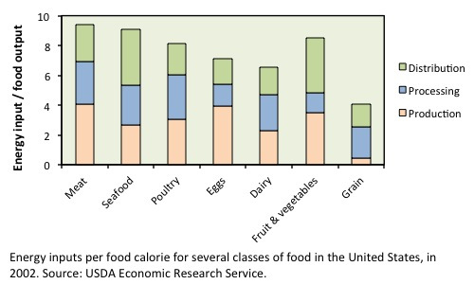
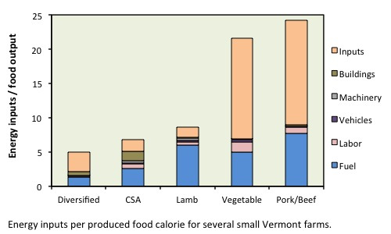
So… Can’t we all just be vegan then?
https://learn.uvm.edu/foodsystemsblog/2014/07/10/meat-vs-veg-an-energy-perspective/

Slide 7
Irrigation… Again…
Allows areas that would normally not be usable to grow crops
Long periods of irrigation tend to result in salt buildup in the soil (salinization). Eventually, the soil will become unusable.
  Large amounts of fresh water are needed to wash this out
  Washing out requires permeable soil underneath.
  Widely believed to have contributed to the breakup of several ancient empires in northern Africa and the middle east

Slide 8
Some background
Some plants are able to “fix” nitrogen
  Bacteria in root system extract nitrogen from air and convert it into a form the plant can use.
  After the harvest, some excess nitrogen remains in the solid
The majority of plants are not capable of extracting nitrogen like this. Fertilizers provide it instead.

Slide 9
Fertilizers
Natural fertilizers
  Dead plants
  Manure
Synthetic fertilizers
  Nitrogen
  Phosphates
  Potassium

Slide 10
Monocropping
Higher short term output
Allows for use of specialized equipment
Depletes nutrients from soil
Raises chance of serious insect infestation or blight
  Chance of very serious famine in this case (eg “Irish potato famine”)
  Risk is lower in countries with lots of chemicals that can be used
Usually yearly tilling (soil is “mixed up”)
  Frequent tilling degrades soil
Easier, might have higher yields long term (debated)
After harvest, soil can be easily blown or washed away

Slide 11
Other methods
Crop rotation: Switch what crop is grown in the field every year. Typically at least one crop in the rotation is a nitrogen fixer.
  Can reduce, and in some cases eliminate, need for chemical fertilizer
  Does not help with tilling
  Helps control insect populations year to year, but doesn’t help with single year events
  Doesn’t aid in erosion control
Intercropping Plant multiple species together in the same field
  Makes harvesting more difficult
  If a species that is not harvested yearly is included (like trees in agroforestry), it can dramatically help with erosion control.

Slide 12
Other methods, cont.
No-till agriculture
  Residue of last crop is left behind. This returns nutrients to the soil, and means that tilling isn’t necessary.
  Since seeds from weeds also enter the field and aren’t pushed deep under the surface, more herbicides are required.
Contour plowing: plow perpendicular to contour lines
  Reduces soil erosion by rain
  Provides more even amounts of water to plants (may be good or bad)

Slide 13
Insecticides/herbicides
Advantage
  Increases yield
Disadvantage
  Most are at least mildly toxic to non-pest plants and animals
  The first pesticides were extremely so
    First was “Paris Green” Copper acetate triarsenate (NOAEL~600ng/kg/day)
    Replaced by lead arsenate because it was 1/10 as toxic…
Persistent pesticides are resistant to degradation
  Applied infrequently, potential for long term damage
Non-persistent pesticides are not
  Applied frequently, potentially more short term damage
Pesticides can be narrow spectrum (aka targeted) or broad spectrum

Slide 14
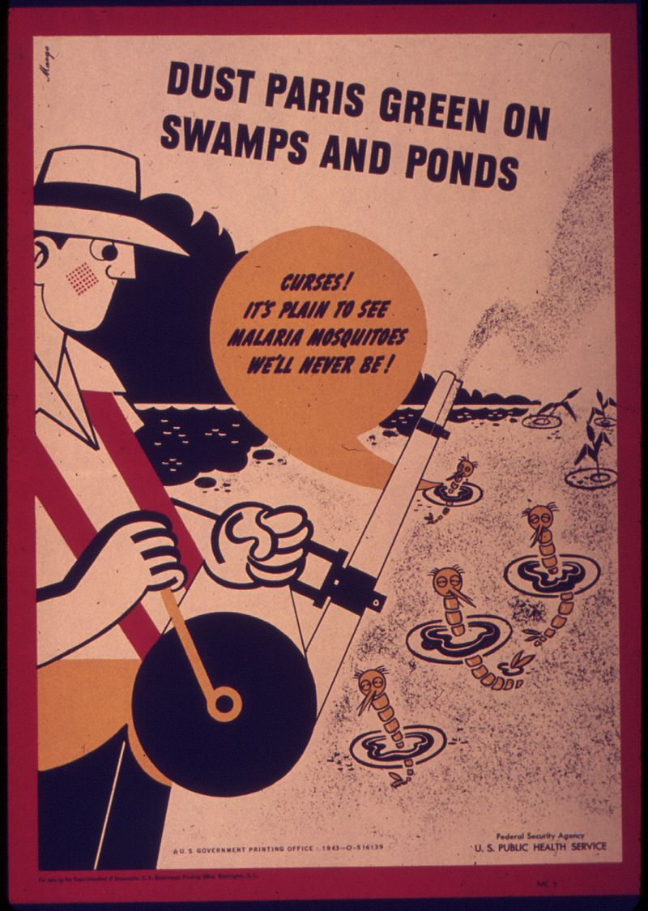
From the US Department of Health circa 1940 (creator unknown)

Slide 15
Pesticide resistance
Pesticide applied, MOST individuals die
Remaining individuals are those that avoided or resisted the pesticide
  These traits are selected for in an example of negative artificial selection
Pesticide applied again
  Less effective, so higher amount used
  Traits are selected for again
Long term result is very high frequency of resistant alleles in the population

Slide 16
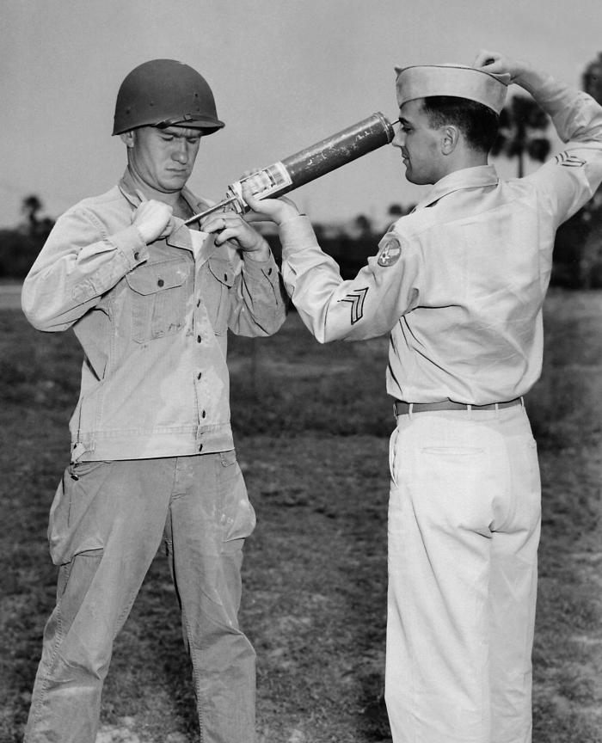
Soldier being sprayed with DDT

Slide 17
Case study: DDT
Dichloro-diphenyl-trichloro-ethane
Very effective pesticide
Works by opening voltage gated sodium ion channels
Persists for an extremely long time
Appears to have VERY low acute toxicity to humans
  People were given up to 30 mg/day for up to 18 months with no adverse affects apparent
  https://wwwn.cdc.gov/TSP/PHS/PHS.aspx?phsid=79&toxid=20
  Estimated LD50 for humans is at least 200mg/kg (there is no evidence of any deaths acute toxicity)
Very toxic to aquatic life
Causes birds to lay eggs with thin shells that break before hatching
Removing insects from the environment may not be a good thing
Banned in USA, still used elsewhere to control malaria
  Some populations were developing resistance anyway

Slide 18
DDT in the modern world
Recent studies show that DDT has epigenetic impacts in rats at high doses, that persist across generations
  https://pubmed.ncbi.nlm.nih.gov/24228800/
  Applicability to humans is questionable because of doses involved and because rats…
Human studies
  Endocrine disrupter (metabolite is a weak androgen antagonist, less common isomer is a weak estrogen receptor agonist)
    Known since 1980s at least
  Appears to be associated with fertility of daughters of those exposed
    https://pubmed.ncbi.nlm.nih.gov/12842376/
  Other organochlorides, and probably DDT, impact neurological development
    https://core.ac.uk/reader/36030490?utm_source=linkout
  Most of these studies are rather weak in design and statistical power, so the possibility remains that these correlations may be spurious

Slide 19
Replacing DDT
Permethrin (and related compounds)
  Same mechanism as DDT
    Resistance appears to be shared between the two compounds, probably arises from a mutation to the gene encoding Glucathione S Transferase enzymes, which break down pesticides
      https://www.sciencedirect.com/science/article/pii/S0048357519304560
    Another means of resistance (termed knockdown resistance) comes from changes to the voltage gated sodium ion channel sensitivity, also common to the two insecticides
  Very safe for humans, even used as a medication
  Toxic to cats
  Highly lethal to fish (LC50 about 3 mcg/L)
  Still a weak endocrine disrupter

Slide 20
Replacing DDT
Organophosphates
  Act to block acetylcholinesterase
    Acetylcholine is the neurotransmitter that activates motor neurons
  Far more toxic than DDT
    Chemical class includes Sarin and VX. Sarin was actually developed as a pesticide.
    Many are extremely lethal to fish, humans, and some animals (LD50<1mg/kg)
    Endocrine disruptors
    Cause diabetes in farm workers
    Etc.
Neonicotinoids
  New, tentatively appear safe for mammals, less lethal to birds and fish
  Very lethal to bees
  Act on nicotinic (ACh) receptors

Slide 21
Integrated Pest Management (IPM)
Apply pesticides only when pest levels reach a certain level, or at special points during the life cycles of the pests when they are particularly susceptible
Prevent first, typically with crop rotation or by selecting pest resistant crops
Use mechanical or targeted methods before less targeted ones
Generally reduces pesticide use
Generally reduces expansion rate of pesticide resistance
Sometimes also increases yields because the farmer is paying more careful attention to crops

Slide 22
GMOs
Plants can have DNA modified by adding genes that encode for specific proteins taken from other plants (eg resistance to herbicides or resistance to pests)
Seem to not have any toxicity to humans
  If toxicity did exist, it would come from an effect of the new protein
Alleles may spread to wild populations

Slide 23
Organic farming
Synthetic fertilizers and pesticides are not used
Expensive to operate due to higher labor costs
Organic farming may use other pest control options that still aren’t great for the environment, but they are generally better than pesticides

Slide 24
Meat production issues
Beef/Pork Feed lot problems
  High density of animals being given anti-biotics contributes to resistance
  Large amounts of manure are produced. These can pollute nearby water.
  Relatively high fossil fuel requirements when compared to grains or legumes
  Animal welfare concerns
Commercial fishing
  Overfishing is the largest concern
    Roughly 30% of fisheries have declined by at least 90% in the last 30 years
  Bycatch: accidently catching non-target species
    Results in death of other species, including endangered ones
  Large amount of fuel use for ocean fishing.

Slide 25
More sustainable meat
Fishing quota systems limit the number of fish that an individual or company can harvest
  Successful in Alaska, New Zealand
Aquaculture
  Fish farms have the same anti-biotic resistance issues as feed lots, and if partially open to the ocean can sometimes transfer pests to local populations
Animals can be raised free range,
  limits the need for anti-biotics and fossil fuels,
  reduces manure pollution
  Requires more land
  More expensive

Slide 26
Discussion Questions
Should everyone eat organically grown food? Why or why not?
Should all synthetic pesticide use be eliminated? What would be the benefits and drawbacks?
A new pesticide is created. What will determine how effective the pesticide is and how long it remains effective?
What are some advantages and disadvantages of a vegan diet?
You are tasked with managing the U.S. seafood industry. What changes do you make when fish populations appear to be declining?

