Slide 1
Localized Changes

Slide 2

Life is interconnected
https://www.nature.com/scitable/knowledge/library/food-web-concept-and-applications-84077181/

Slide 3
Habitat changes
Deforestation:
  Removes habitat
Flooding
  Changes habitat
What else can you think of?

Slide 4
Eliminating a species
Eliminating a single species may have anywhere from almost no effect to dramatic effect
Generally species with higher populations are more important for the balance of a given system
What attributes of a species might increase or decrease risk.

Slide 5
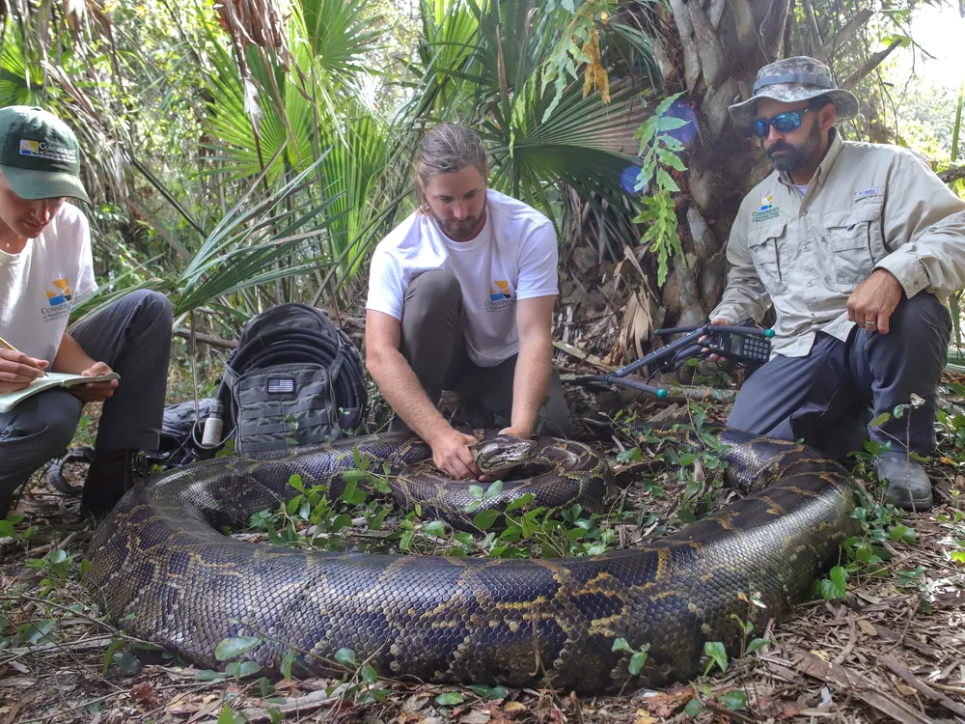
Adding a Species
May have no predators
Local fauna may have no defense against it
Pythons in Florida

Slide 6
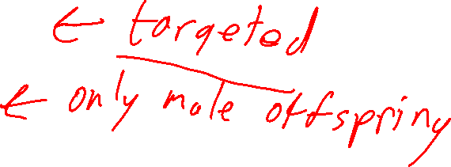
Dealing with invasive species
Inserting a predator
  Hawaii introduced mongoose to combat rats
  Mongoose became a problem
  Modern predator control is better
Genetic modification
  Malaria containing mosquitos
What else might work?

Slide 7
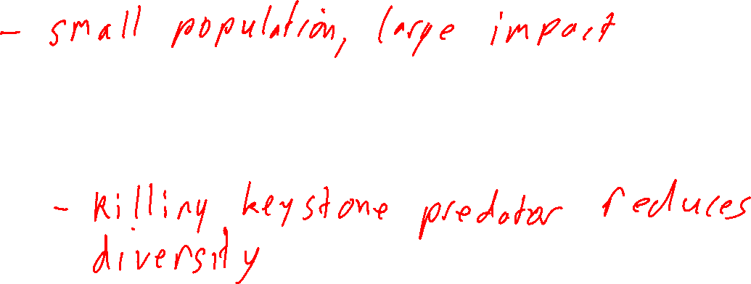
Keystone Species
Generally small in number, but large in effect
Keystone predator: eg sea stars
Ecosystem engineer: eg beavers
Think: what if we eliminate a keystone species?

Slide 8
Species Richness
Definition: count of number of species
Generally high richness is good.
Time: Regions that have been relatively unchanged for longer times have more richness
Proximity: Especially for islands, distance from other sources of species for colonization

Slide 9
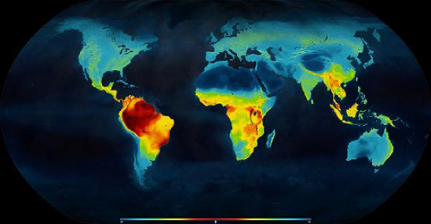

Species richness
Latitude (Mannion, P. D. 2014. Patterns in Palaeontology: The latitudinal biodiversity gradient. Palaeontology Online, Volume 4, Article 3, 1-8.):
What else might be important?

Slide 10
Other metrics
What other things might we like to know?

Slide 11
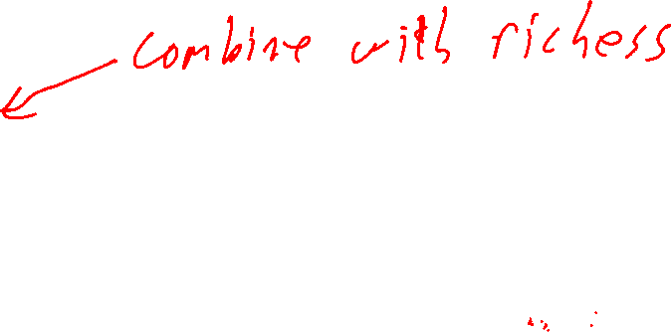
Other metrics
Species evenness: Relative abundance of species
  Generally a single organism having a high relative abundance is bad
Net primary productivity
  Amount of new carbon added to plants per area per time
  https://neo.gsfc.nasa.gov/view.php?datasetId=MOD17A3H_Y_NPP
Amount of available nutrients per area
Extinction rate

Slide 12
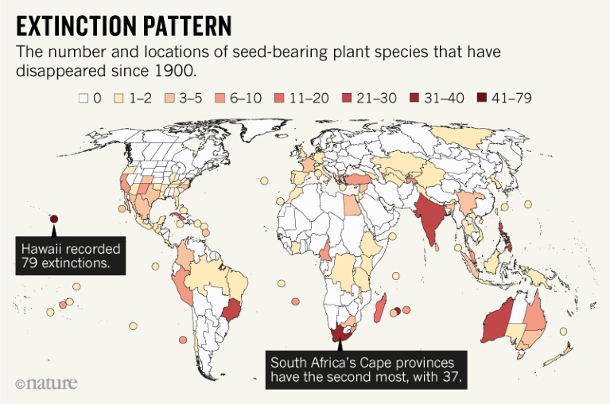

Extinction rate (image from Nature Magazine)

Slide 13
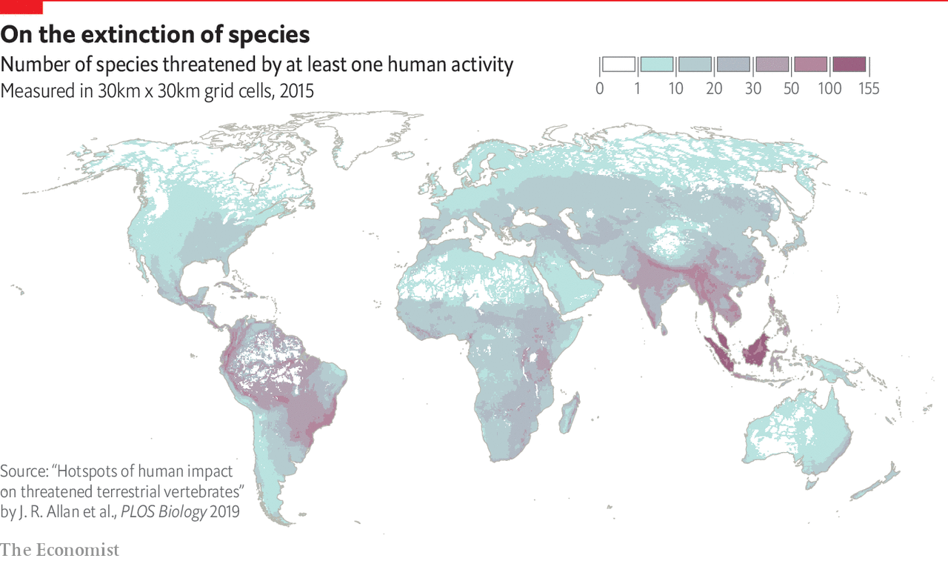

Currently threatened species

Slide 14
Preserving biodiversity
Some regions have very high densities of unique species
  Hawaii

Slide 15
Seminar Day
A city has a surplus of deer that are eating too many farmed crops. What should the city do?
The USA has one of the highest ecological footprints in the world. What, if anything should be done about this?
You are interested in the effect of increasing elevation on species diversity.
  What would you hypothesize the relationship to be and why?
  How would you test your hypothesis?
  What would be some confounding variables

