Slide 1
Distribution of Damage

Slide 2
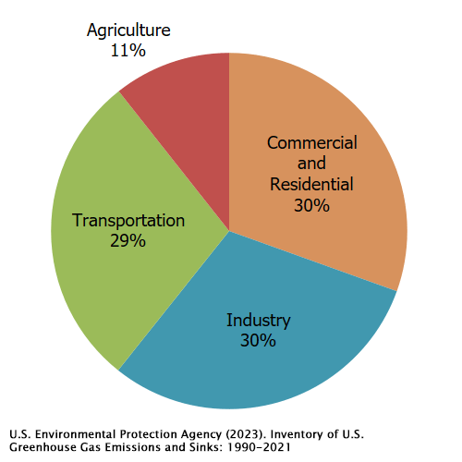
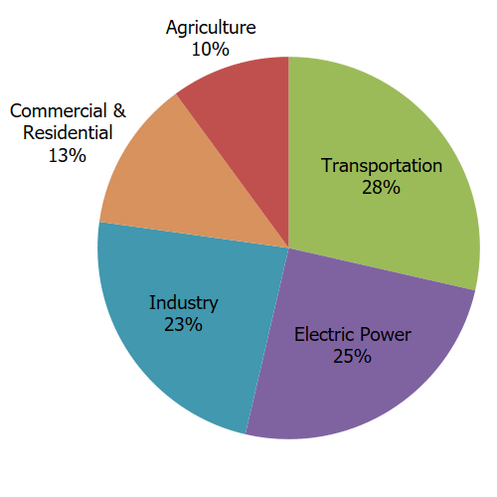
Greenhouse gas emission (EPA): Left, who is directly responsible. Right, where the energy ends up

Slide 3
Ocean pollution (data from NOAA)
80% comes from land
Likely that most of this is runoff (aka non-point source pollution), but hard to prove

Slide 4
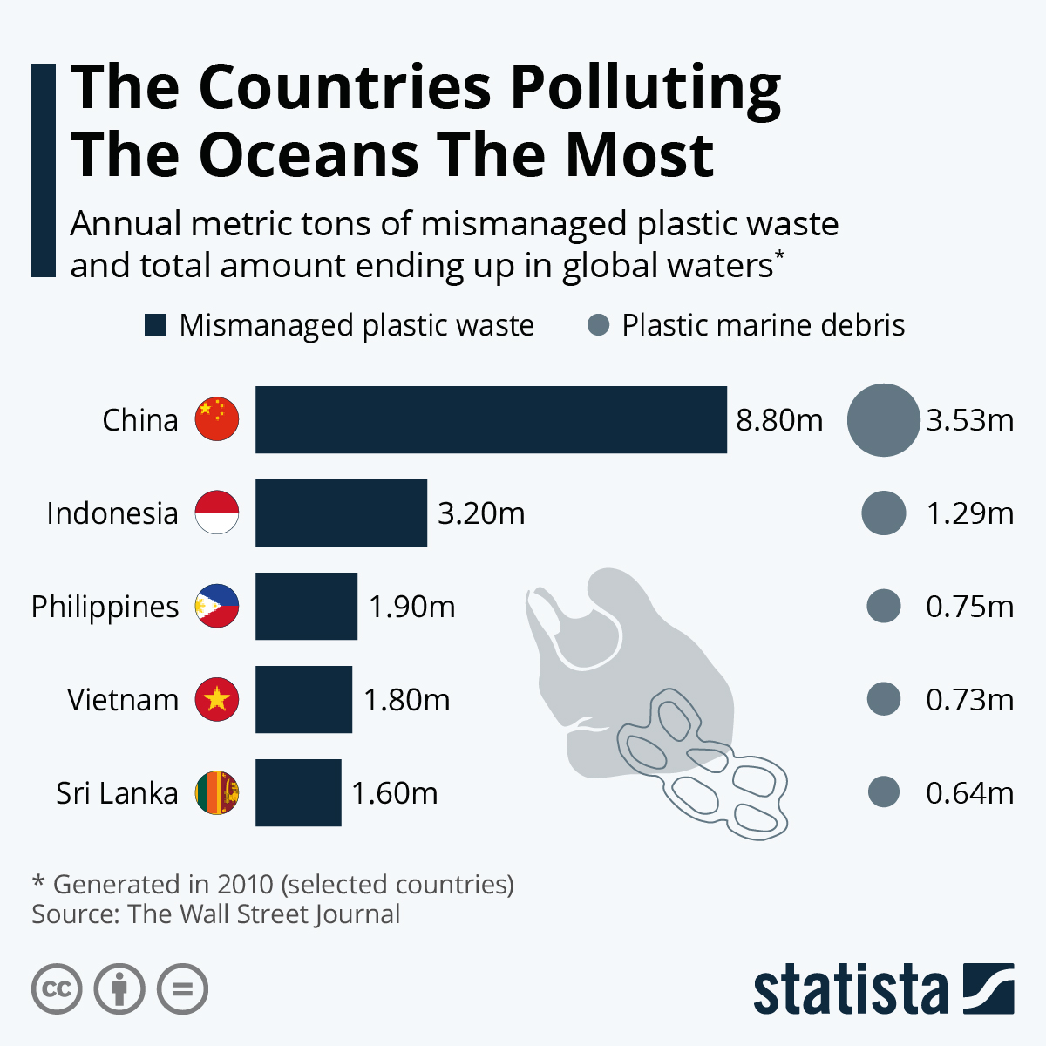
Plastic ocean pollution (2010)

Slide 5
Plastic pollution (2019)
https://ourworldindata.org/plastic-pollution

Slide 6
Deforestation
https://glad.earthengine.app/view/global-forest-change#bl=off;old=off;dl=1;lon=15.480406994984408;lat=-4.450036356544626;zoom=2;
https://www.visualcapitalist.com/mapped-30-years-of-deforestation-and-forest-growth-by-country/

Slide 7
