Slide 1
Declining Biodiversity

Slide 2
Mass extinctions
5 times before
Ordovician: about 85% of species, 440 Million years ago, caused by an ice age
Devonian: about 70% of species, 375 million years ago, cause not definitively determined (loss of oxygen, ice age, volcanoes, meteors)
Permian: 70% of terrestrial and 80% of ocean life, 250 million years ago, cause unknown
Triassic/Jurrasic: 50% of species, 200 million years ago, caused by extreme volcanic activity and other factors
K-PG: 75% of species, 65 million years ago, began with changes in climate and ended with a meteor impact

Slide 3
Mass extinctions
Most involve multiple more gradual changes rather than a single sudden event
Climate change was important for at least 2

Slide 4
Permian extinction observations
Strong evidence of large shift in Carbon-12/Cabon-13 ratio
Strong evidence of an unusually slow recovery after the extinction
Extinction was probably relatively prolonged, ocean anoxia appears to have began at least 7-8 million years prior to PTB (1,2)
There were probably multiple separate anoxic events, they likely continued after the PTB (4)
Evidence of mutated tree spores during extinction era (3)
Nickel concentrations and isotropic ratios were dramatically different before and after the PTB, this could be a result of aerosolization of Ni compounds by volcanism (5)

Slide 5
Permian extinction hypotheses
Volcanism
  Cannot alone explain carbon shift
    Evidence that the volcanoes may have ignited large coal beds (1)
  Cannot explain anoxia 7 Myr before PTB
    May be longer lived
Microbial action driven warming
  Nickel is well known to be associated with increased action of methanogenic bacteria, this could have led to a period of extreme warming
Ozone depletion
  High UV flux is known to lead to mutations and sterilizations, tree spores are known to be sensitive to this (2)

Slide 6
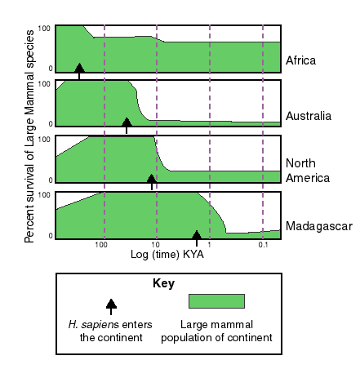
6th mass extinction (image: Wikipedia)
Many (but not all) scientists believe that the Earth is undergoing a 6th mass extinction, most would argue this is human caused
Evidence
  Genetic diversity is decreasing at a rapid rate
  Large species die-offs correspond with human activity

Slide 7
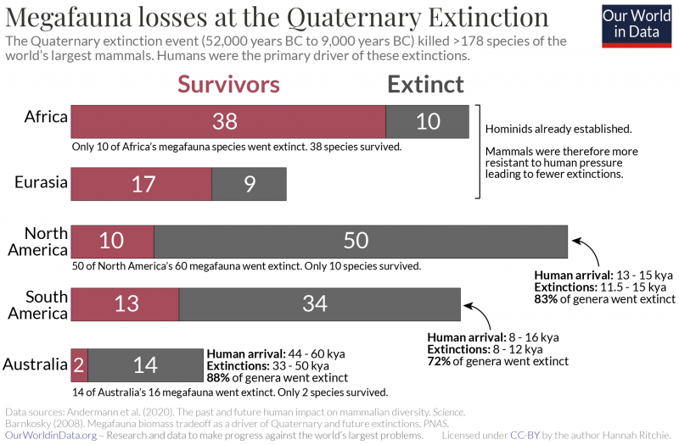
Quaternary extinction: Human caused?

Slide 8
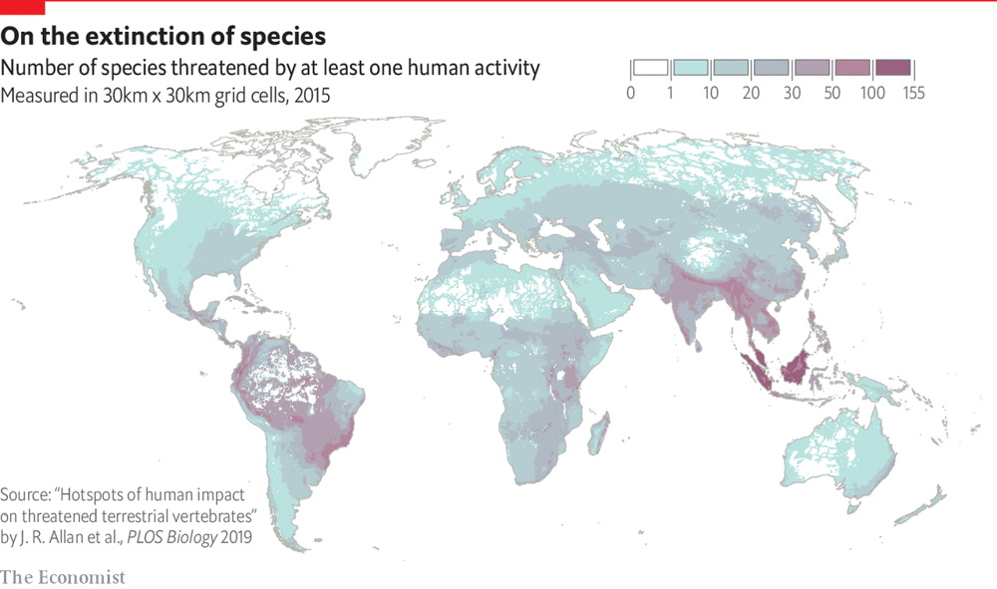
Animals are threatened all over the world

Slide 9
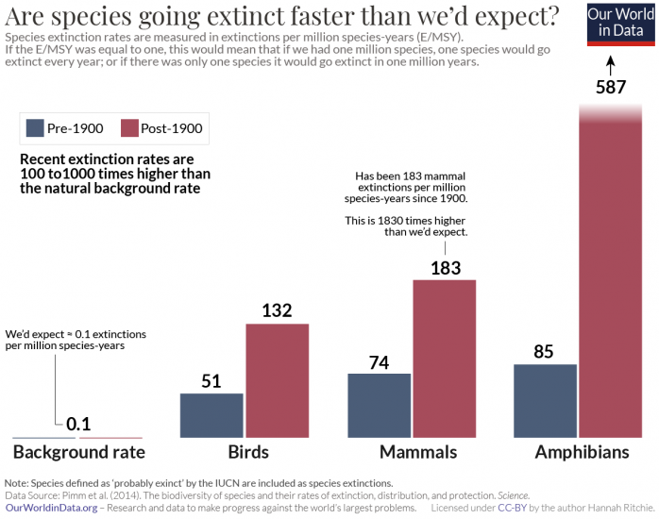

Slide 10
Reasons
Habitat loss/Change
  Melting sea ice
  Deforestation
  Dams
  Expansion of cities
  Mostly favor generalist species
Overharvesting
  Buffalo
  Atlantic salmon
Poaching
  Elephants
  Rhino

Slide 11
Reasons, continued
Pesticide toxicity
  Amphibians
  Fish
  Birds
Other pollution
  Acid rain lowers PH of water
  Air pollution has the same effects it does on humans
  Plastics
Natural factors

Slide 12
Nonlinear effects
Something that happens to one species will alter the fate of others
  Example: Bison
  High variability in great plains climate
  Large changes in carrying capacity
  Humans hunting
  Population plummeted
  Grass started to take over
  Reduced other biodiversity
    We don’t fully know the extent of this change
  Bison numbers are recovering
    Minimum number: 500
    Current number: 30,000

Slide 13
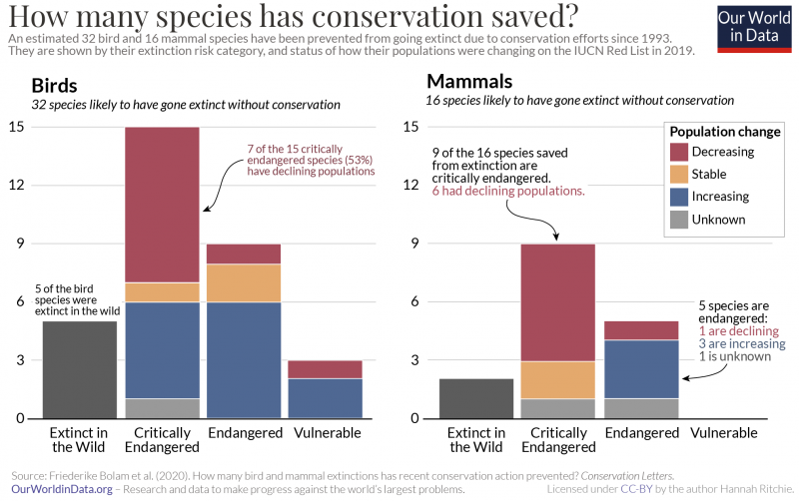
Conservation works… sort of

Slide 14
Further information
https://ourworldindata.org/extinctions
  Most of the graphs are taken from here. They did an excellent job at providing visualizations for data taken from research papers

Slide 15
The future
???
The future of Earth’s ecosystem is ultimately up to us.

