Slide 1
Prerequisites: Concepts from other Sciences

Slide 2
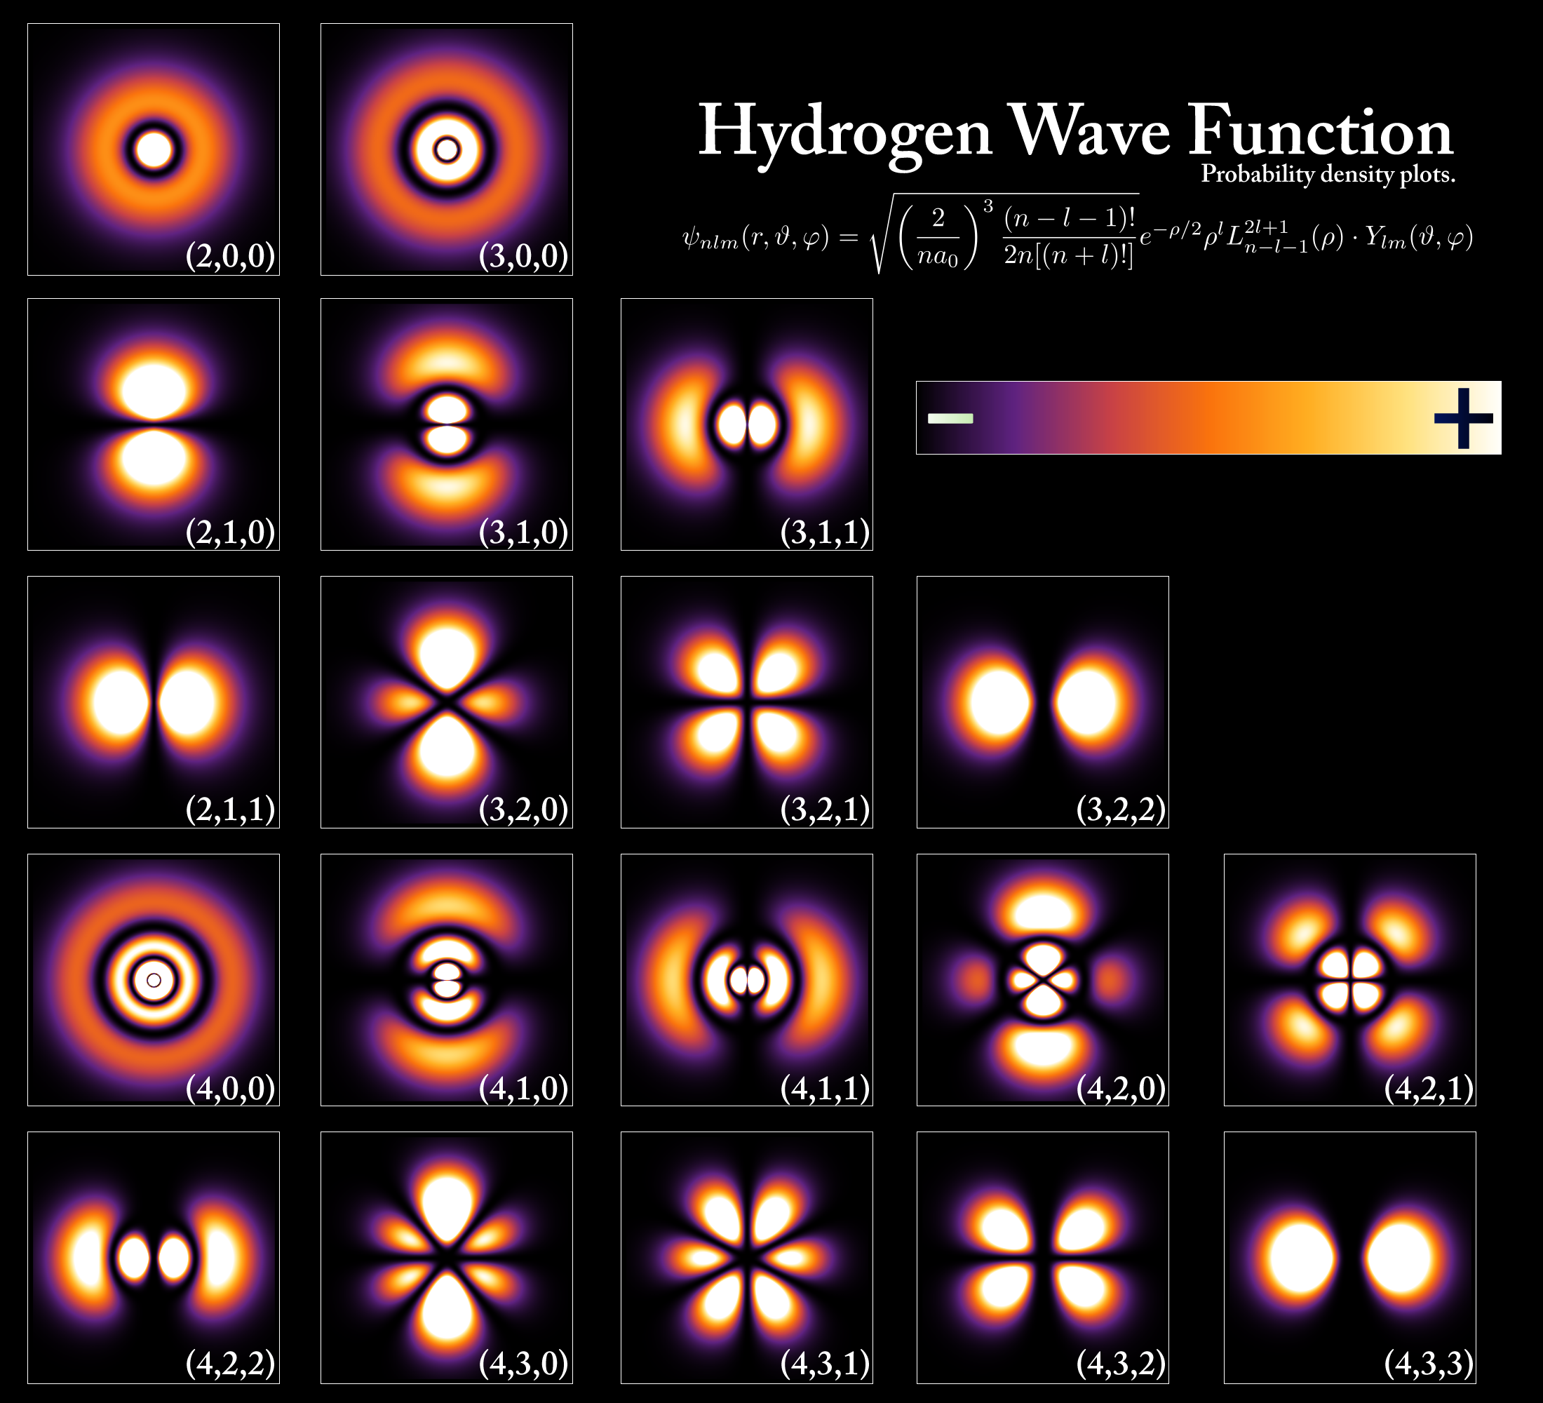
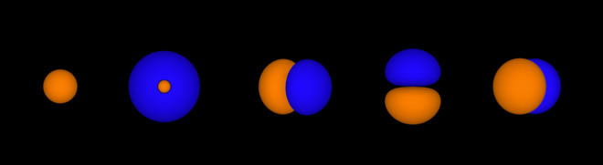
Chemistry: Atomic Structure
Nuclei are at the center of atoms and have protons and neutrons
Electrons exist in a cloud around the nucleus
Images: Wikipedia- atomic orbital

Slide 3
Chemistry: Water
Water is highly polar
  Acts as a (polar) solvent
  Has high surface tension
  Exhibits capillary action
Water is abundant
  70% of Earth’s surface
  60% of you
Water expands when freezing

Slide 4
Physics: Thermodynamics
0th law: temperature is defined and measurable
1st Law: Energy (of the universe) is conserved
2nd Law: Entropy (of the universe) increases with time
  Entropy is sometimes called a measure of disorder, but a better way to think about it is a measure of probability of occurrence in a closed system
    High entropy states would have a high probability of occurring randomly
    Low entropy states would have a very low probability of occurring randomly
3rd Law: Don’t worry about this

Slide 5
Physics: Heat transfer
Conduction: Heat one end of an object. The heat flows through the object to the other side
  SLOW, speeds up as temperature difference increases
  Much more efficient in metals
Convection: Heat part of a fluid (solid, gas, or plasma). The heated part rises, carrying the energy
  Efficient for medium to large temperature differences
  Dominant energy transfer mechanism in the atmosphere
Radiation: Photons carry the energy
  Efficient for high absolute temperatures.
  Brings energy from Sun to Earth

Slide 6
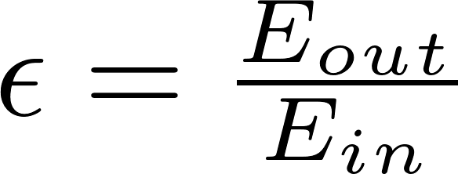
Engineering: Efficiency and Quality
Usually substantial losses happen when energy is converted between different forms
Energy efficiency: Fraction of energy input to a system that we get as useful energy
Energy quality: Multiple ranking systems exist. Basic idea is “how easy is the energy to extract usefully?”
  Electrical: high, since the energy density per kg is extremely high and nearly all is immediately available to do work
  wind: low, quite a large amount of total energy, but spatial density is low, and conversions are necessary to make it useful

Slide 7
All sciences: Systems
System is the set of things that are being considered when working on some question. Examples
  For a nuclear physicist, a single nuclei might be a system
  For a biologist, a single fish might be a system
A system might be open or closed depending on whether energy can be exchanged with surroundings
  There are very few truly closed systems, but sometimes it is a decent approximation
Generally, larger systems are harder to model completely, and harder to take measurements of
  Why?

Slide 8
Modeling and Understanding a System
Idealized system :Mass on flat frictionless surface:
  What must we think about to model it?
  What must we measure?
Very small real system: One atom
Small scale real system: One cell
Medium scale real system: One organism
Large scale real system: ecosystem
Very large real system: Earth

Slide 9
Modeling/Understanding systems: partial fixes
Start larger
  If considering a human, start with organs instead of individual cells
  If considering an ecosystem, start with organisms
Determine what measurable quantities convey key information rather than measuring everything
  For determining solubility
  For an ecosystem

Slide 10
Modeling/Understanding systems: partial fixes
Start larger
  If considering a human, start with organs instead of individual cells
  If considering an ecosystem, start with organisms
Determine what measurable quantities convey key information rather than measuring everything
  For determining solubility
    Polarity
    PH
  For an ecosystem
    Species richness: How many species are present?
    Extinction rate: How quickly are species disappearing?
    and many more, depending on the question you are trying to answer.

Slide 11
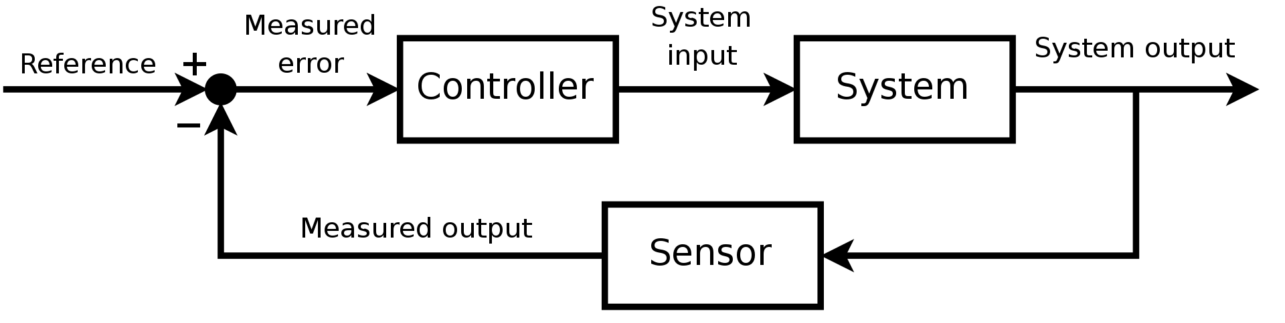
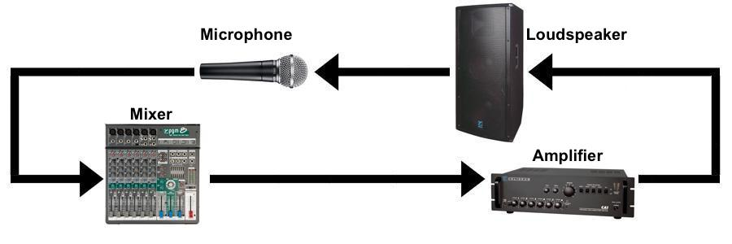
Feedback
Complicated systems often involve nonlinear effects. One of these effects is called feedback.
  Positive feedback occurs when a change in some variable, x, creates a chain of effects that eventually increases the value of x more. Systems with lots of positive feedback tend to be unstable
  Negative feedback occurs when changing some variable, x, creates a chain of effects that eventually results in the value of x changing by less than the initial change. Systems with lots of negative feedback tend to be stable.
  Control Image: Wikipedia- nonlinear control; mic image: https://mynewmicrophone.com/microphone-feedback/

Slide 12
Steady state
A system is in a steady state when the values of all measured values are not changing with time
Perfect steady states are rare
Nearly steady states are very common.

Slide 13
Discussion Questions
What can we, as individuals, do to help the environment?
How should economics be balanced against environmental factors?
How might we determine how healthy a country is?
What should be responsible for maintaining environmental health?

