Slide 2
Bell work
What will be the speed of a uniform disk that rolls without slipping down a hill with a height h?

Slide 3
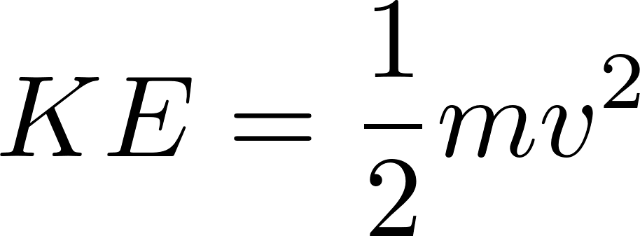


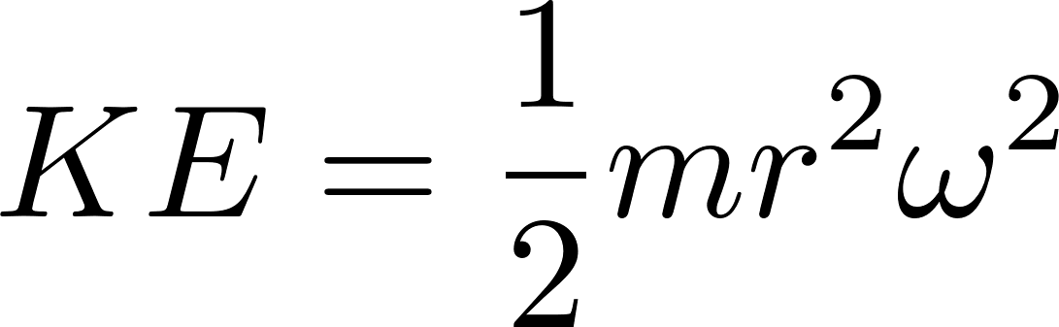
Review of moment of inertia
Recall that, kinetic energy for a point mass is
Since the speed of an object as the result of rotation is given by
A point mass that is a distance from the axis will have more kinetic energy than one closer, specifically

Slide 4
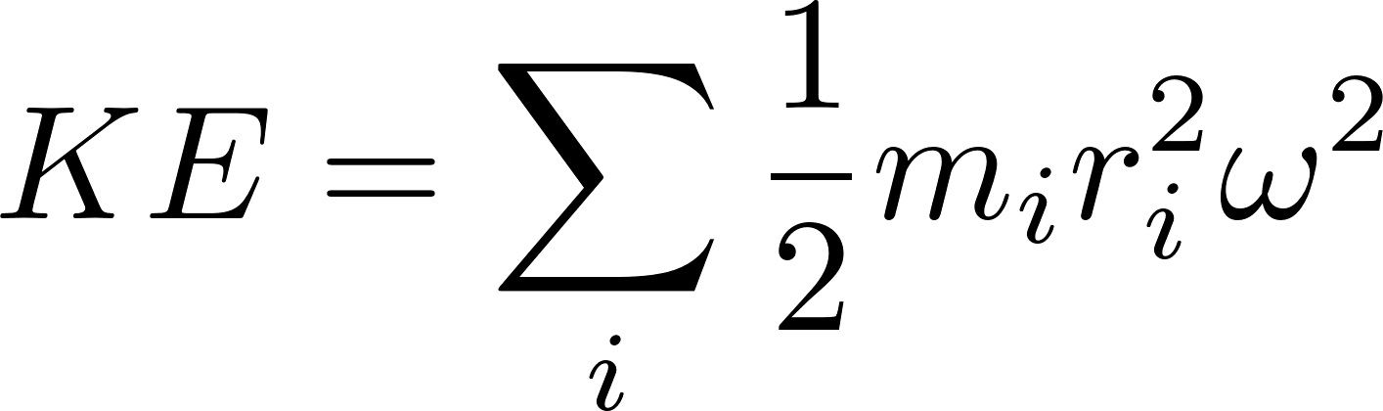
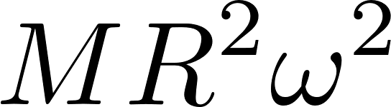
Review of moment of inertia
Consider an object with radius R and total mass M. To get KE we add the energies of all the point masses together to get the total energy
But not every point on most objects is at the very edge of the object, so we need to add up the contributions of every point to get the total energy.
Each point is some fraction of the radius R, so we end up with something less than
Typically done through integration, but for some simple configurations we can actually compute the sum.

Slide 5

Take away
Note that behaved like mass for the rotational case (it controlled how much energy we had at a given angular velocity)
It makes sense that objects with larger I would be harder to start spinning and harder to stop spinning.

Slide 6
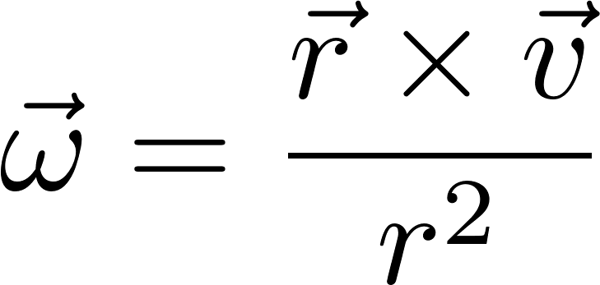
Angular velocity
We dealt only with the angular speed so far
  Energy is a scalar
Angular velocity for an object moving around a circle can be given by
Note that if everything is nicely perpendicular, this just gives back
Note that the direction of the angular velocity is perpendicular to the plane of motion

Slide 7
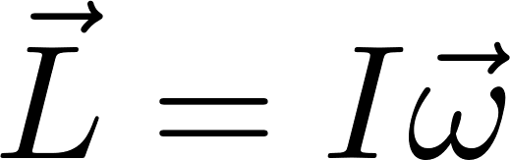
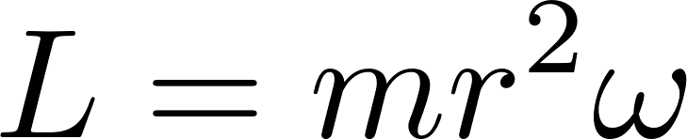
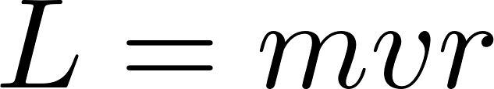
Introducing angular momentum
In math anything can be defined (but it might not be useful)
Look for something like momentum, but with rotation
First guess
Dropping directions for a second, and taking a point mass
We can write this as

Slide 8
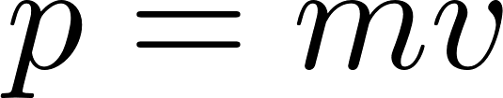
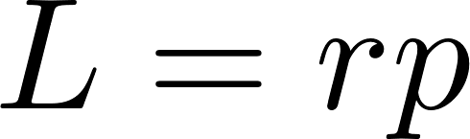
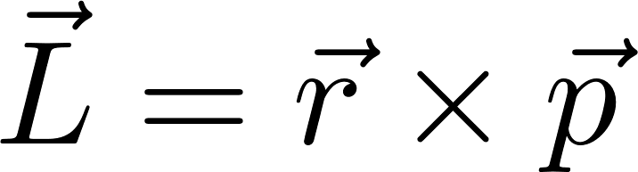
Introducing angular momentum
Recognize that
So we can write
But what sort of product should we take? Both of these are vectors
Try cross product
Now check if it makes sense…

