Slide 1
Evolution

Slide 3
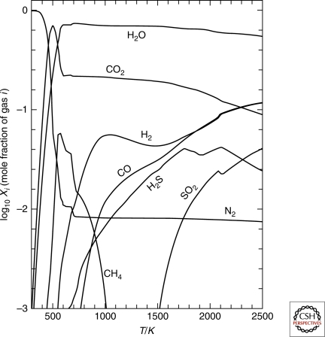
The Early Earth
Composition of Early Earth atmosphere is not fully known
Lab experiments imply lots of carbon and sulfur containing gases
Image:Zahnle et al 2010

Slide 4
Prebiotic synthesis
Under certain conditions, amino acids can be synthesized abiotically
  Aqueous HCN
  Electrical discharge
  Meteorites also contain some amino acids, synthesis mechanism remains unknown

Slide 5
Autocatalytic Reactions
Any reaction where the product is also a reactant
A+B⇌ 2B
Some key biological components are known to have autocatalytic reactions
  Some of these have chiral preference

Slide 6
Membrane formation
Non-polar compounds in water tend to self aggregate

Slide 7
RNA World
RNA acts auto-catalytically

Slide 8
?????
?????

