Slide 1
The El Nino Southern Oscillation

Slide 2
Water movement in the Pacific
Coriolis force and pressure gradient drives trade winds
Trade winds blow west, carrying heated water westward
  Replaced with cold, deep water
  Causes higher sea level in Australia than South America
High water temperature near Indonesia
Heats air, causing it to become buoyant
Air rises and drifts eastward at high altitudes

Slide 3
Wind driven Gravity waves
Initially flat water
Turbulent wind creates inhomogeneous pressure perpendicular to the interface
Air flows across the growing wave, creating a pressure differential that strengthens the wave
Moves in the direction of wind

Slide 4
The Coriolis and centrifugal forces
Centrifugal force: force that pushes outward in a rotating frame
Coriolis force: complicated vector force... On the equator it also pushes outward or inward depending on direction.
Objects moving Eastward near the equator deflect toward the equator. Objects moving westward deflect away.

Slide 5
Kelvin wave
Trade winds lessen or rarely reverse (reasons for this are often unknown)
Water level starts to equalize
Brings warm water Eastward
  Drives thermocline lower
Warmer East water further damps trade winds

Slide 6
Kelvin waves to El Nino
https://faculty.washington.edu/kessler/TALKS/ENSO_UWHS_Aug2012.pdf

Slide 7
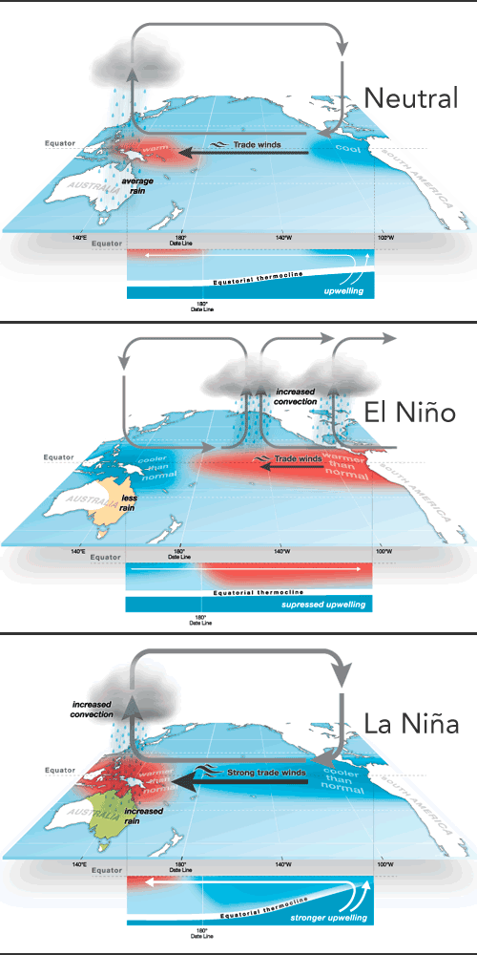
(image Columbia ENSO)

Slide 8
El Nino effects

Slide 9
Detailed wave description (very technical)
https://atoc.colorado.edu/~whan/ATOC5051/Class_Notes/chapter4.pdf

Slide 10
Review: Atmospheric circulation
Winds from the North and south converge on the equator, driven by Hadley cell convection
The Coriolis force drives thi

Slide 11
Precipitation

Slide 12
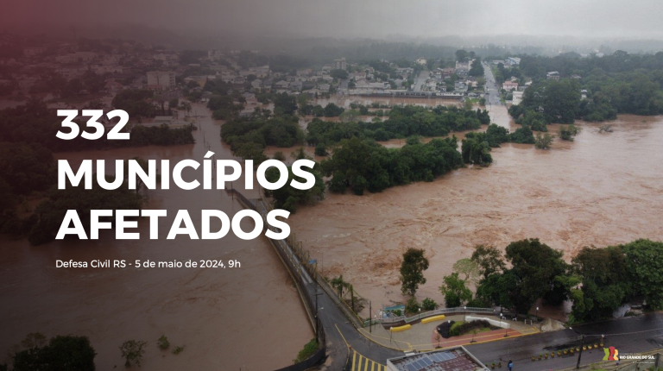
Image: Rio Grande do Sol

Slide 13
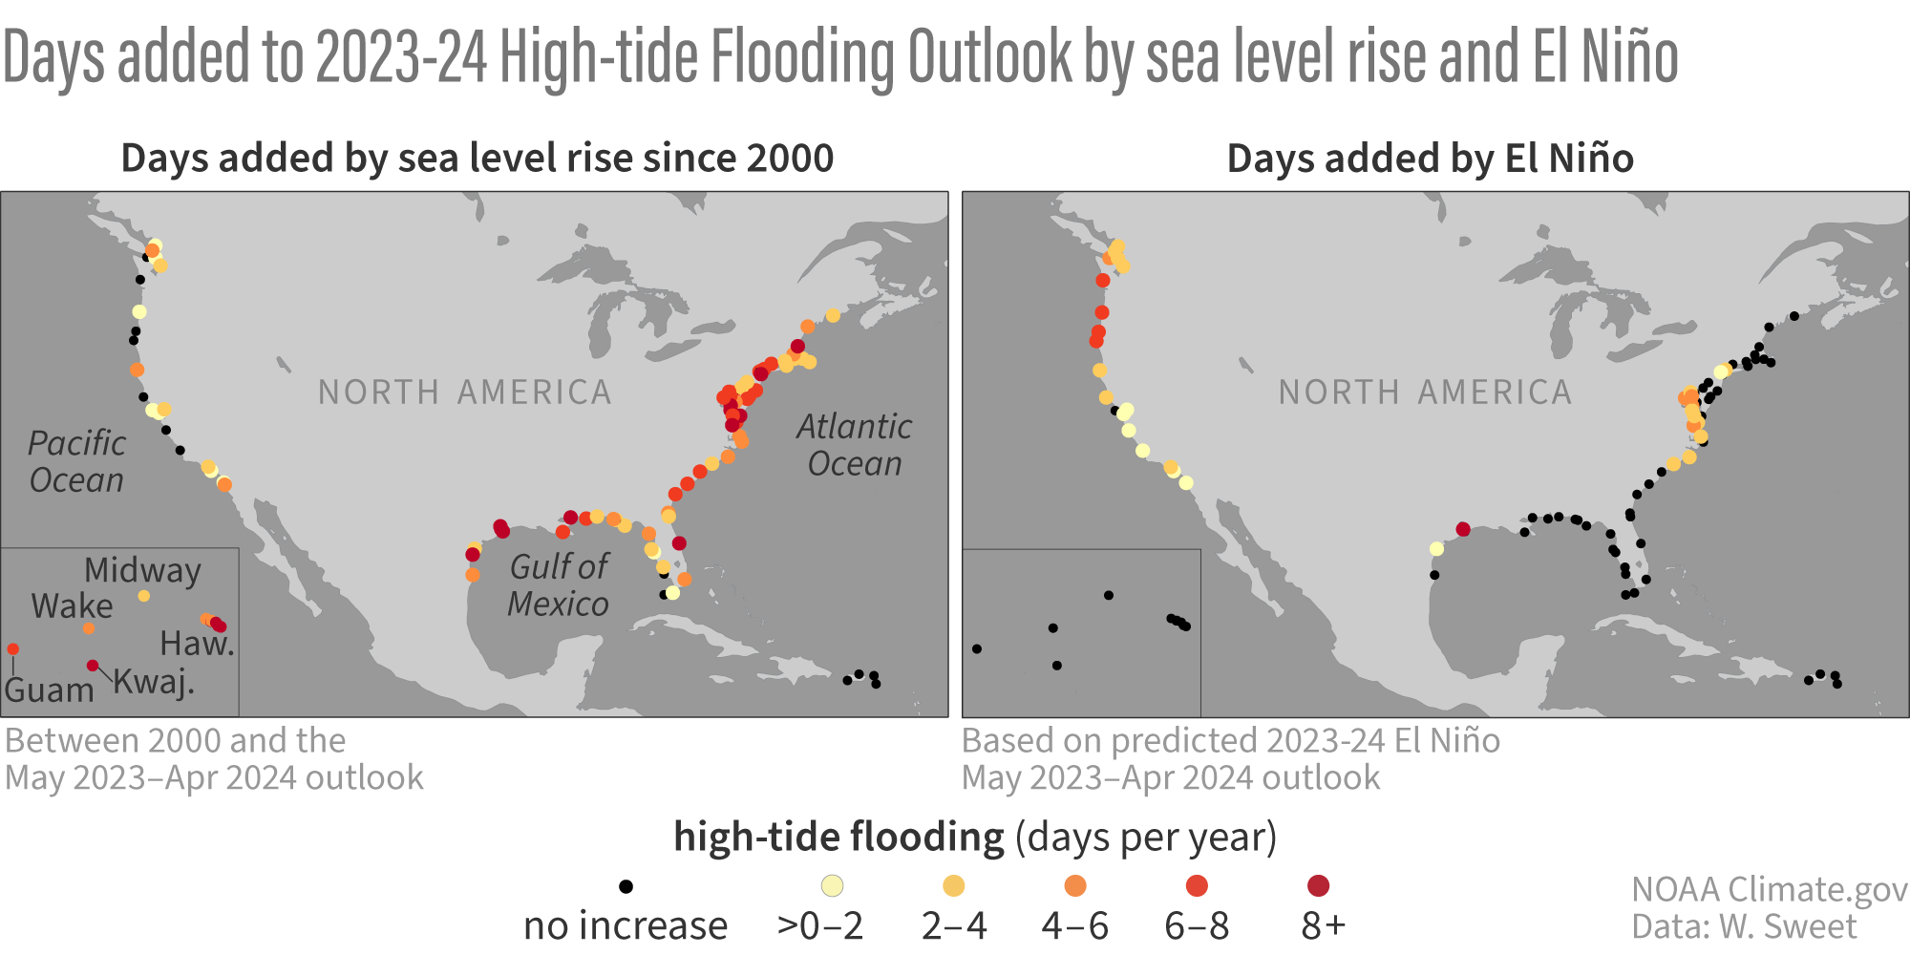

Slide 14
East Africa Flooding (2016 Reuters)

Slide 15
Aftermath of Ethiopia Flood Nov, 2023 (Care interational)

Slide 16
