Slide 1
Water!

Slide 2
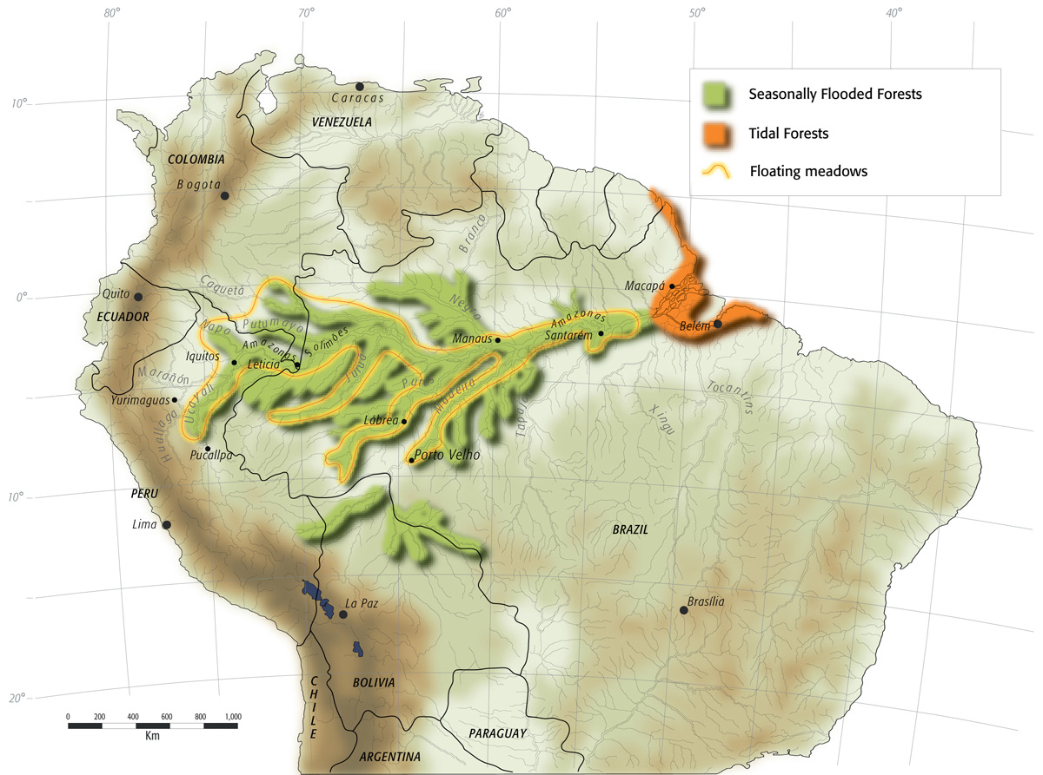
Water is everywhere!
71% of Earth’s Surface is covered in water
Large portions of Earth undergo regular flooding
  https://enviroatlas.epa.gov/enviroatlas/interactivemap/

Slide 3
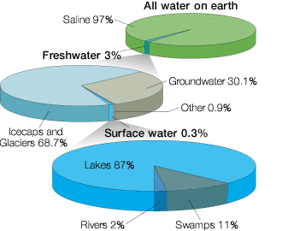
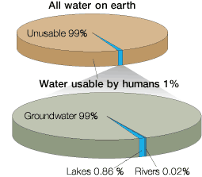
So… why are we worried about water then?

Slide 4
A calculation:
The Earth has a radius of 6 million meters
The average depth of the ocean is about 4000m.
How much available, non-saline, surface water is there?

Slide 5
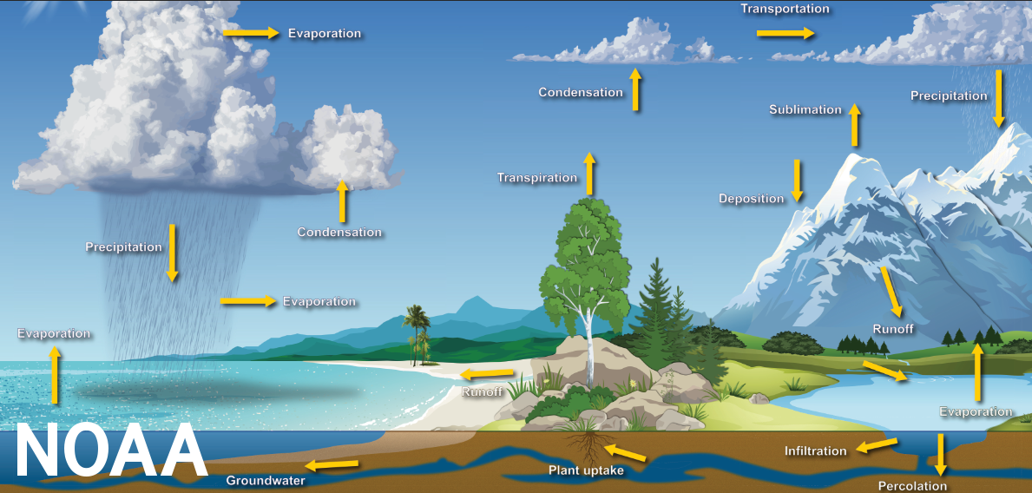
The water cycle

Slide 6
Drought
Period with abnormally low rainfall
May make water scarce locally

Slide 7
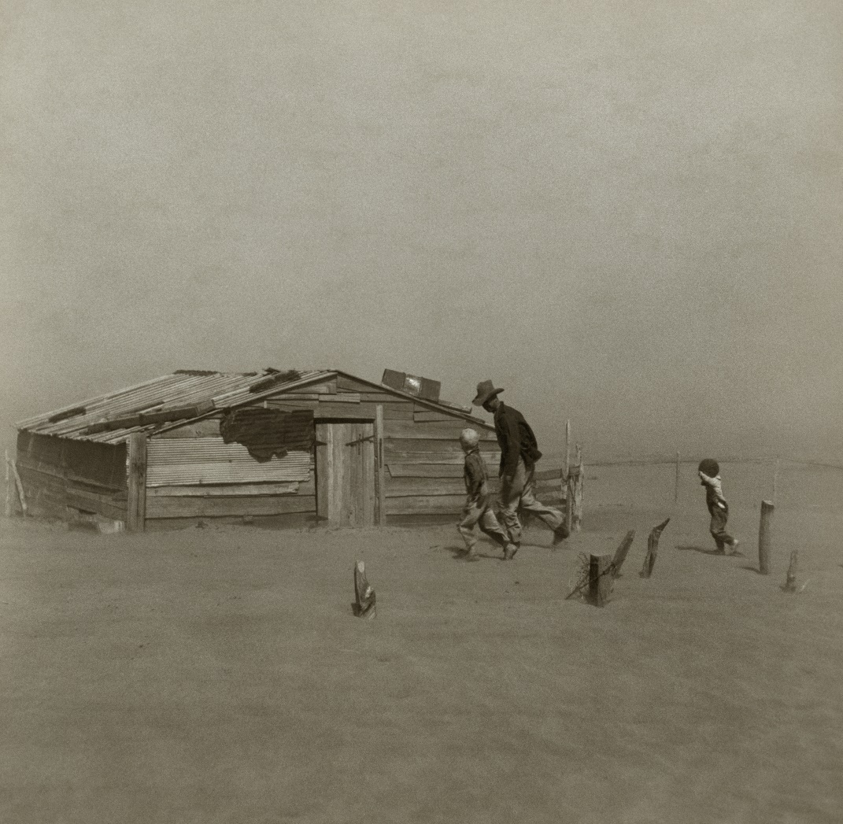
The dust bowl (image credit: Arthur Rothstein)

Slide 8
Flood
River
  Overflow
Seawater
  storm surge / storm tide
  Tsunami
Other
  Flash flood
  Rainfall

Slide 9
Is flooding always bad?
Blank: it’s thinking time!

Slide 10
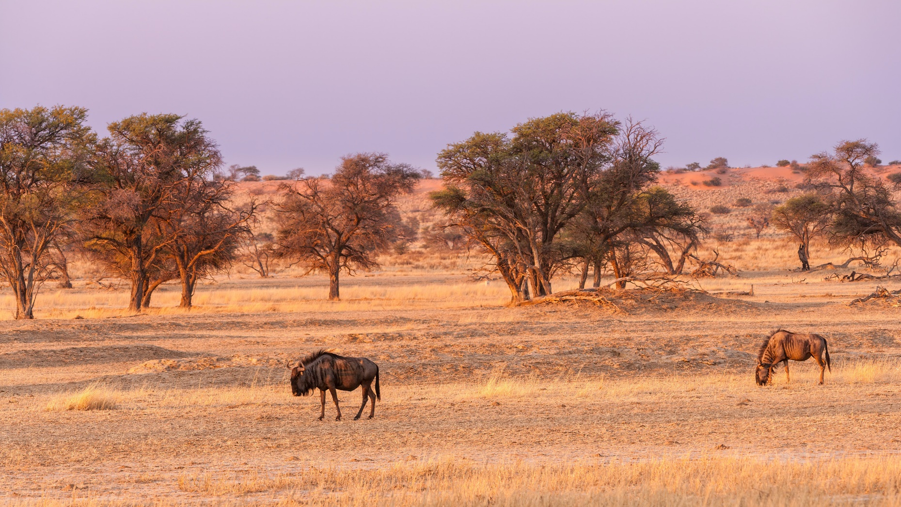
Kalahari (image credit: Chris Stenger)

Slide 11
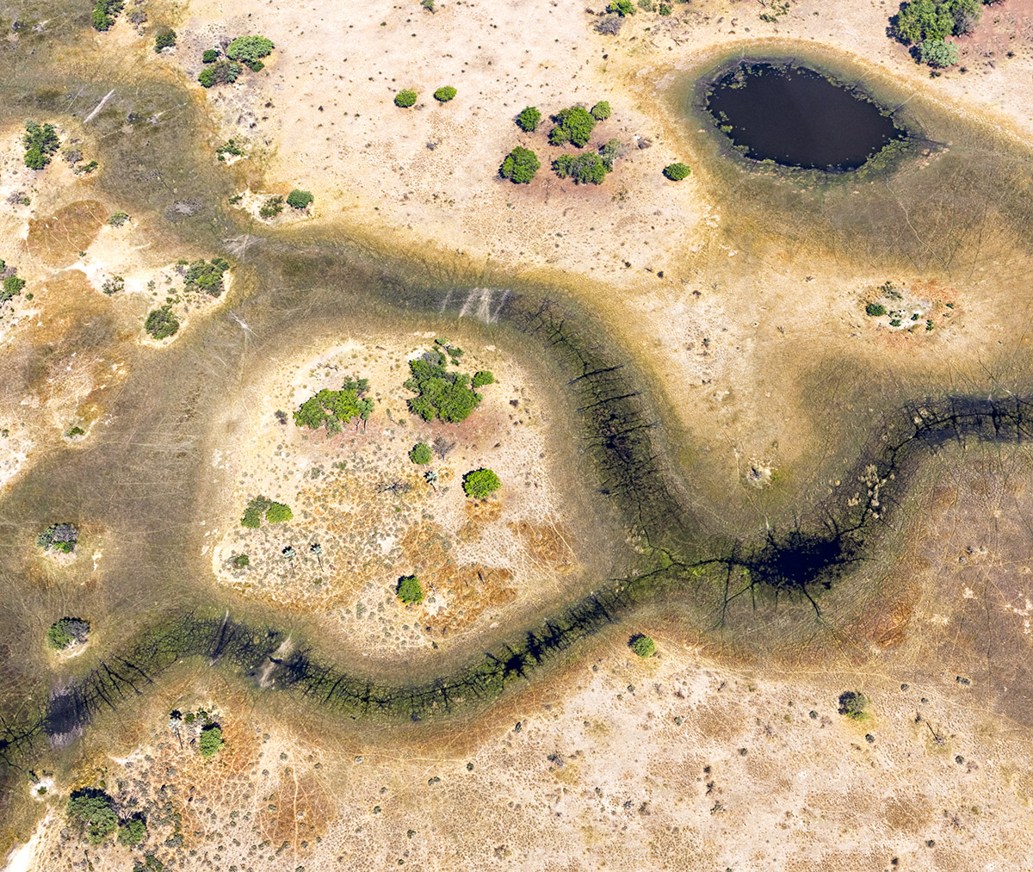
Okavango, dry season (image credit: Dick Keeley)

Slide 12
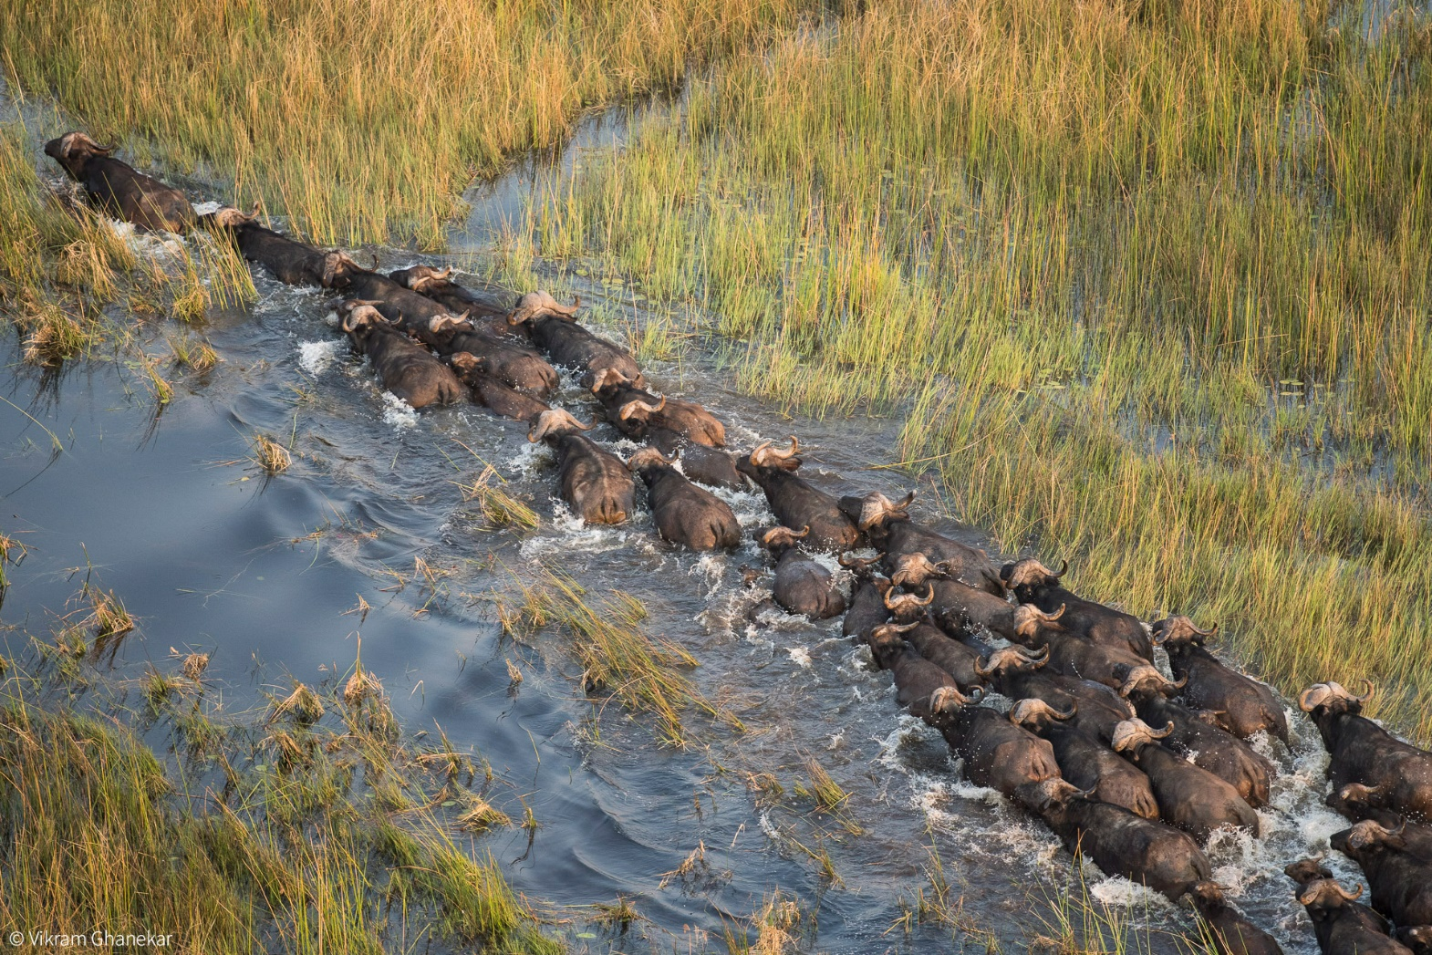
Okavango, wet season (Vikram Ghanekar)

Slide 13
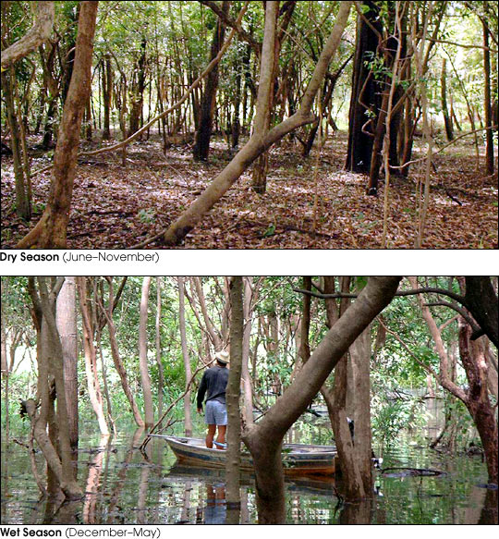
Amazon River (Photo Max Plank Instititue)

Slide 14
Humans and water

Slide 15
Dikes and Levees
Textbook is slightly wrong according to NOAA.
Dike: Protects land that would otherwise normally be underwater or would be tidally submerged. The water is not required to be saline as the textbook implies.
Levee: Protects land that would otherwise lie in the floodplain or a river or stream, but would not normally be submerged.

Slide 16
Dams
Hydroelectric power
Recreation
Flood Control
Water storage
Damage to fish populations
Changes in river conditions

Slide 17
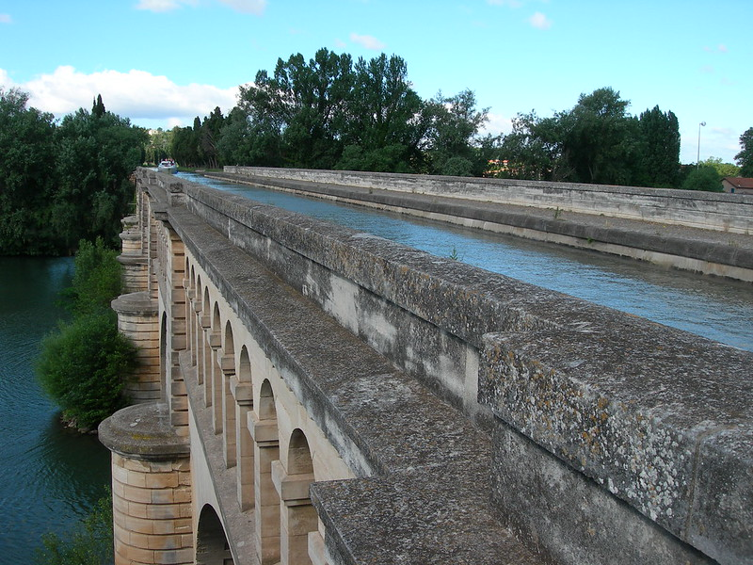
aqueducts
Divert water from one location to another
Traditionally above ground, but modern aqueducts may also be underground
Aquaduct in Beziers, France: https://www.flickr.com/photos/thecrypt/

Slide 18
Consequences
What might be the consequences of building a new aqueduct?

Slide 19
Colorado river
Supplies much of the water for (among other places) Los Angeles, Phoenix, Los Vegas, and Baja California
Involves several major agreements between several US states and Mexico
Lake Meade is draining rapidly
  https://earthobservatory.nasa.gov/images/148758/lake-mead-drops-to-a-record-low

Slide 20
Groundwater
Most regions have substantial amounts of ground water (even desert regions like Phoenix)
Ground water is a major water source for many communities

Slide 21
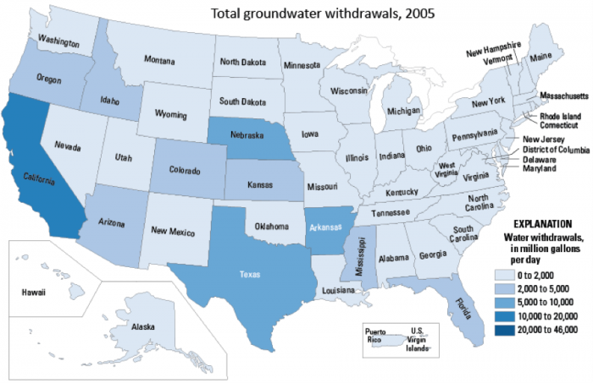
Image: Carlton College

Slide 22
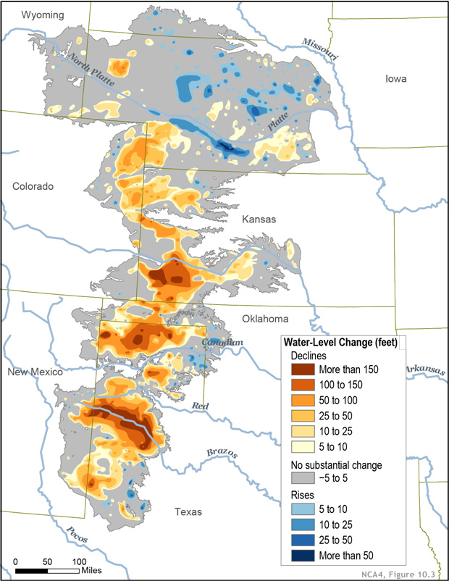
Ogallala Aquifer
Best estimate, around 10% depleted, depletion rate is increasing rapidly
Total withdrawals since 1950 are about 85% of the volume of lake Eerie
Image: Michon Scott for NOAA

Slide 23
Types of aquifers
An aquifer is confined if it is surrounded by layers of rock on both sides
Shallow aquifers are usually unconfined
Deep aquifers are frequently confined
Deep, confined, aquifers are replenished on relatively long timescales (~10 thousand years)
Unconfined aquifers are replenished much more rapidly

Slide 24
Desalinization
Mostly in very dry regions
Energetically expensive
Reverse osmosis uses less energy but produces brine
Potentially lower energy using methods available soon.
  https://news.mit.edu/2020/passive-solar-powered-water-desalination-0207

Slide 25
Water usage
Global water usage (from textbook)
  70% agriculture
  20% industrial
  10% household
USA water usage (from USGS data as of 2015)
  Thermoelectric: 41% (31% of fresh water)
  Industrial: 5%
  Irrigation: 37% (42% of fresh water)
  Public Supply: 12% (14% of fresh water)
  Livestock: 1%
  Aquaculture: 2%
  Mining: 1%

Slide 26
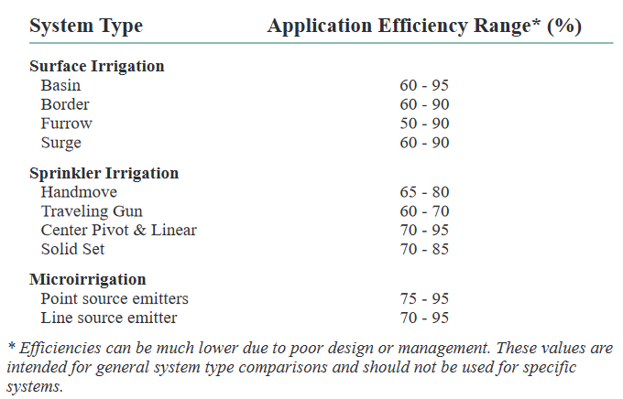
Agricultural efficiency (credit: Kansas State University)

Slide 27
Water conservation
What can we do to preserve water resources?

Slide 28
Water conservation (how can we use less?)
Grey (or black) water recycling
Drought resistant plants (xeriscaping)
Incentive structures

Slide 29
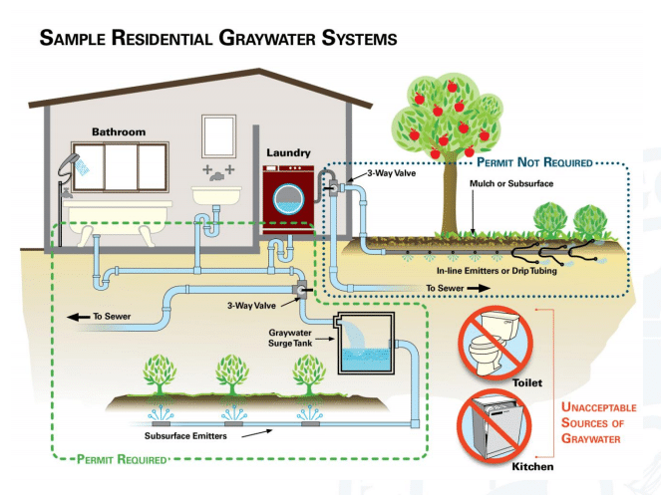
What issues might grey water recycling have?
Image: groundstone wastewater systems

Slide 30
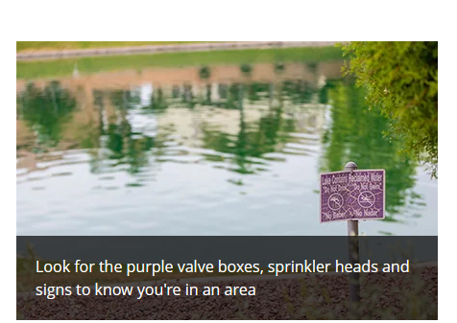
Black water recycling on a municipal scale
Image: City of Chandler
https://www.chandleraz.gov/residents/water/water-conservation/reclaimed-water

Slide 31
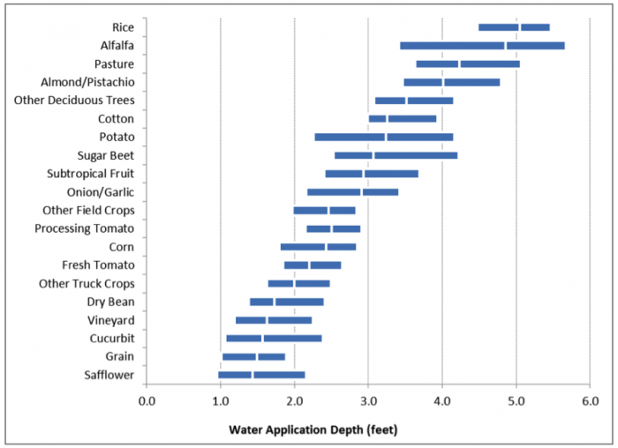
Grow the right crops (source Heather Cooley, Pacific Institute)

Slide 32
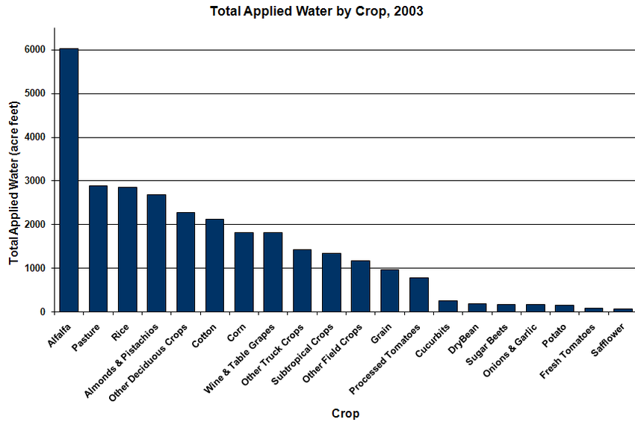
We aren’t growing the right crops (source CA Department of Water Resources)

Slide 33
Some local interest…
Large amounts of water have been used to grow foreign crops https://www.pbs.org/newshour/politics/in-drought-stricken-arizona-fresh-scrutiny-of-saudi-arabia-owned-farms-water-use
  Terminating the water lease seems to have worked here, this company is leaving as of 2024: https://www.cnn.com/2024/03/07/us/foreign-farm-fondomonte-groundwater-arizona

Slide 34
Seminar Day
How might you make farmers use water more efficiently. What would be the consequences of each action?
How should water be distributed in regions where it is scarce? Who should have priority?
How could we reduce the rate Lake Meade is draining? What would be the consequence of doing so?

Slide 35
Irrigation methods
Flood irrigation
  Furrow: Dig trenches between crops and fill them
  Basin: Flood whole field
  Surge: Intermittently release water
  Border: flood channels around the crops
Sprinkler Irrigation
  May be fixed, automated, or manually moved
Microirrigation
  Line source: The tube is the delivery device
  Point source: Spcific emitters are placed along the line

