Slide 1
Population Dynamics

Slide 2
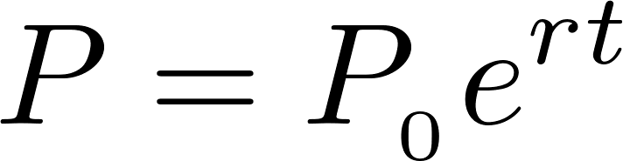
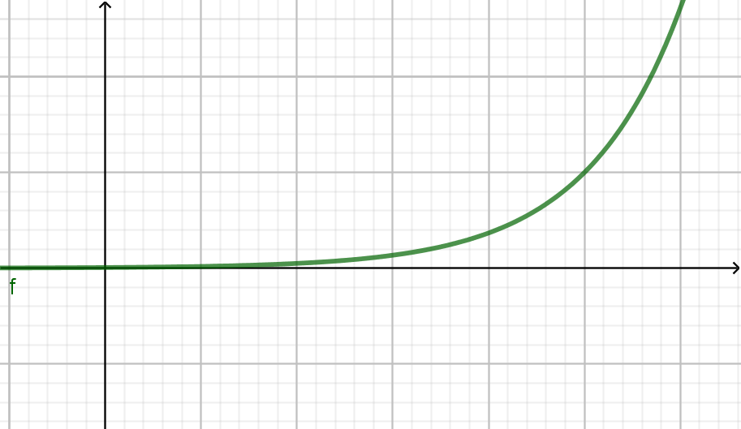
The simplest model of population growth
Exponential function

Slide 3
Influences on population growth rates
Left blank: time to think!

Slide 4
Density dependence
Density Dependent
  Disease
  Resource availability
Density independent
  Droughts/floods
  Earthquakes

Slide 5
Logistic growth
Left blank: discussion and explanation

Slide 6
r selection
r selected species prioritize rapid reproduction (ie high r value in the last equation)
Some typical characteristics of r-selected species
  Usually small
  Reach sexual maturity quickly
  Many offspring per pregnancy
  Little parental care for newborns
  Short life span

Slide 7
k selection
k selected species have low intrinsic growth rates
Some typical characteristics of k selected species
  Larger
  Slow to mature
  Substantial parental care
  Low numbers of offspring per pregnancy
  Long life span

Slide 8
Problems with the model
What is wrong with an exponential growth model?

Slide 9
Better models of population growth
Logistic growth describes what happens to k selected species well
  Takes into account that any species will eventually use all resources available to it

Slide 10
Population Dynamics
Models and simulations…

Slide 11
Metapopulations
Sometimes multiple separate populations will exist that are separated spatially with weak interconnections
Regions of connection are called corridors
The whole population is referred to as a metapopulation
How will metapopulations behave?

Slide 12
Resource partitioning
2 species compete for the same resource
What happens?
Simulation!

Slide 13
Resource partitioning: cases
If one species is much better at acquiring the resource, the other species will tend to evolve away from needing it (or die out)
If the species are relatively equal, both species may evolve to avoid sharing the resource, but this may be overwhelmed by other selection pressures

Slide 14
Survivorship curves
Type 1: Most individuals survive to close to the maximum age
Type 2: A relatively constant fraction of individuals die in each age range
Type 3: Most individuals die very young, with a very small fraction reaching adulthood. A relatively large fraction of those that reach adulthood tend to persist into old age.
What are some examples of species that might have each type?

Slide 15
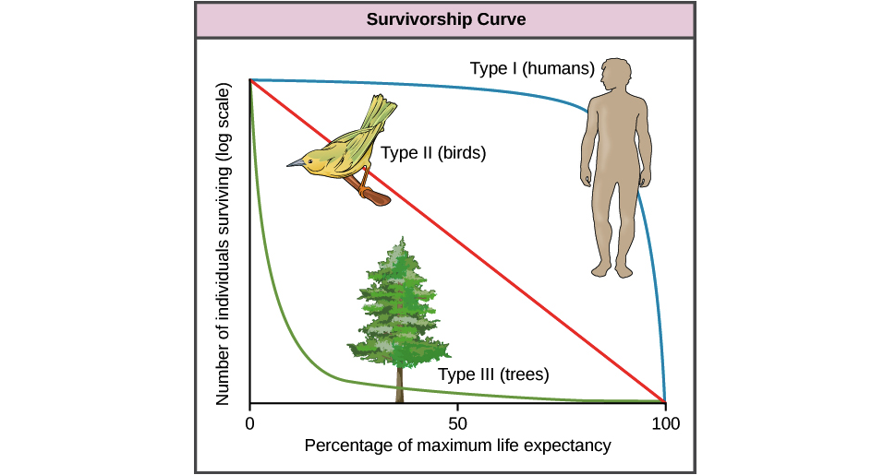
Image: Population demography, openstax https://openstax.org/books/biology/pages/45-1-population-demography

Slide 16
Human population
Ideal
  Economically: slightly above replacement
  Sustainability: at or below replacement

Slide 17
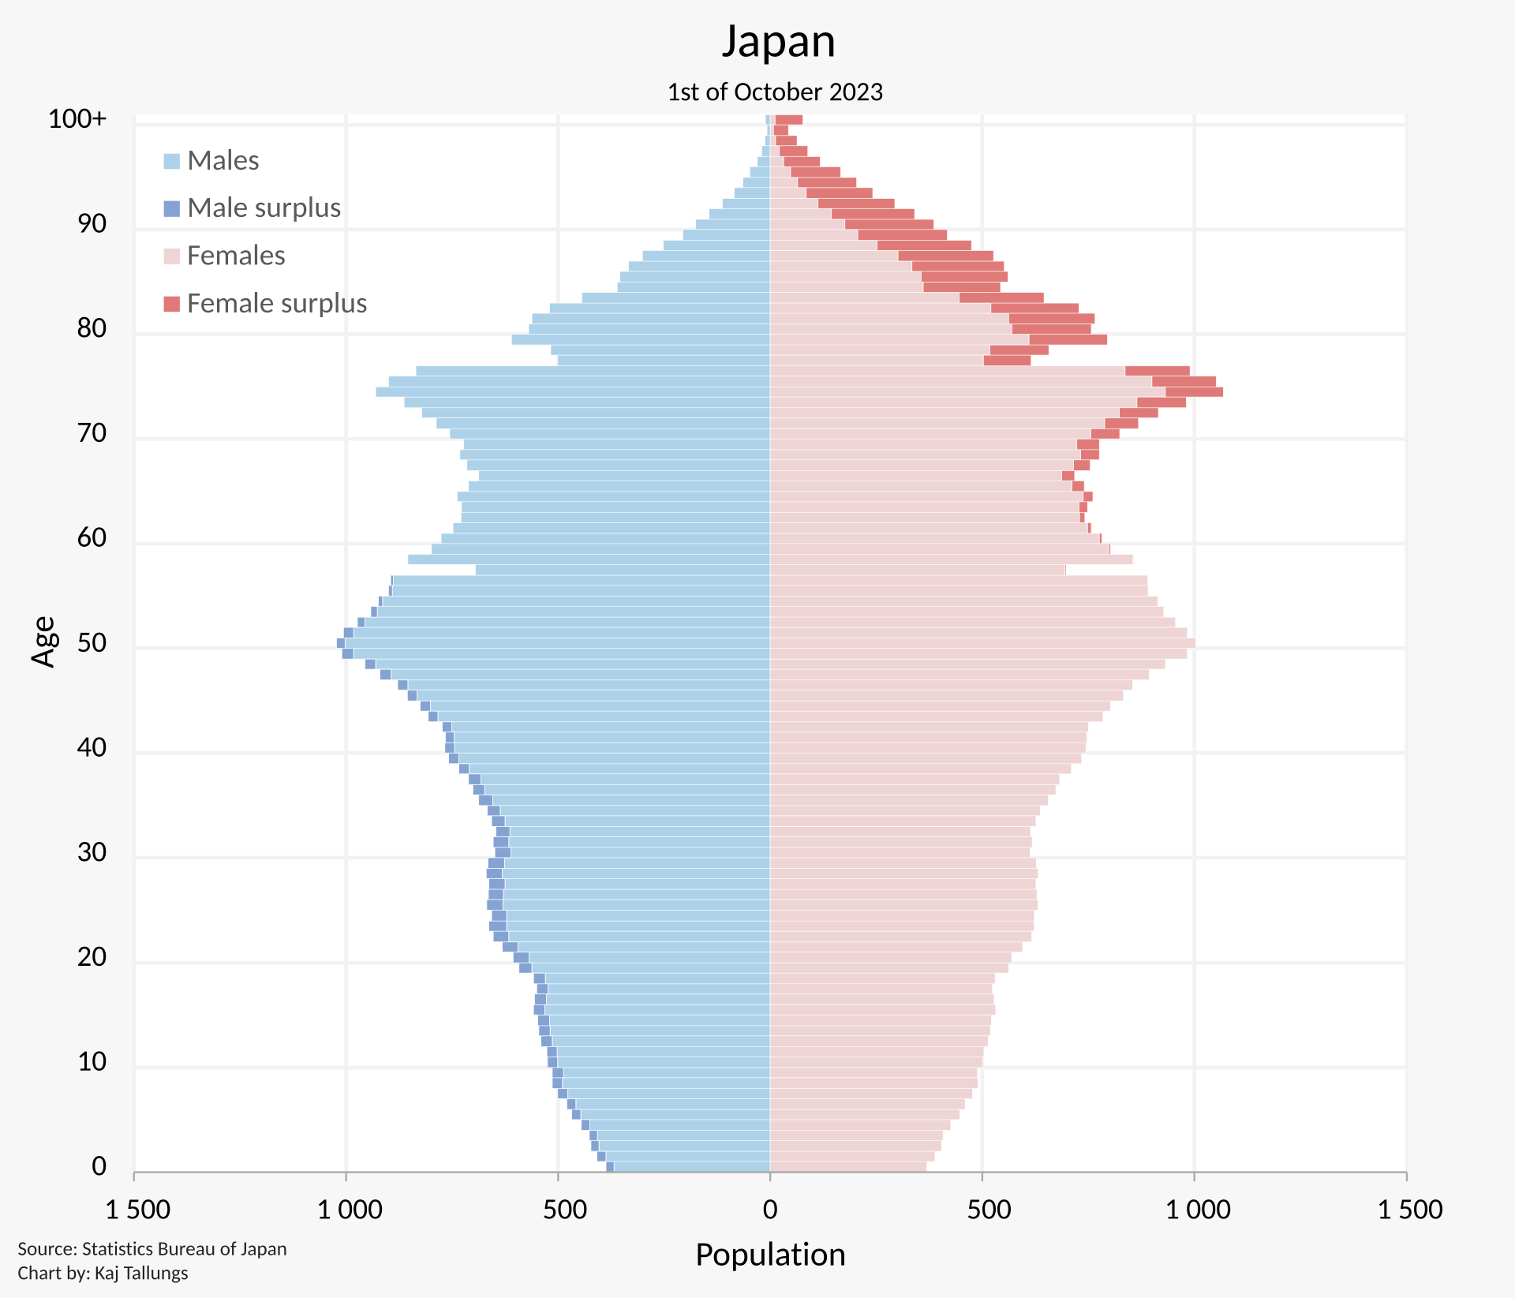
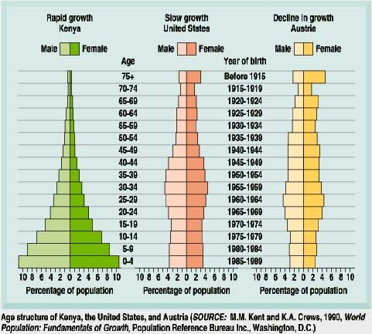
Age structure diagrams

Slide 18
Side Note: Male to female ratio
Slightly higher fraction of babies are male in nearly all countries. For older people, there is a strong female skew in most countries. Why?

Slide 19
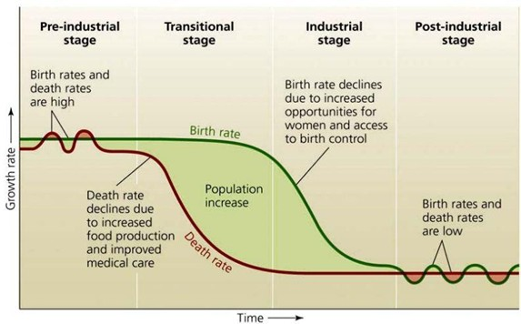
Time evolution of Birth and Death rates
Pre-industrial: High birth, high death
Industrialization: Rapidly lowering death, flat-ish birth
Industrialized: Low death, lowering birth
Post-industrial: low birth, low death
Image: Layton Field, MSM university

Slide 20
Slowing population growth
Forced sterilization: India, China…
  India: 1970s/80s with full financial support from the World Bank
  China: Mostly on minority groups… some have called it genocide
Incentivized sterilization: India, China…
Education and Birth Control: India, Japan, USA, Europe…

Slide 21
Increasing Population Growth
“Do it for Denmark” and “Do it for Mom” (Denmark, 2014 and 2015)
  Promote romantic getaways for young couples and generally encourage having kids
  Questionable success (small, short increase)
Tax credits for pregnant moms and childbirths (USA, 2023-ongoing)
  Birth rate is still decreasing, maybe slightly slower based on 2024.
  Some have argued that $2000 is too small to be meaningful
Everything they can think of (Japan, 2010ish onward)
  Direct financial support for most families with kids
  Requiring better maternity/paternity leave policies
  Childbirth and education cost reimbursement

Slide 22
Ecological Footprint
How much land is required to sustain some entity (individual, country, city…).
  In the calculation, the land is assumed to be the global average productivity, and the land is assumed to take exactly as much damage as can be repaired
Ecological footprint by Country: https://worldpopulationreview.com/country-rankings/ecological-footprint-by-country

Slide 23
Seminar Day
A city has a surplus of deer that are eating too many farmed crops. What should the city do?
The USA has one of the highest ecological footprints in the world. What, if anything should be done about this?
You are interested in the effect of increasing elevation on species diversity.
  What would you hypothesize the relationship to be and why?
  How would you test your hypothesis?
  What would be some confounding variables?

