Slide 1
Toxicology terms
LD50: Dose lethal to 50% of individuals
LC50: Concentration that is lethal to 50% of individuals
ED50: Effective dose in 50% of individuals
NOAEL: No observed adverse affect level
NOEL: No observed effect level

Slide 2
Signaling mechanisms (very simplified!)
Slowest (hours to months): Hormones, receptor density changes, gene expression
Medium (minutes to hours): neurotransmitters, hormones
Fastest (seconds or less): Electrochemical, neurotransmitter

Slide 3
Ion channels
The body uses multiple different ions to transmit signals
Sodium/Potassium: Primary ions used to maintain resting transmembrane potential and initiate action potentials
Ca: Triggers neurotransmitter release in many synapses
  Involved in gene expression among other things
Mg: Tends to inhibit release of excitatory neurotransmitters, also acts as antagonist at the NMDA receptors
Types of channels:
  Ligand gated: A neurotransmitter binds to open/close
  Voltage gates: A voltage change opens/closes
  Leakage: Always open

Slide 4
Some CNS Neurotransmitters (very simplified!)
Dopamine: Motivation (note, NOT equivalent to enjoyment!)
Serotonin: Attachment
Norepinephrine: Energy/Alertness

Slide 5
Dopamine
Responsible for motivation, but not necessarily enjoyment
Dopamine transport protein is a target of many drugs prone to abuse
  Amphetamines (also used as an ADHD drug)
  Cocaine (also used as an anesthetic, due to unrelated action)
Long term high levels are associated with schizophrenia
Causes excitotoxicity in high concentrations

Slide 6
Serotonin
Ancient in origin
  Behavioral effects in octopi are very similar to humans
In brain controls attachment, well being, hallucination (mostly 5HT2a), bonding
Outside CNS controls body temperature, digestion, circadian rhythm…
Pharmaceuticals that target Serotonin transport proteins are used as anti-depressants (SSRIs)

Slide 7
Acetylcholine (simplified)
Excitatory neurotransmitter
Expressed in sympathetic nervous system
In PNS controls motor neuron activation
In CNS affects motivation, alertness, concentration
In insects, expressed only in CNS
Some pesticides act as agonists here, or bind to acetylcholinesterase

Slide 8
Acetylcholine (less simplified)
2 main categories of receptors
  Muscarinic
    Named for muscarine, first agonist discovered
    Mostly responsible for re-polarization
    Agonists cause delirium, pain relief, slow heart rate, and death at high doses
  Nicotinic
    Named for nicotine, a relatively strong agonist
    Associated with selective and nonselective ligand gated channels
    Mostly responsible for depolarization
    Agonists cause muscle spasms, seizures, and death at high doses

Slide 9
GABA
Generally inhibitory
Agonists and some modulators act as anti-anxiety or anti-convulsive agents
Some pesticides are agonists for this, but much less common than acetylcholine or sodium ion channel binding pesticides

Slide 10
Hormones:
Estrogen: Female sex hormone, but also has a role regulating water retention, muscle growth and blood pressure in men
Testosterone: Male sex hormone, but also has a role regulating muscle growth, aggression, and sex drive in women

Slide 11
Neurotoxins
Neurotoxins are chemical agents that directly or indirectly cause damage to tissue in the nervous system (or impair its normal function).
  There are many ways that a substance can be neurotoxic, the details vary wildly
  Many beneficial medications are neurotoxic (especially at higher doses)
  Many neurotransmitters are neurotoxic (especially at elevated concentration)

Slide 12
Chemical neurotoxins
Pesticides
  Acetylcholinesterase inhibitors: Cause damage by allowing excessive acetylcholine to build up in the synaptic cleft which leads to damage from over activation of the associated neurons. Note that the death of neurons is not really responsible for the lethal effects
    The most toxic examples have LD50 of ~1mg/kg orally
Bacteria
  Botulism toxin is the most toxic substance known (LD-50 ~10ng/kg by inhalation). It works by destroying SNARE proteins associated with the release of acetylcholine. This prevents any release from occurring, leading to paralysis and death by respiratory depression.

Slide 13
Heavy Metals
Water soluble mercury compounds
  Methylmercury: Created from mercury by microbes in the ocean and bio- magnifies. Very long biological half life (~50 days) and toxicity (LD50 ~20mg/kg)
  Dimethylmercury: Extremely toxic (LD50 <50mcg/kg). Found in the ocean in very small quantities. The origin remains unknown.
  Molecular mechanism of neurotoxicity remains unknown
Lead compounds
  Mostly from action of acidic water on lead pipes
    Example: Flint, Michigan
Arsenic:
  Mostly natural sources

Slide 14
Other neurotoxins
Dopamine
  Dopamine has several breakdown products that damage dopamine and serotonin neurons
Glutamate
  In high levels, glutamate causes cells to intake too many Ca2+ ions. This results in over-activation of proteins in the cell that damage it. (called excitotoxicity)
Amphetamines
  Releases dopamine and serotonin (already involves some neurotoxicity)
  Many have metobolites that are directly neurotoxic to dopaminergic or serotonergic neurons

Slide 15
Mutagens
Mutagens change DNA structure
Many lead to increases in cancer rates
Asbestos: Common insulation material in the 1970s. Fibers are highly carcinogenic.
Radon: Naturally occurring radioactive gas that is a decay product of radioactive isotopes (notably radium).

Slide 16

Teratogens
Interfere with normal fetal development, causing birth defects.
Alcohol: Leading cause of birth defects in USA
Pharmaceuticals: Many drugs act as teratogens.
  Thalidomide: Given to pregnant women as an anti-nausea drug in the 1950s. Led to lots of birth defects.
Image credit: Dr Judith Johnson, University of Manchester

Slide 17
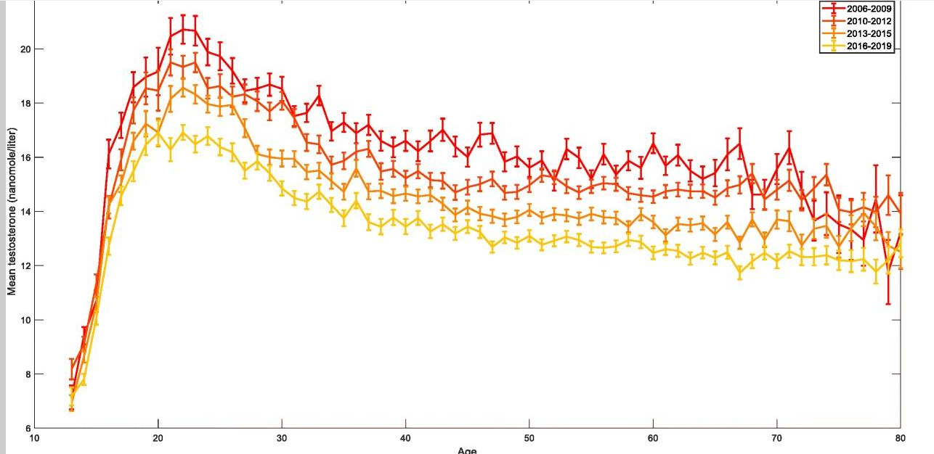
Testosterone Levels are declining rapidly
Image: Reprod Biol Endocrinol. 2020 Mar 9;18:19. doi: 10.1186/s12958-020-00575-2

Slide 18
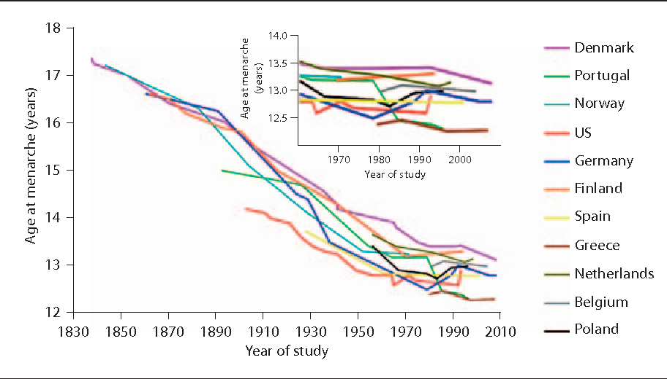
Girls are reaching puberty much earlier
Image: Sorensen et al, 2012

Slide 19
Activity: How can we explain this?
What, factors might be involved?
Try to come up with multiple alternative explanations.
How would you design a study to differentiate between these alternatives?

Slide 20
Endocrine disruptors
Drugs that mimic a hormone found in the body
Very often mimic estrogen (high promiscuity)
Phthalates: Chemicals used to make some plastic more pliable
  Mimic estrogen
  Being phased out
Many insecticides and herbicides (DDT, Atrazine,…)
Receipts (often contain known E.D. bisphenol A as a developer)
  Easily absorbs through skin after contact
  Washington state was first to ban in 2024

Slide 21
Testosterone: No obvious explanation
Huge sample size of about 100,000
Other studies have found the same trend, going back to 1970s
  Same trend found in studies in Netherlands
Controlling for BMI is not sufficient to explain
Omitting individuals with chronic diseases is not sufficient to explain

Slide 22
Hypotheses from different authors
Vitamin D deficiency may be related…
Decline in smoking might be related… (aromatase inhibitor)
General worsening of diet/exercise may be related…
Changing gender roles and occupations may be related…
Exposure to endocrine disruptors may be related…

Slide 23
Earlier Menarch: No obvious explanation
Higher body fat
  Probably insufficient alone, and endocrine disruptors are likely one of the causes of obesity anyway…
Exposure to hormones from meat
Less exercise or worse diet
Exposure to endocrine disruptors

Slide 24
Design an experiment to answer each question.
How much does penicillin resistance impact resistance to methicillin? (hard)
Which of 2 viruses is more deadly to mice? (easy)
Does a vaccine for Covid work in humans? (medium)

Slide 25
Discussion Questions
How can we objectively determine and represent the risk of something?
How should risk of environmental or human harm be balanced against availability of new products and what should the threshold be for removing an existing product from the market?
How should human risk be balanced against environmental risk?
How do we balance the need for insecticides with their toxicity?

