Slide 2
Understanding the dilemma: a game
Every player starts with $5.
Every round you may put $1 into the center. If you put in the $1, every player gets 10 cents.
You will state your intention to do so or not on a sheet of paper.
You may make whatever claims you want to about whether you intend to put in the money. Those claims are not binding. You may not show other players your paper.
All players will hand their sheets to me.
If a player has $20, that player immediately wins and exits the game with 5% extra credit on the next exam.
If you no longer have at least $1 you are out. If you are the first player eliminated, you must write a 1 page paper on game theory and how it applies to ecology by next Friday.
If it ever becomes impossible for any player to reach $20, all players lose and must write a 1 page paper on game theory and how it applies to ecology by next Friday.
If you have the most money at the end (even if you technically lost) you get 5% extra credit on the next exam.
Ties for winner count. Ties for loser count.

Slide 3
Game Theory (very short version)
Rational people will almost never arrive at the optimal solution with most incentive structures.
Better incentive structures can get us closer to optimal outcomes.
https://ncase.me/trust/

Slide 4
Common good vs personal good
The best choice for an individual is seldom the best choice for everyone else.

Slide 5
Externalities
The total cost to society of buying/using something, manufacturing something, or providing a service is not just the dollar cost of buying it
  Social cost/benefit
  Environmental cost/benefit
  Cost/benefit to neighbors
  The externalities are not necessarily known to the person

Slide 6
Land use
Companies and individuals want to use land to make profits
What are the costs?

Slide 7
Logging:
Clear cut: cut down all trees in a region
Selection cutting: cut down a fraction of all trees of the same species
Selective cutting: extract only the economically advantageous trees
What are some advantages and disadvantages? How would different types of selective cuts change outcomes?

Slide 8
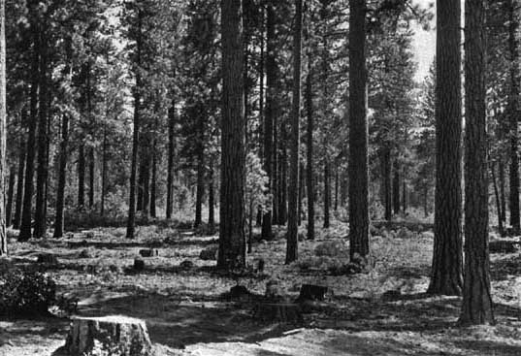
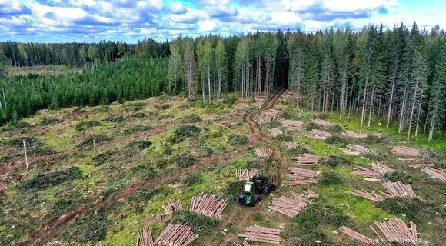
Clear Cut vs selection cut

Slide 9
Logging
Clear cut: cut down all trees in a region
  Major ecological impacts
    Soil erosion
    Displacement of animals
    Problems with regrowth of trees that need shade
    In very forested areas, might actually increase diversity
Selective cut: cut down only valuable trees
  Still has large impact
    Problems with regrowth of trees that require sun
    Might still eliminate habitat for animals that depend on specific species
    Might shift balance to other species, so it can be worse long term than clear cutting

Slide 10
Logging
Selection cut:
  Substantially reduces environmental damage when done well
  Can be modifies to be clumpier for sun requiring trees
  Considered a good practice for sustainable forestry
  More difficult logistically
Note: Selection and selective cut are sometimes used interchangeably, particularly by logging companies.

Slide 11
Government intervention
National Parks: Areas reserved for preservation, scientific and recreational purposes
  Often unique or unusual regions
National forest: Areas where resource extraction is controlled and multiple usage goals are balanced against each other.
  Mining
  Logging
Wilderness area: Area where no (new) resource extraction is allowed, no roads can be built, and no developed campgrounds may be constructed
Wildlife refuge: Goal is to protect wildlife. Typically limited human usage is allowed.

Slide 12
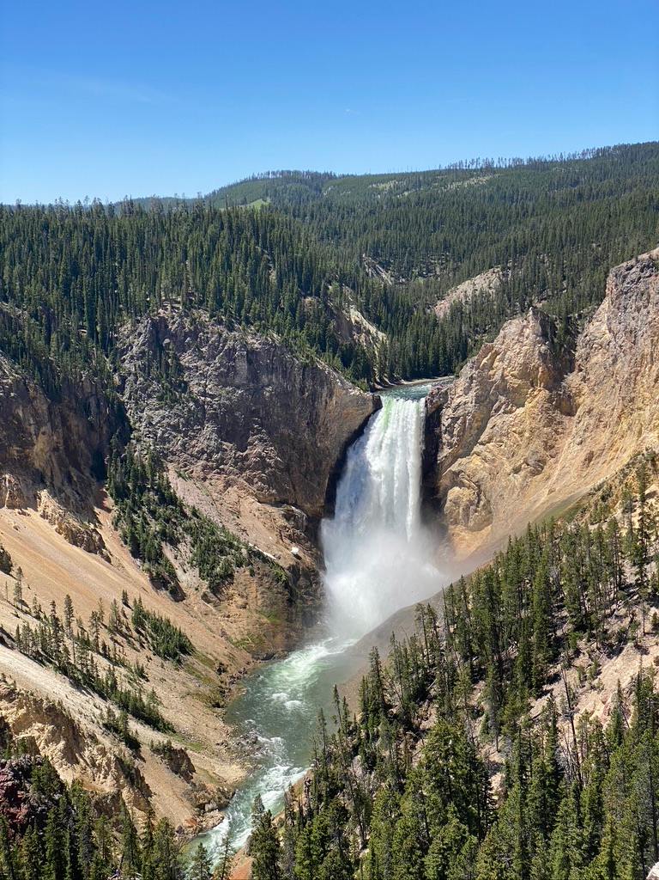
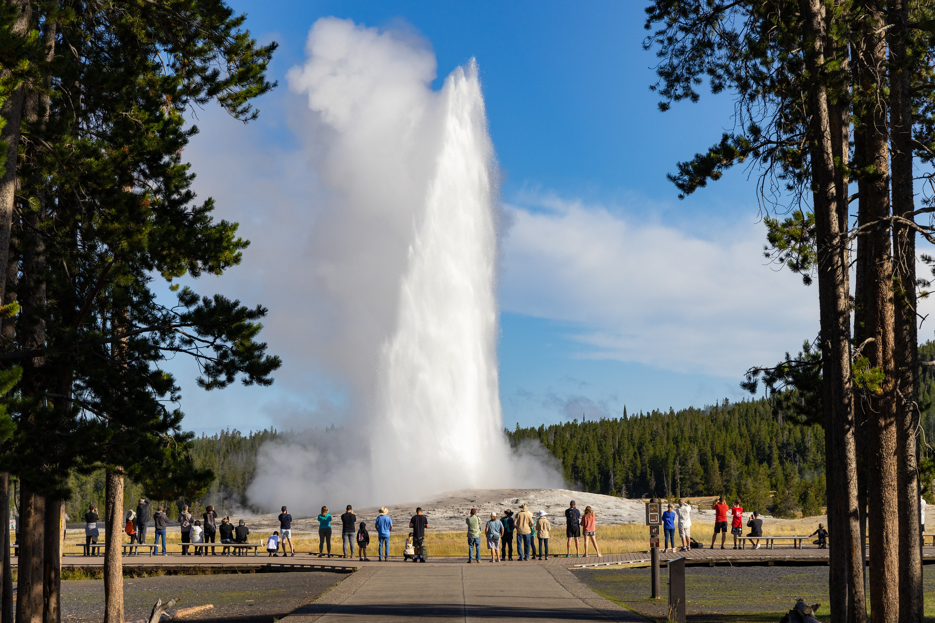
Yellowstone, left: Wikipedia, right: NPS

Slide 13
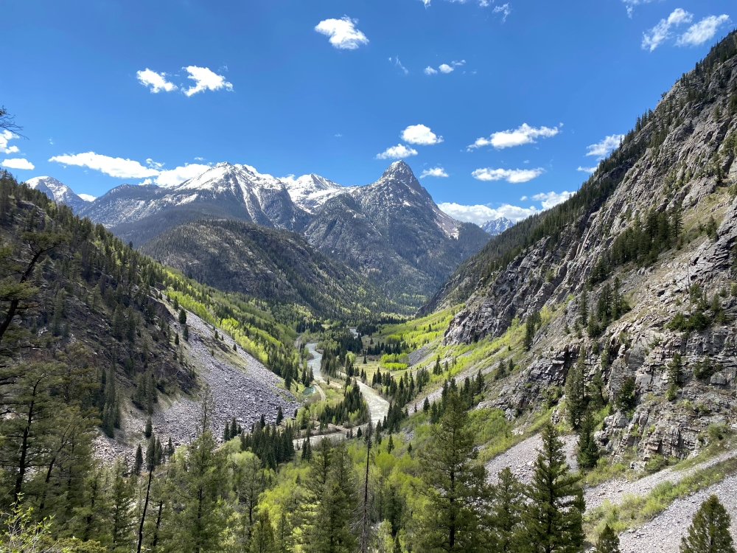
Weminuche Wilderness, San Juan Mountains association

Slide 14
Forest management
Could logging ever help forests?

Slide 16
Managing a forest
Controlling fires
  Fires are a natural and necessary part of the forest cycle
  Officials will use prescribed (aka controlled) burns to avoid large fires
  Activities will be restricted during times of high fire risk

Slide 17
Managing a rangeland
Rangelands are dry, open regions used for grazing cattle.
Grazing on rangeland is less energy intensive than feedlots
Grazing adds manure to the land (a good thing)
Overgrazing ruins the land
  Removes too many plants
  Makes soil vulnerable to erosion by wind
A permit system is used to limit grazing
Some claim that too many permits are given out at too low a cost

Slide 18
Suburbs
Suburbs have a larger environmental impact
  Lower population density
  Longer commutes (on average)
So… what is people’s incentive for doing so?
  Cost
  Room for kids to play
  Quieter
  Lower crime (usually)
History
  Became popular in the 50s as a result of more highway infrastructure

Slide 19
Urban blight
As people start to move to the suburbs, what should happen?
  Wealthier leave first because they have the means
  Lower tax revenue
  Businesses leave
  City cuts non-essential services, raises taxes
  Neighborhoods decline
  Positive feedback…

Slide 20
Gentrification
People (often younger people) start moving back to a city
  Businesses open to cater to them
  Increases tax revenue
  Cities increase services
  Draws more people
  Positive feedback again….
Would there be any downsides?

Slide 21
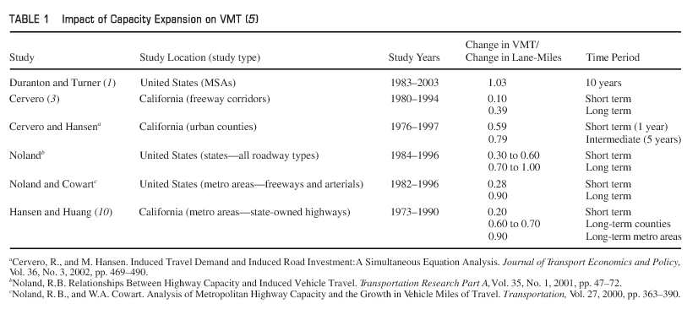
Getting to cities
Congested, highways between suburbs and cities
Solution: Expand highways to have more lanes
  Problem: induced demand
  Actual effect (credit Milam et. al. 2017)

Slide 22
Zoning
Idea: make neighborhoods safer and less busy by designating specific areas to only have specific uses and building types
  Generally something like this
    Industrial (factories)
    Commercial (businesses and retailers)
    Residential (houses, sometimes apartments are separated)
  Implementation
    Early zoning laws were mostly to keep out minorities and poor people
    Modern zoning laws are more focused on city planning with (usually) less racism
  Result of modern zoning laws
    Lots of driving is needed because stores and entertainment cannot exist in residential neighborhoods

Slide 23
How can we do better?
Smart growth neighborhood
  Parks, school, shops, restaurants
  Housing for many different income brackets
  Make neighborhoods walkable
  Encourage community involvement in city planning
  Make the community distinctive
  Preserve open space and environmentally important areas
  Make decisions predictable, fair and transparent
  Provide many transportation options
  Use compact building design
  Strengthen existing communities with intelligent redesign

Slide 24
Understanding the dilemma: a game
Every player who has more than $100 at the end of the game gets 5 extra credit points on the next exam.
Every player who has less than $74 at the end of the game loses 5 points on their next exam.
You gain $5 in revenue for each sheep when you sell it at the end of the round.
Grazing a sheep on common land is free.
Grazing a sheep on your own land requires $3 in resources for that round.
You start with 5 sheep and get 5 new sheep at the end of each round.
The carrying capacity of the common land is 50 sheep. As long as there are fewer than this, the common land will not be depleted. Each sheep past 50 depletes 2% of the land’s resources that will not replenish until fewer than 50 sheep are grazing there. If the land runs out of resources, it is unusable until it replenishes.
The game lasts for 5 rounds. Any player may make agreements with the group or other players, but the deals are not binding.

