Slide 1
Hazardous waste disposal

Slide 2
Types
Medical (biologically hazardous)
  Needles
  Pharmaceuticals
  Laboratory waste (eg bacterial cultures)
  Anything else with bodily fluids
  Typically incinerated
Industrial waste (chemically hazardous)
  Dioxins
  PCBs
Household chemicals

Slide 3
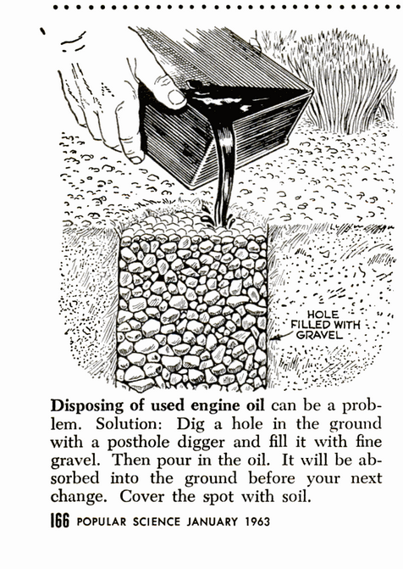
Details
Petroleum products
  Motor oil/Heating oil…
    Cannot be thrown in trash
    Consumers can give it to designated facilities
    Either recycled or burned for energy
Household chemicals
  Generally require special disposal
  Paint
  Bleach
  Acetone

Slide 4
Industrial Waste
Phthalates
  Plastic manufacture
  Strong endocrine disruptor (synthetic estrogen)
  Probably causes insulin resistance
  Also used in cosmetics…
  Most Americans test positive for multiple Pthalates
  Lower molecular weight phthalates are being phased out due to toxicity concerns
  Possibly causes epigenetic effects in subsequent generations

Slide 5
Dioxins
Unwanted byproduct of combustion of other chemicals in the presence of chlorine compounds, and known contaminant of the herbicide “Agent Orange” used widely in the Vietnam War
Endocrine disruptors
Tetragenic
Strong agonist of the AcR (aka dioxin receptor)
  Modulates expression of hundreds of genes and levels of many metabolic enzymes
    Many of the genes encode enzymes involved in the breakdown of toxic compounds

Slide 6
TCDD: The most toxic human creation?
Most toxic Dioxin compound
“Safe” exposure limit 700 fg/kg/day (fg is femtogram)
Human Biological Half life: 5-10 years
Environmental Half life: years (brightly lit surface) to centuries (under soil)
LD50 unknown
Concentration requiring soil cleanup: about 70 pg/g

Slide 7
Industrial Waste
PCBs/PBBs
  Used as dialectic coolants for transformers, as heat transfer liquids, and in the manufacture of some papers
  Very carcinogenic
  Very low water solubility, long environmental half life, long biological half life
  Some activate AhR (like structurally similar dioxins) although usually less strongly than dioxins
  Estrogenic effects and anti-androgen effects
  Not stopped by skin or gloves
  Banned in USA in the 1970s, banned globally in 2001

Slide 8
Superfund
Government fund that is used to finance cleanup of large environmental disasters
Typically the responsible company is later sued for the cost of cleanup and the fund is replenished
Sites include mines, manufacturing, toxic waste dumps…

Slide 9
Love Canal
Love Canal
  Hooker Chemical Company bought in 1947
  Filled with clay
  About 20,000 tons of hazardous waste buried
    Consisted of many different compounds
      Dioxins
      PCBs
      Pthalates
      Solvents
  Sold to school board in 1953

Slide 10
Love Canal continued
School built
Continued to be used until the 1970s
Residents were found to have multiple ailments
  Chromosome damage
  White blood cell anomalies
  Miscarriages
  Birth defects
Political response to love canal lead to the creation of superfund

