Slide 1
Geology

Slide 2
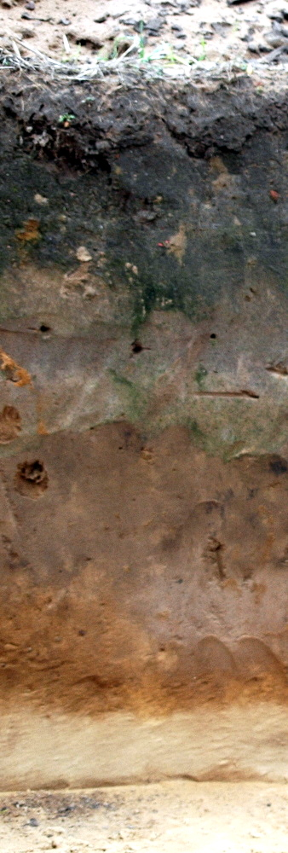
Soil horizons
Soil generally exists in separate layers
Exact details of composition depend on many environmental factors
  Climate, topology, volcanism, plant species…
Not all soils will have all types of horizons. Some will have multiple horizons of a single type.

Slide 3
Main soil horizons
Litter Layer: Consists of leaves, pine needles and other things that rest on the surface and are still immediately recognizable
O: Organic layer. Usually on top. Defined to consist of at least 20% organic carbon. Material may show minimal to high levels of decay.
  Ex: forests, where leaves/pine needles that carpet the forest will begin to decay
  Ex: Slowly decaying matter at the bottom of lakes or swamps
A: Surface soil. This is where plants grow from.
  Almost no rock structure
  Lots of decayed organic matter
  Lots of minerals
  Usually dark in color

Slide 4
Main soil horizons continued
B: Subsoil.
  Lower organic material content
  Most rock structure is gone
  High content of soluble minerals that have percolated through higher layers
  Often has reddish hue due to accumulation of iron oxides
  Often exhibit clay accumulation
C: Partially altered rock
  Rock structure may exists, but must exhibit at least some weathering/breaking.
  Little evidence of organic materials.
  May be tightly or loosely bound together.
  Often has high mineral content as a result of percolation from higher layers

Slide 5
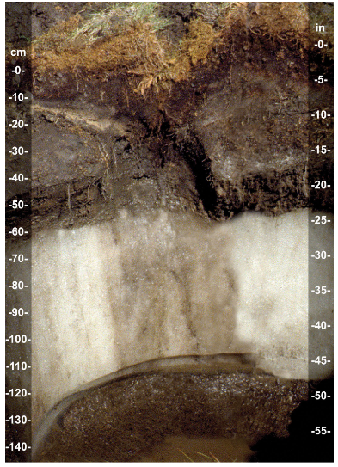
Some other horizons
E: Less organic material than A, but the clays and soluble salts have left making it lighter in color than A or B horizons. Often occurs between A and B, but can completely replace A in some instances.
Wf: permafrost. Ice layer below the surface that remains frozen all year. Exists in arctic/subarctic only.
R: Not actually soil. R refers to the bedrock that exists under the soil.

Slide 6
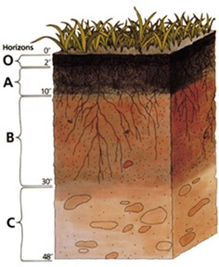
Most common patterns
O-A-B-C-R: Textbook example, probably what the AP would ask about
  O layer is typically thin
  R is often omitted.
  E layer may exist between A and B

Slide 7
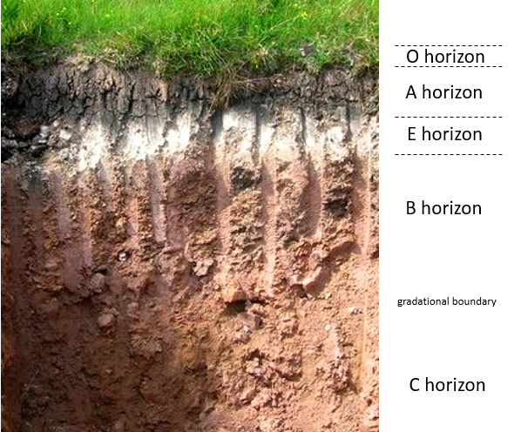
Real World example.

Slide 8
Weathering/erosion
Weathering: Process by which rock, soil and minerals are broken down by water, atmospheric degradation biological processes and sunlight.
Erosion: process by which rock is broken down and moved by water, glaciers, wind etc.

Slide 9
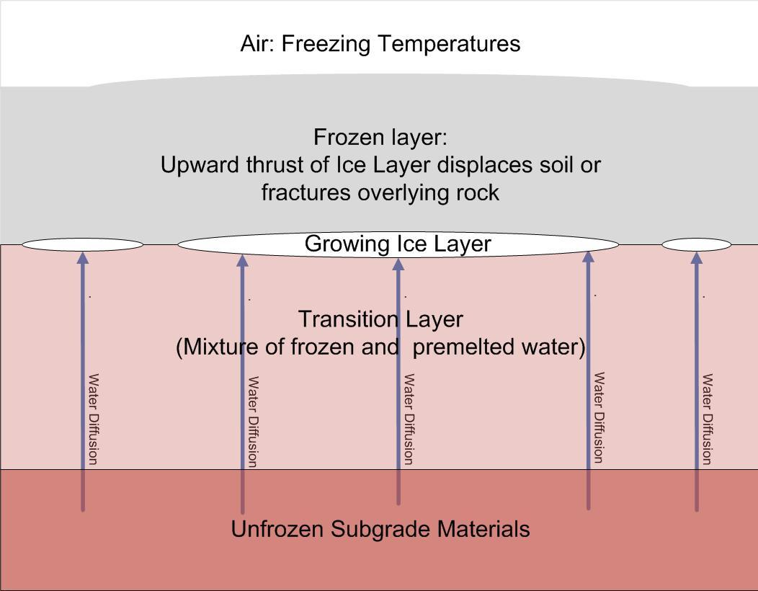
Physical (aka mechanical) Weathering:
Freeze-Thaw cycles
  Volumetric expansion: water gets into crevices and freezes. This generates very high pressures (200 MPa) When it expands it shatters the rock.
  Ice lens formation: Water begins to freeze near the surface. Diffusion and capillary action move more water to the disk causing it to grow and fracture the rock.

Slide 10
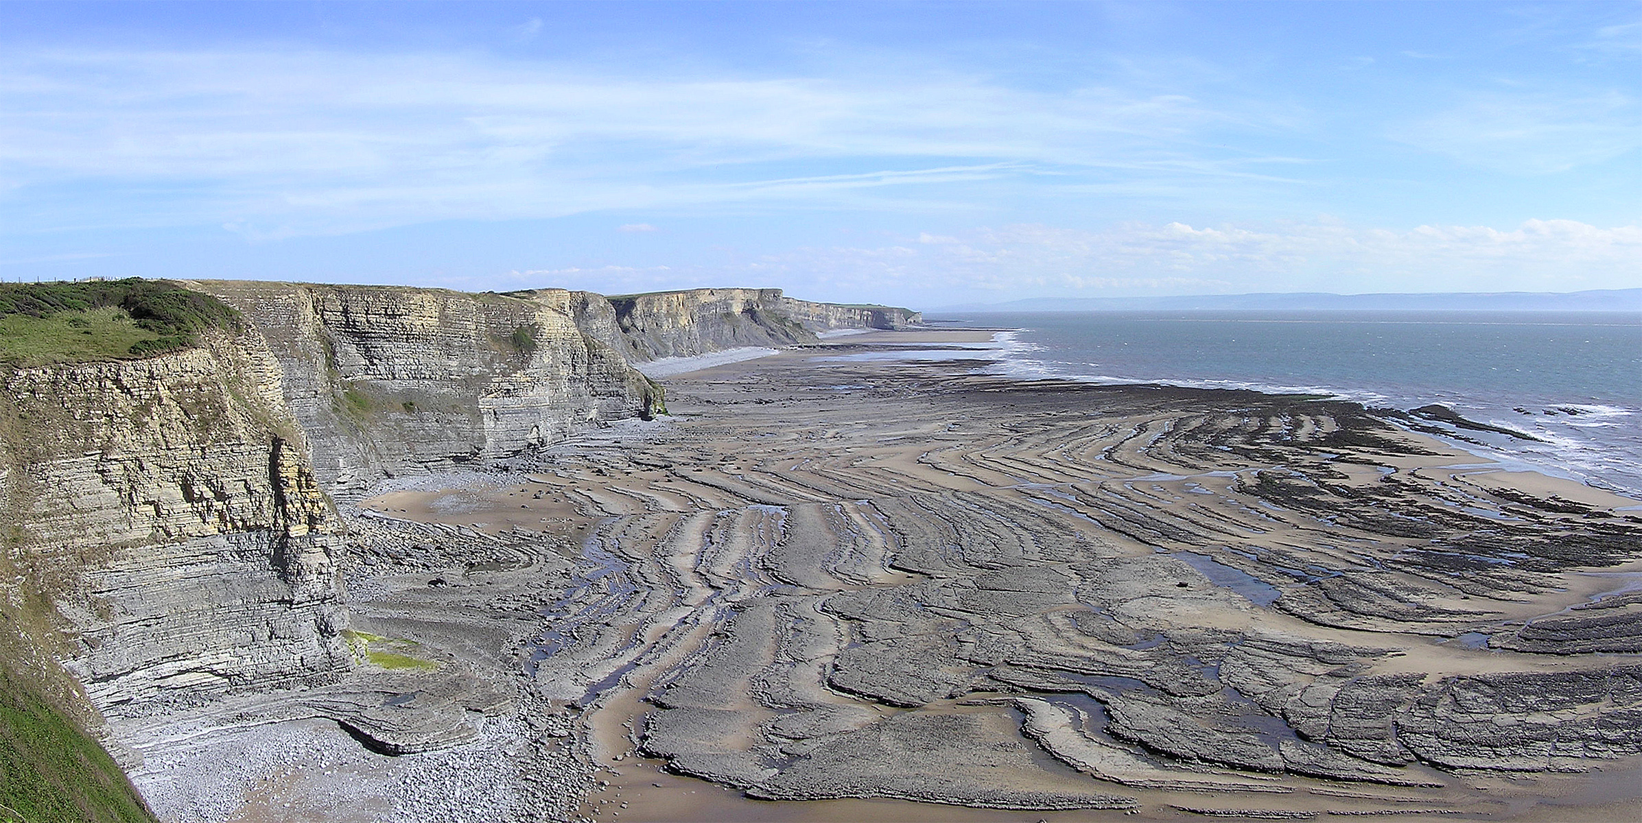
Tidal erosion of cliffs

Slide 11
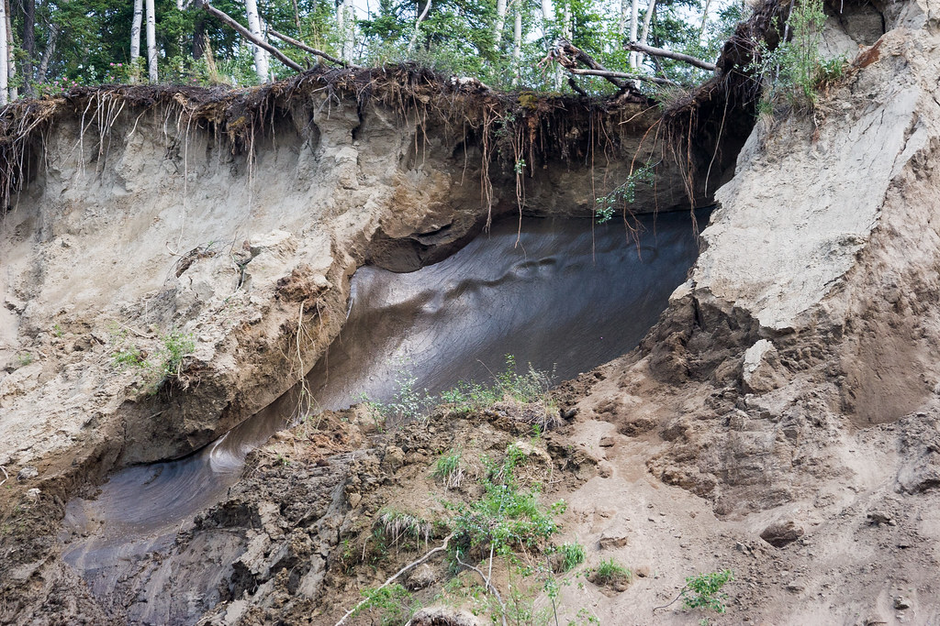
An ice lens in Alaska

Slide 12
More mechanical weathering
Thermal Stress: As rock is rapidly heated or cooled, it will expand and contract. Because the heating is uneven, this can damage and eventually fracture the rock.
  Very important when day/night temperature differences are very large
  Wildfires can cause rapid weathering this way
Pressure release: Deeply buried rock is under very high pressure. As it moves upward, the top is under less pressure than the bottom. This causes the rock to fracture into sheets.

Slide 13
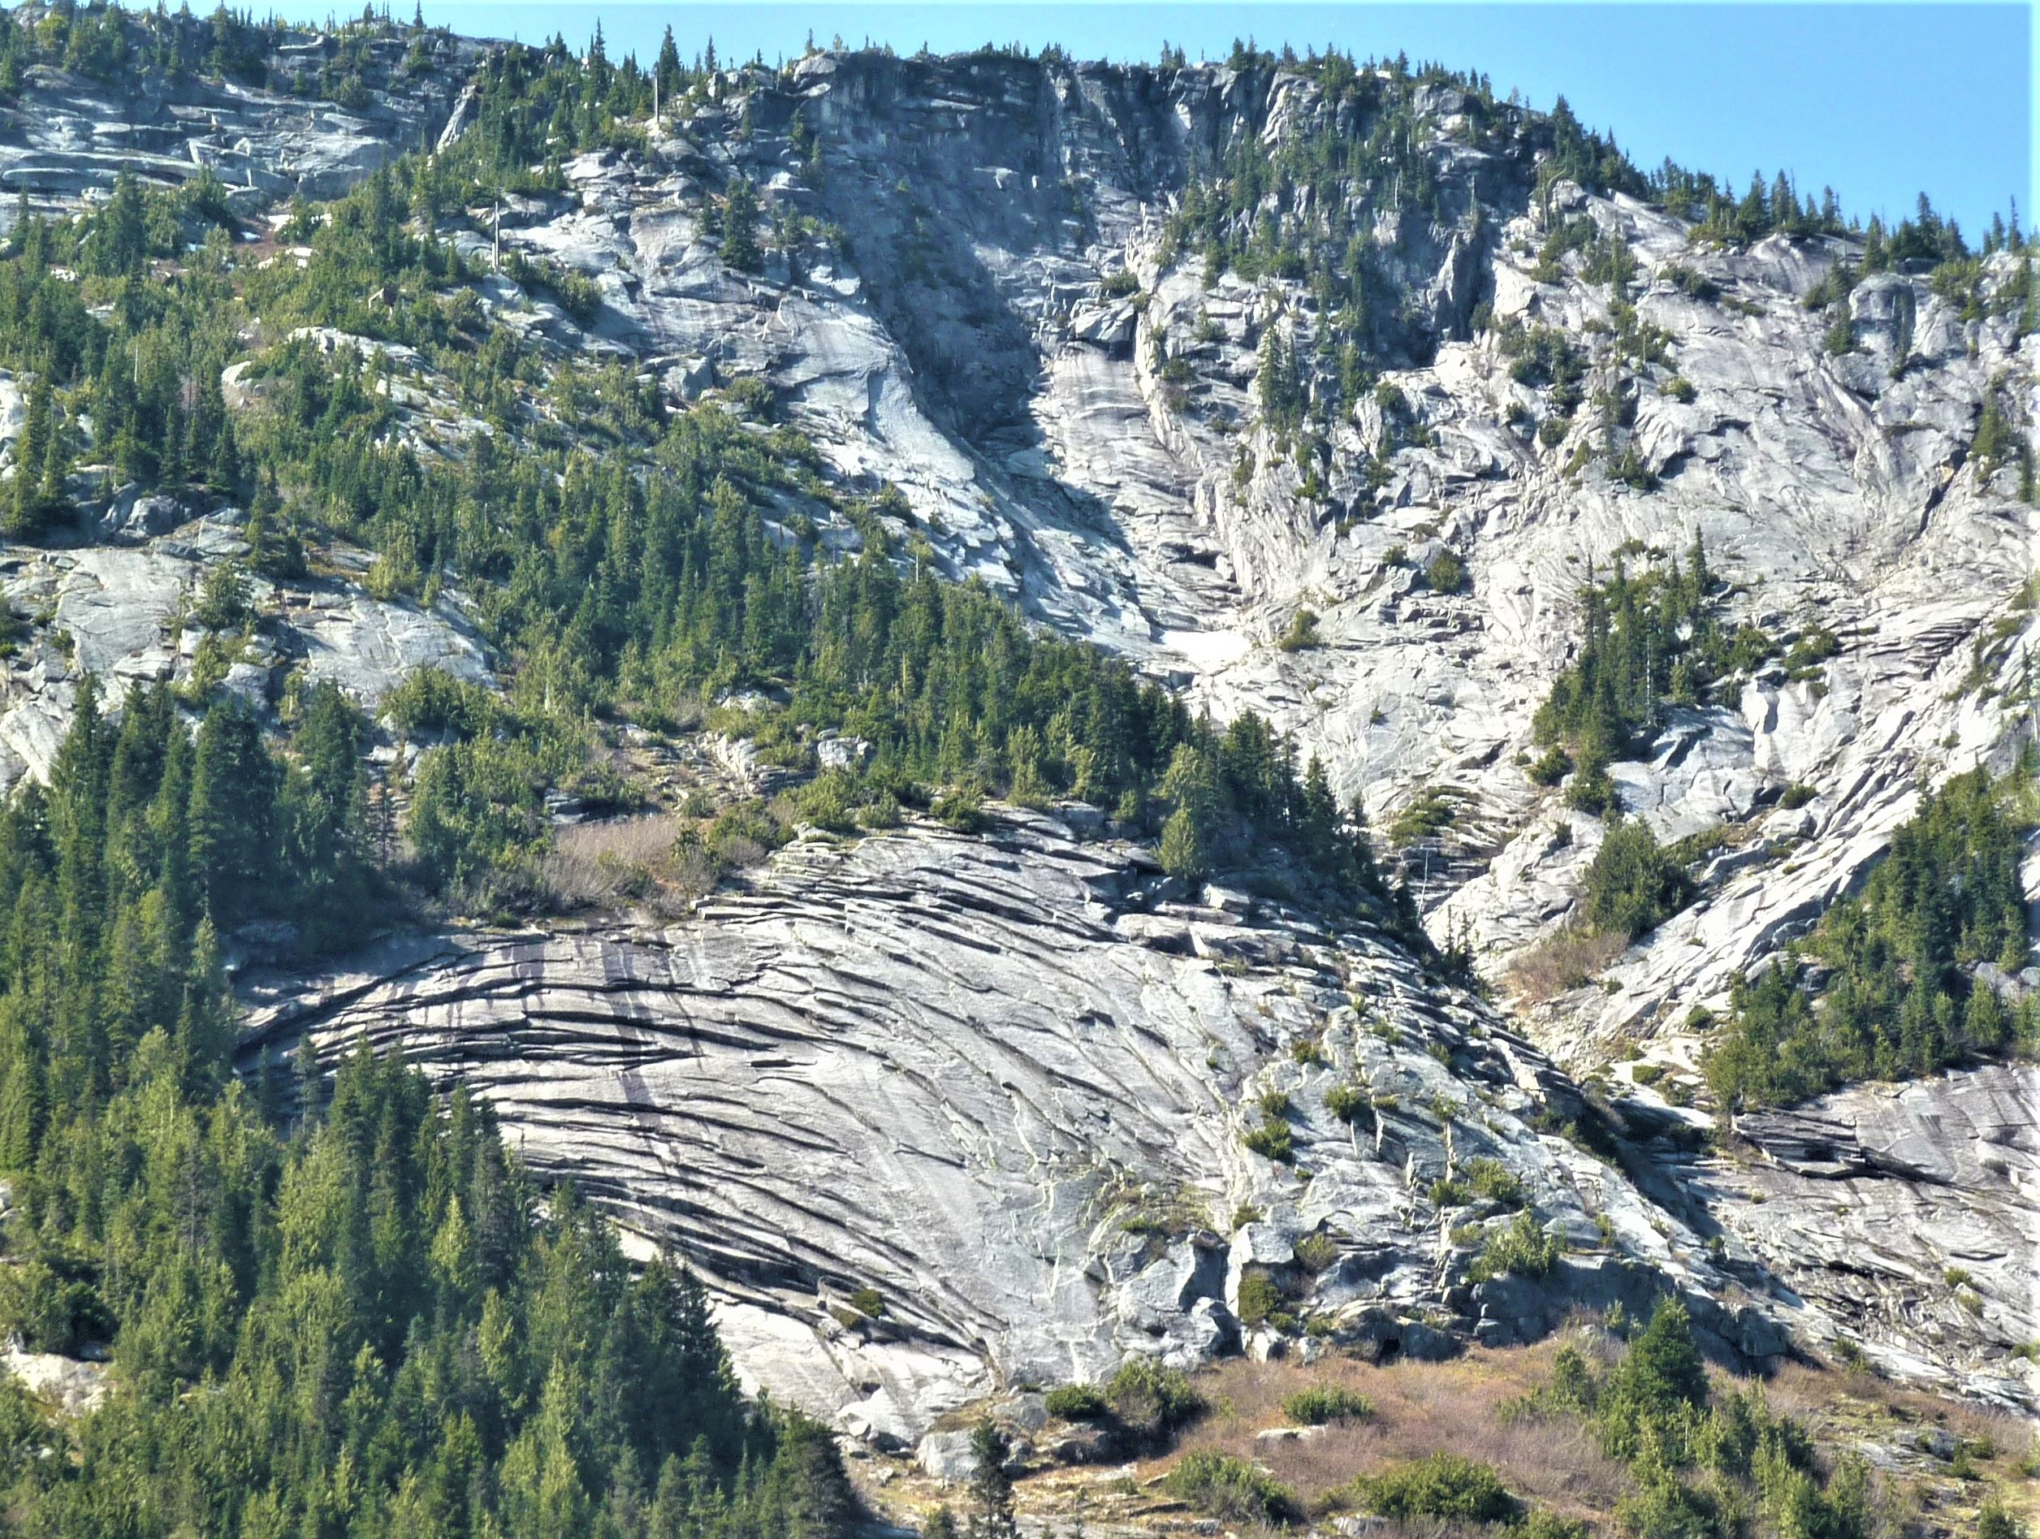
Image: Steve Earle, Physical Geography 2nd ed

Slide 14
Chemical Weathering
Oxidation: Many minerals (notably iron) react with oxygen.
Hydrolysis: Water (particularly acidic water) can dissolve part of the structure of some types of rock.
  Carbonic acid reacts with silicates to form carbonates. This is important as a sink for carbon dioxide because it reduces the acidity of the water.
  Also a form of chemical erosion.

Slide 15
Erosion
Flooding: The very large currents over very large areas that are associated with flooding lead to rapid erosion, particularly where few trees exist to hold soil together.
Glaciation:
  Glaciers flow slowly over land, breaking off and/or polishing rock under them. They will also deposit large quantities of rock at their ends.
Wind: In regions with lots of sand, particles picked up by wind can lead to relatively rapid erosion.
Tides: Coastal regions experience erosion from tidal action

Slide 16
Tectonic Activity
Evidence:
  Similar fossils have been found in many regions that now lie on different continents.
  Glacial sediments with similar composition have been found in many regions that now lie on different continents.
  Magnetic striping of the ocean floor. (We’ll get to this…)

Slide 17
But why? A detour into the structure of Earth…
Slab pull: gravity drags the cool plate down into the warm mantle. Probably most important.
Ridge push: gravity on newly formed ridges pushes on the plate
Mantle convection creates drag. Probably less important typically

Slide 18
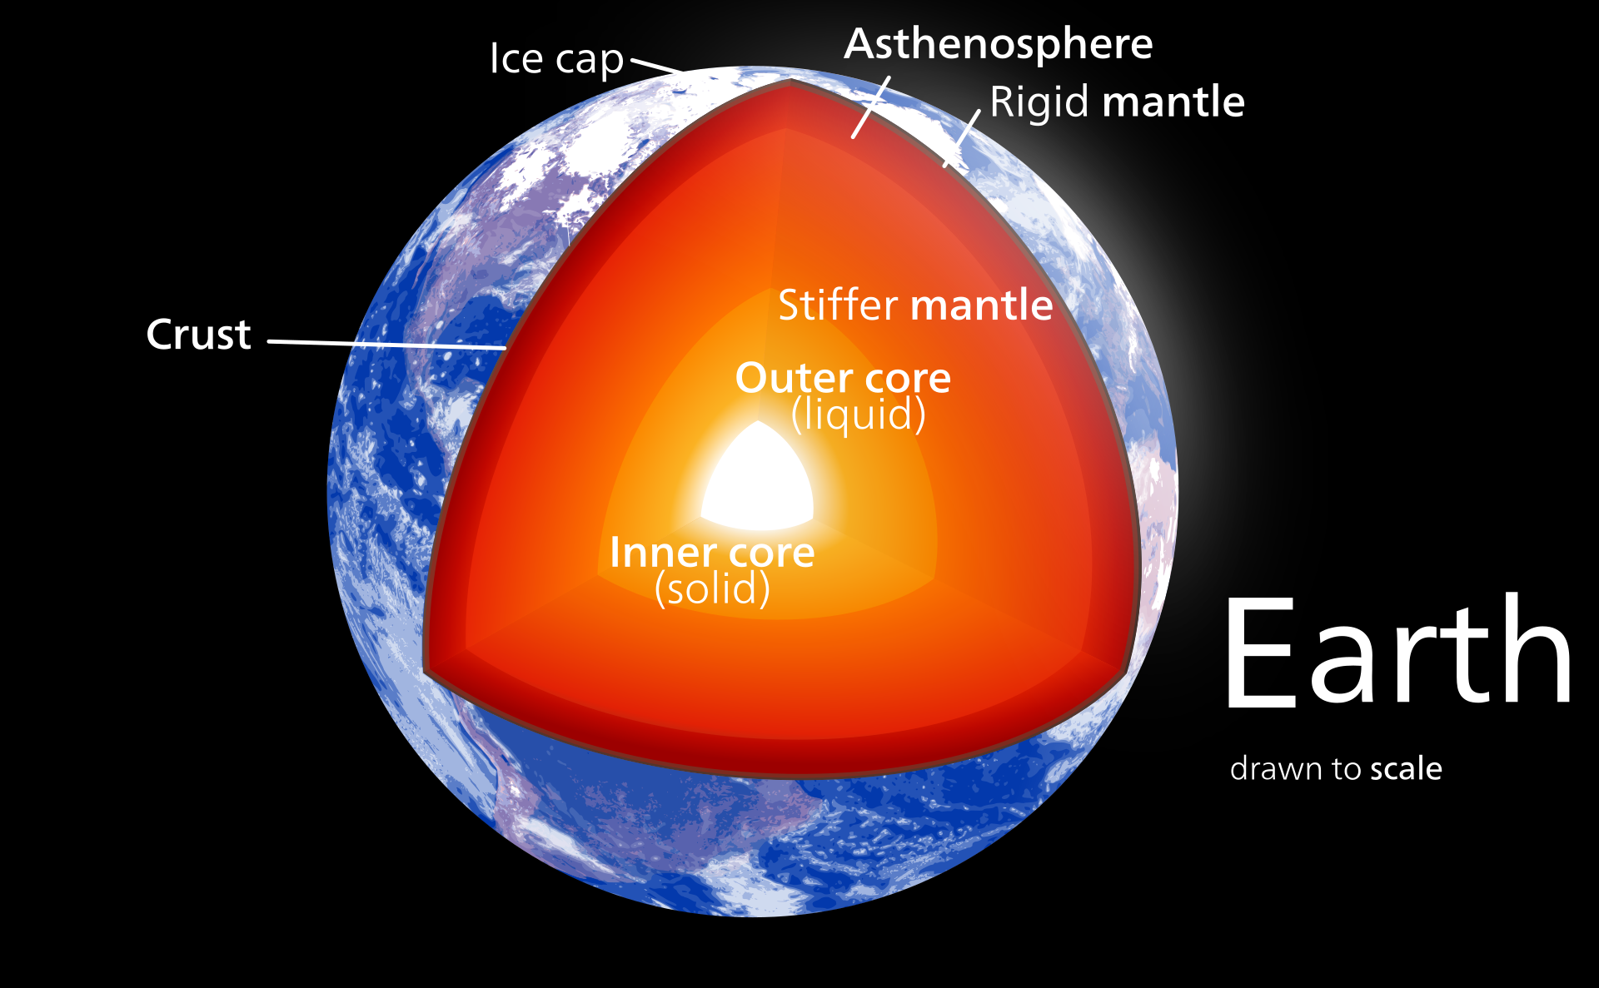
The structure of Earth

Slide 19
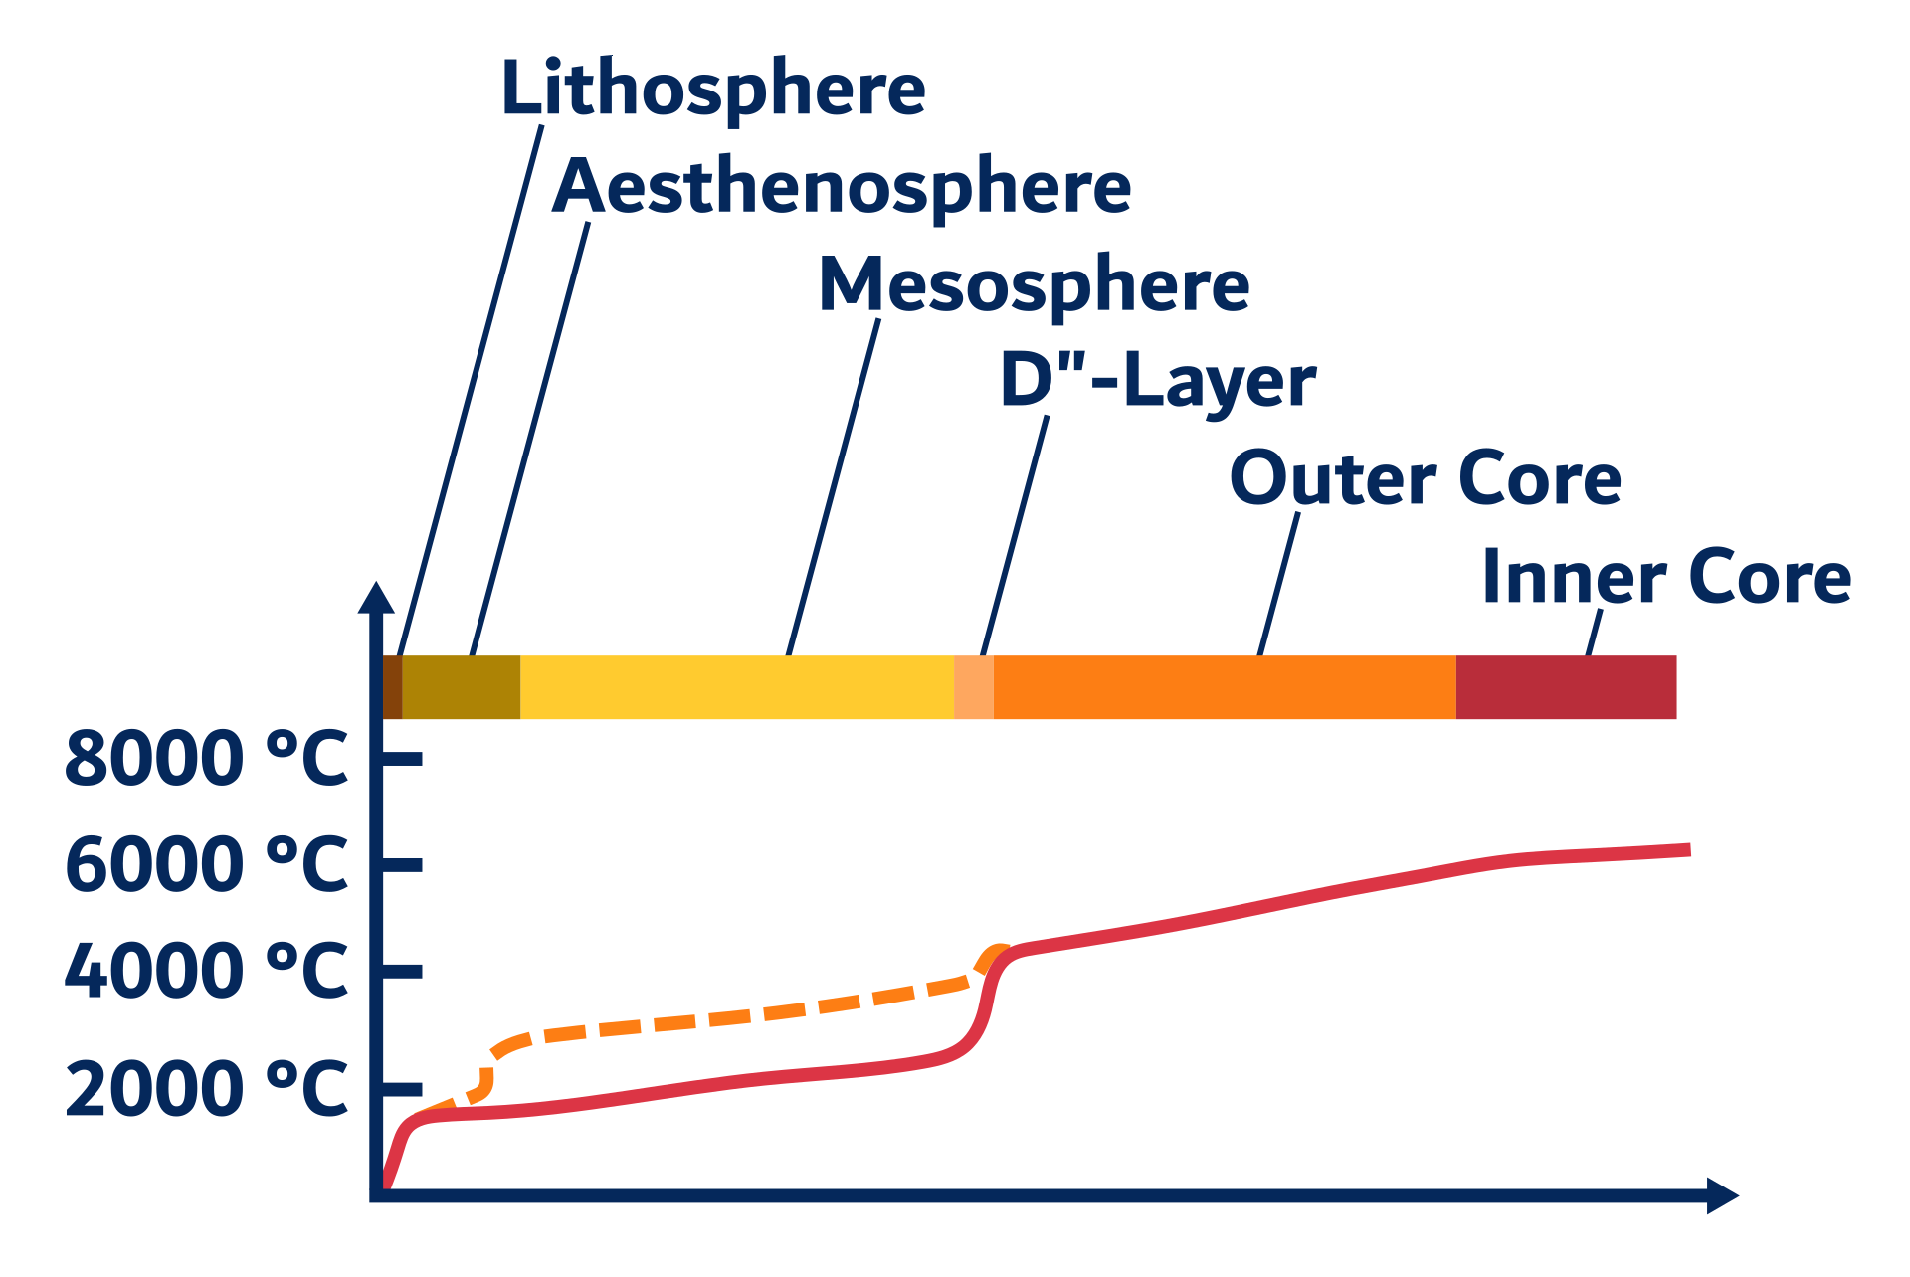
Mantle convection
Relatively strong temperature gradient exists between the surface and the core.

Slide 20
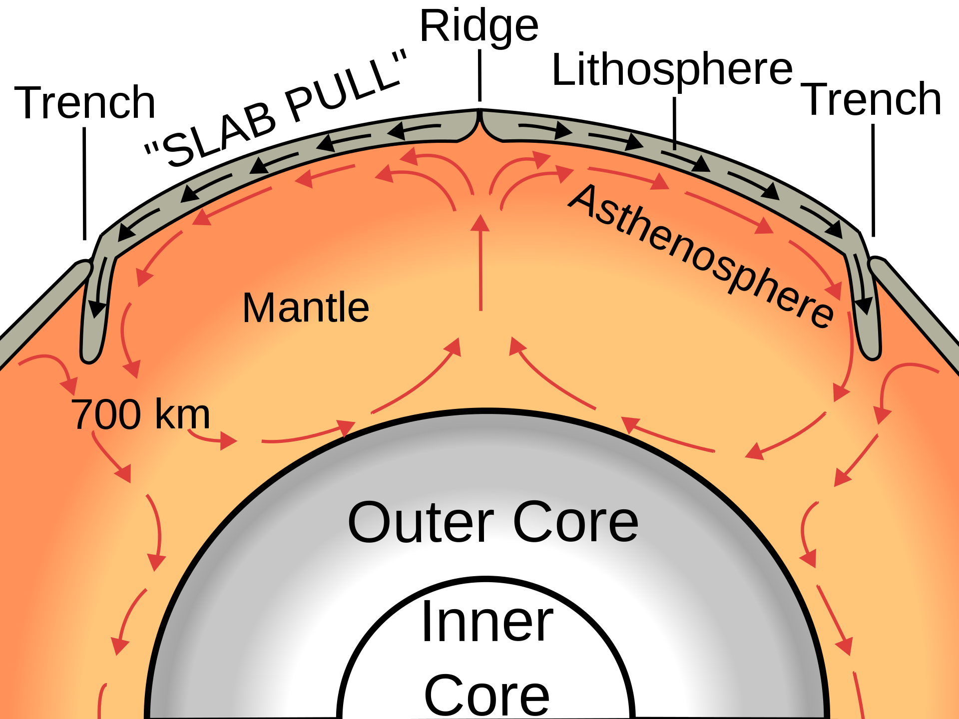
Currents in the mantle. Not remotely to scale

Slide 21
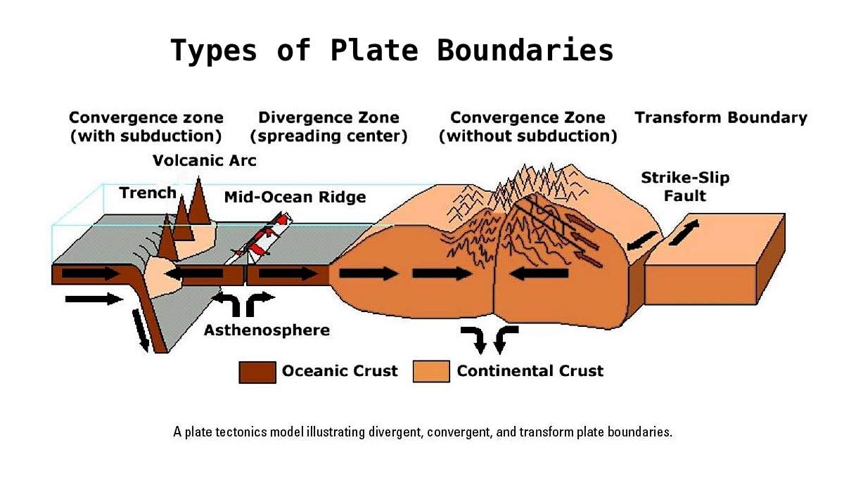
Three types of plate boundary

Slide 22
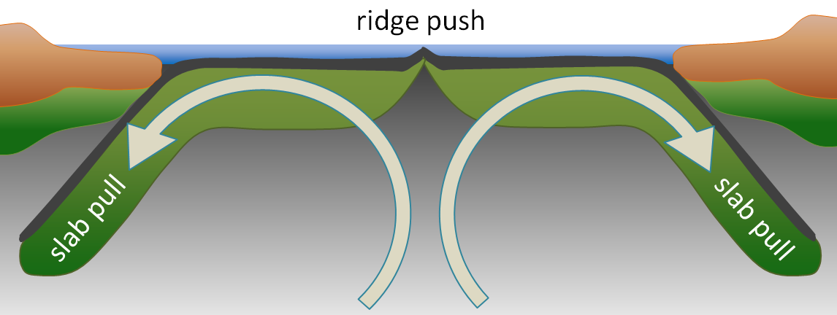
Image: Steve Earle, Physical Geography 2nd ed

Slide 23
Plate boundaries
Convergent: Plates come together. Two outcomes are possible
  One plate usually ends up getting pushed under the other (subduction)
    This allows the crust to be liquified and reabsorbed
  The plates are deformed and a mountain range forms.
Divergent: Plates coming apart. Results in formation of new crust as material from below reaches the surface and cools.
Transform: Motion is along the boundary rather than across it.

Slide 24
Faults
https://www.iris.edu/hq/inclass/animation/fault_types_3_basic_responses_to_stress_

Slide 25
Faults and plate boundaries
Transform boundaries make strike-slip faults
  Eg: San Andreas fault in California
    Responsible for San Francisco Earthquake
Convergent boundaries usually make reverse (aka thrust) faults
Divergent boundaries make normal faults

Slide 26
Earthquakes
All faults (as well as volcanic activity) can produce Earthquakes.
The strongest Earthquakes are produced by shallow angle subduction, presumably due to the large contact surface area

Slide 27
Seismology and Measurement
Richter scale: Original scale for Earthquakes
  No longer used, mainly because it dramatically underestimates energy of very large Earthquakes (Chile 1960 and Alaska 1964).
  Log scale, so there is a huge difference between say 7 and 8
Modern Scale for large quakes (>3.5): Moment Magnitude scale
  Definition is complicated.
  Still a log scale.
  Can be converted to energy relatively easily.
  Using this definition resulted in the Chile and Alaska quakes being measured as 10 times more energetic than original measurements. This fit with the damage they had done.
  9.0 corresponds to about 38,000 nuclear bombs, 10 would be 1,200,000

Slide 28
Local intensity measurement
Modified Mercalli scale: Gives an idea of how intense an Earthquake would feel at a specific point by measuring the amount of movement there.
  Still a log scale.
  Originally went from I to XII, but now goes from I to X+
    Only the Chile 1960 quake ever used XII

Slide 29
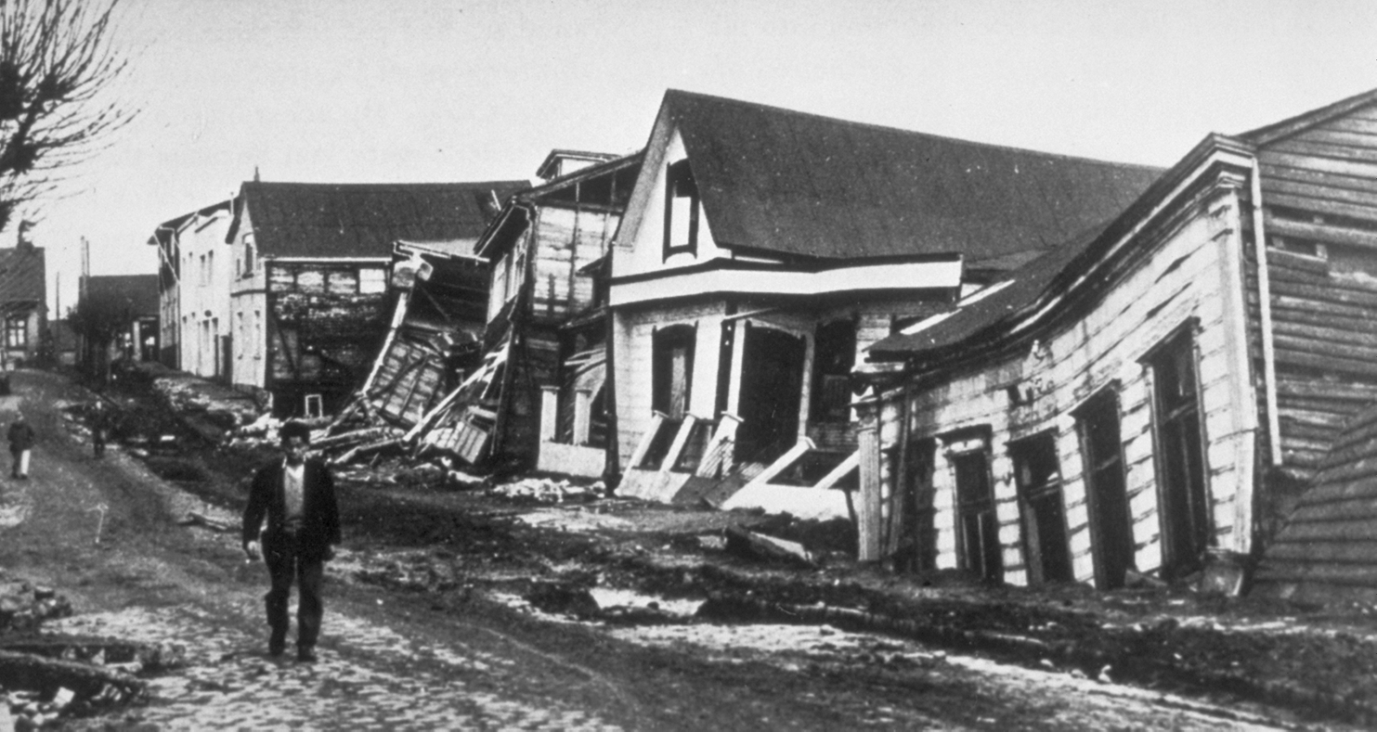
Chile 1960: 9.5 (XII)
Strongest: Chile 1960

Slide 30
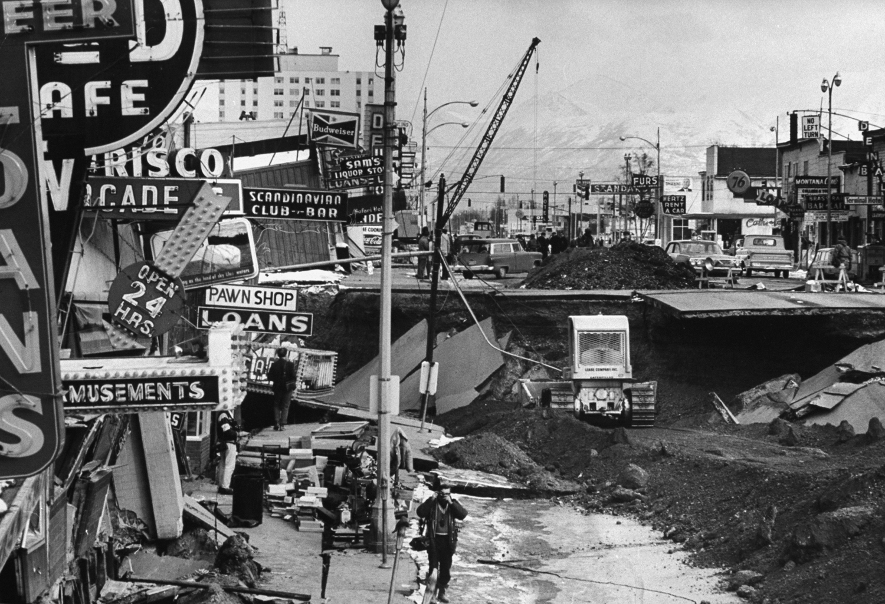
Alaska: 1964- 9.2 (XI)

Slide 31
Earthquakes: cause
Movement in a fault is not necessarily smooth
When a region gets caught, energy builds up
Eventually the rock fractures resulting in sudden release of the energy

Slide 32
Earthquakes: P and S waves
P(ressure) wave: A longitudinal wave that propagates very rapidly.
S(hear) wave: A transverse wave that propagates much more slowly, but causes much more damage.
How can we use these to learn about the structure of Earth?

Slide 33
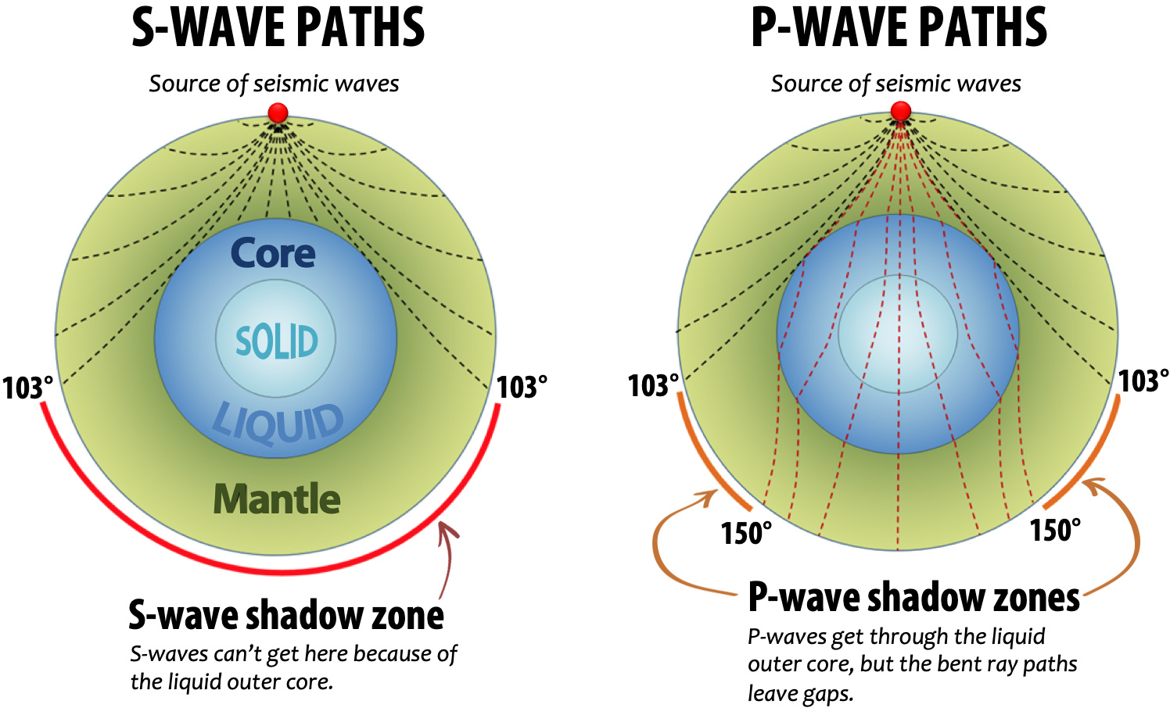
Proving the core is liquid

Slide 34
Importance of liquid mantle/outer core
Magnetic field: the formation of a large scale field requires liquid iron flows
  The magnetic field protects us from the Solar wind
    Without this protection our atmosphere would be stripped
Continental drift: The plates move because of currents in the liquid mantle
Volcanism: Mantle plumes allow superheated rock to rise up at specific points and create hotspots

Slide 35
Volcanoes
https://www.nps.gov/subjects/volcanoes/anatomy-of-a-volcano.htm

Slide 36
Shield Volcano
Very broad
Eruptions usually have almost no explosive power
Built up by slow flow of viscous lava
Examples:
  Hawaiian Islands
  Icelandic Volcanoes

Slide 37
Example: Kilauea
https://www.youtube.com/watch?v=6BdK2IEwtfU

Slide 38
Cinder Cone
Usually tens to hundreds of meters high
Explosiveness is between shield volcanoes and stratovolcanoes, but closer to shield volcanoes
Composed of ash and small rocks thrown out
Examples:
  Many (extinct) volcanoes in Arizona
  Most common type, but few famous examples

Slide 39
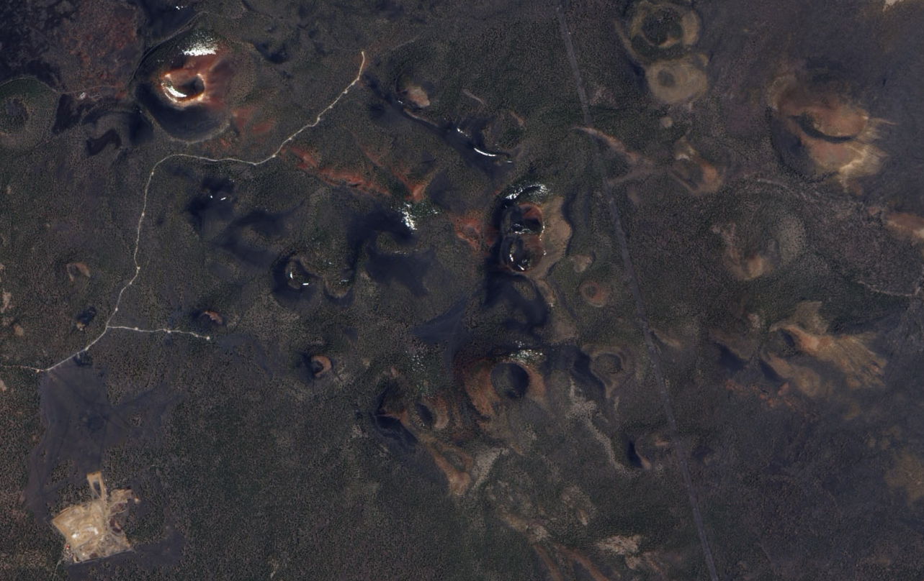
Cinder Cone Volcanoes in Arizona: Image, NASA

Slide 40
Stratovolcano (or composite volcano)
Formed from repeated lava and pyroclastic flows as well as lahars and rock slides (see later slides)
Take many eruptions to form
Generally large, very explosive. Most famous volcanic eruptions were stratovolcanoes
  Saint Helens
  Tambora
  Krakatoa

Slide 41
Example: Saint Helen
https://www.youtube.com/watch?v=AYla6q3is6w

Slide 42
Lava Domes
Small, form in or on the side of other volcanoes

Slide 43
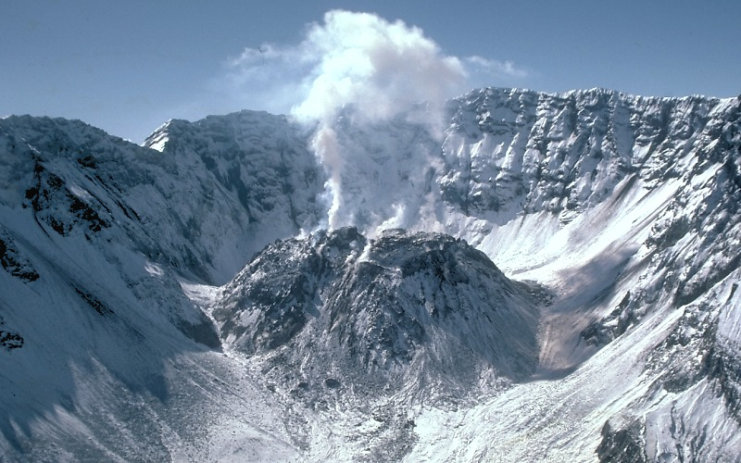
Lava Dome: Saint Helens, USGS 1984

Slide 44
Lahars
Mixture of water and debris that flows rapidly down snowy mountains during an eruption

Slide 45
Image: Large lahar, Redoubt Alaska, 2009, USGS

Slide 46
Pyroclastic Flows
Hot gasses ash, and other tephra (ie volcanic ejecta) combine to form a very rapid flow
Speeds can reach 700 km/hr, but are usually closer to 100km/hr
Temperatures range from 200-1000 Celsius

Slide 47
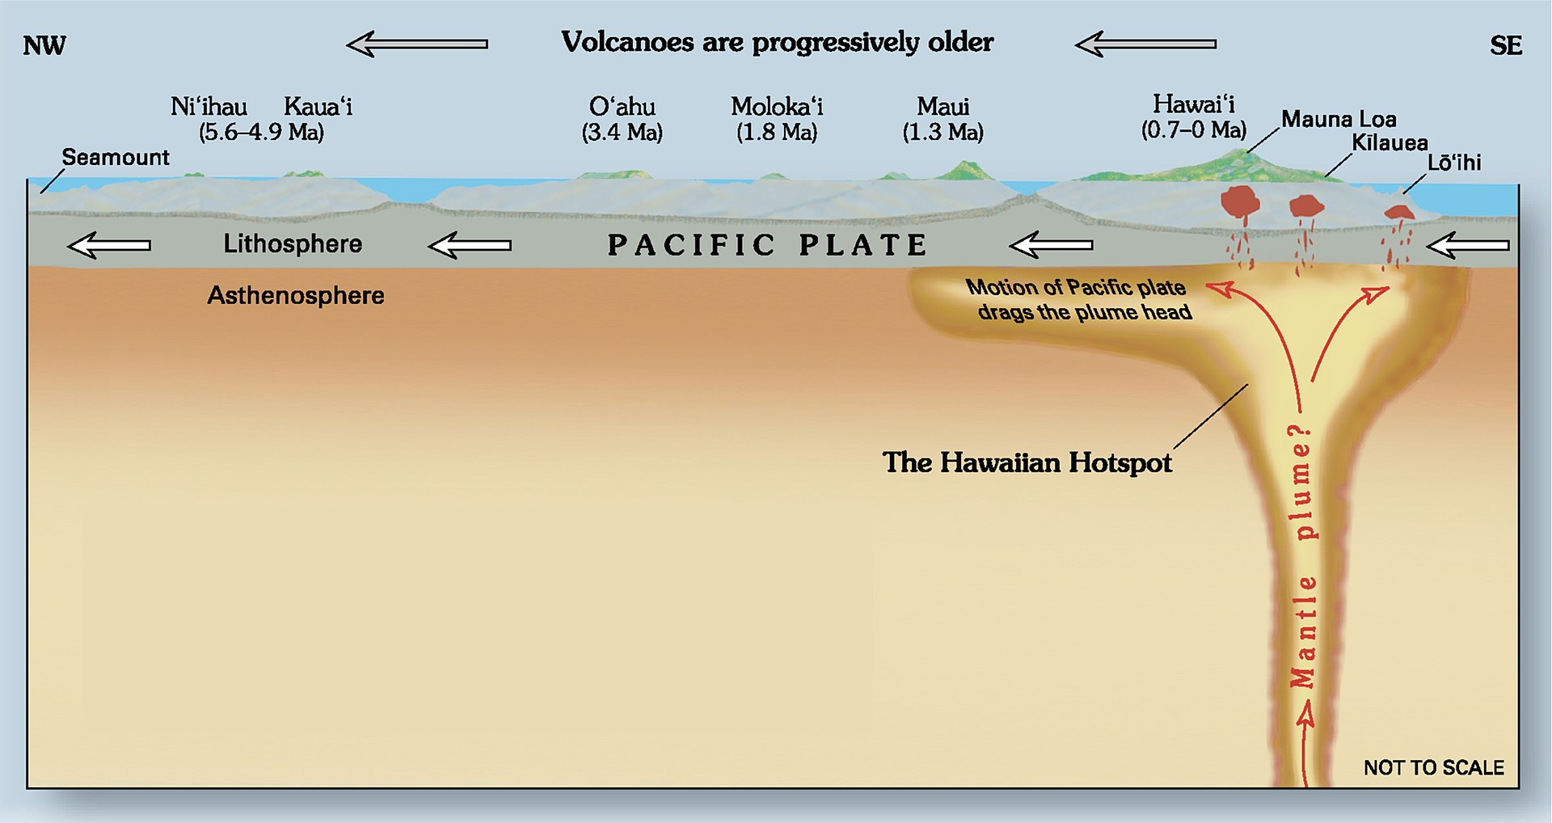
Hot spot Volcanoes

Slide 48
Environmental Effects of Volcanoes
Think of some!

Slide 49
Environmental Effects of Volcanoes: Positive
Brings nutrients to soil
Can create new land masses and unique environments
Particulate emissions may help cool Earth

Slide 50
Environmental Effects of Volcanoes: Negative
Can wipe out large populations if an eruption is abnormally explosive
Gas emissions are toxic and contribute to global warming
Large ashfall events disrupt travel and damage infrastructure
Volcanoes can be unpredictable, even if they haven’t been before (eg Kilauea, 2018 involved a new type of eruption caused by collapse of the caldera)

Slide 51
Rock types
Sedimentary: formed from weathered rock and/or organic sediment near the surface as a result of pressure from buildup of newer sediment
  Bituminous coal (low grade)
  Sandstone
Metamorphic: formed as a result of very high temperatures and pressures typically found near plate boundaries
  Anthracite coal (high grade)
Igneous: rock formed when magma cools below the surface, or when lava cools following an eruption
  Granite (intrusive)
  Basalt (extrusive)

Slide 52
Rock formation
https://education.nationalgeographic.org/resource/rock-cycle/#:~:text=There%20are%20three%20main%20types,part%20of%20the%20rock%20cycle.&text=Sedimentary%20rocks%20are%20formed%20from,existing%20rock%20or%20organic%20material.

Slide 53
Minerals and mining
Most mineable resources are not evenly distributed.
Why?

Slide 54
How deposits form
Gold, silver, platinum… are all very heavy, and sank in the liquid primordial earth.
Diamond, sapphire… require high temperatures and pressures to form. Doesn’t happen on the surface.
Volcanoes, mountain formation, superheated water, bring them near the surface of Earth.
Coal formation requires long timescales, and moderate temperatures and pressures. It also doesn’t happen on the surface, but is usually close.

Slide 55
Surface Mining
Strip mining:
  Used when the deposit is mostly horizontal (often for coal)
  Involves removal of a long strip of material over the substance to be mined.
  Unwanted rubble (called overburden) is then dumped into the hole created by the previous strip
Mountaintop removal
  Top of mountain is removed with explosives to expose material (usually coal)
  Has major environmental impact on forests, streams, and human life
    Nearby rivers/lakes get high concentrations of toxic minerals
      Selinium, sulfuric acid
    Airborne minerals seriously affect air quality nearby

Slide 56
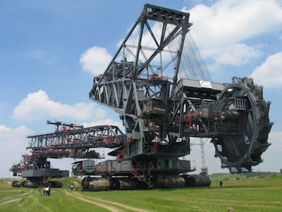
Bucket wheel excavator (31 million pounds)

Slide 57
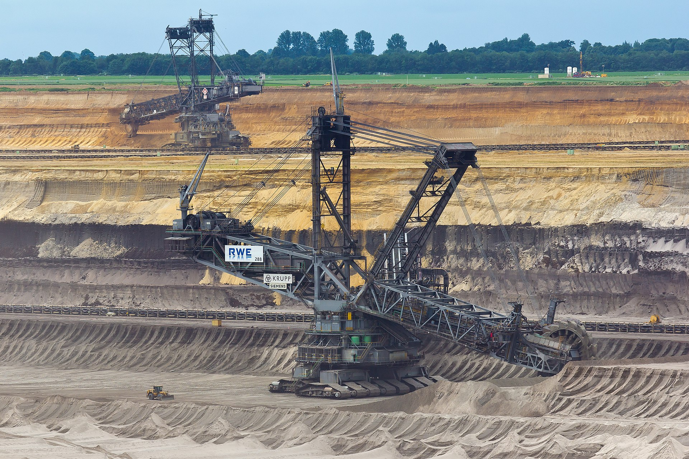
Bucket wheel excavator in use (Germany)

Slide 58
Surface mining continued
Open pit mine
  Wide variety of materials can be mined this way
    Uranium, coal, copper, marble…
Dredging
  Useful if the material is underwater or below the water table
  Mostly gold and other precious metals
  Large machine reaches into the water and pulls out a large amount of material, which is then sifted to separate the intended material

Slide 59
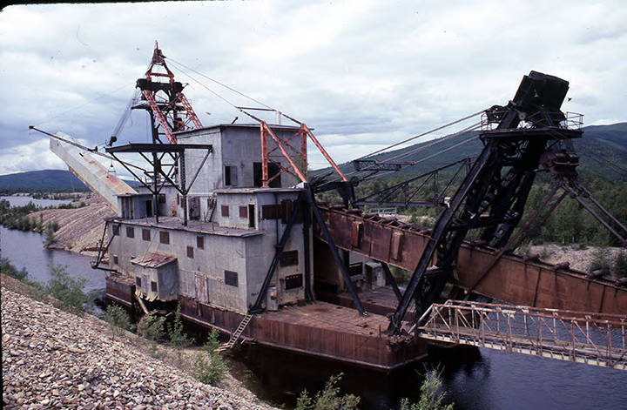
Abandoned gold dredge (Alaska)

Slide 60
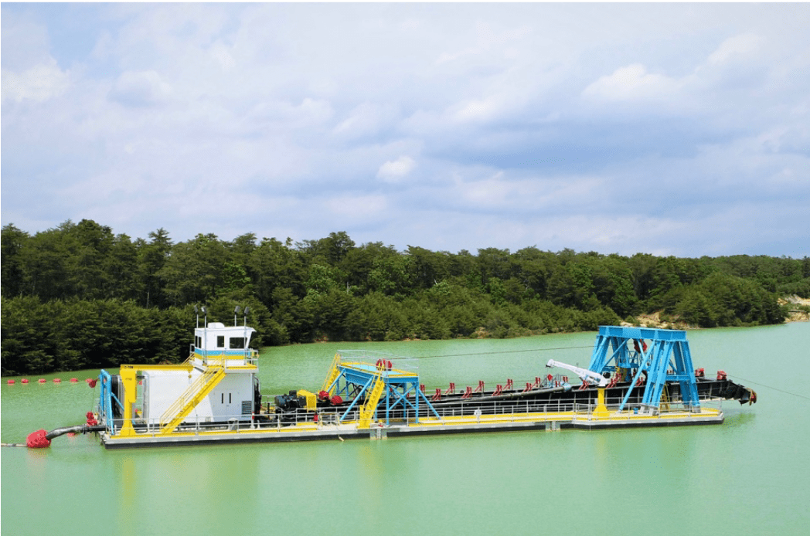
A modern silica dredge (New Jersey)

Slide 61
Subsurface mining
For softer rock, equipment can be brought underground that scrapes the needed material away and transports it to the surface
  An older, but still sometimes used method used explosives
For hard rock, explosives are still usually used, but the exact methods are relatively specific to the terrain and material

Slide 62
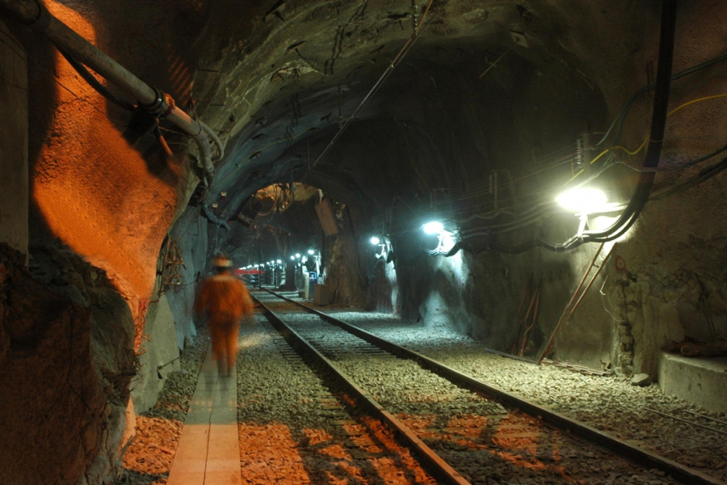
Subsurface Mine: Source, Cecelia Jamasmie

Slide 63
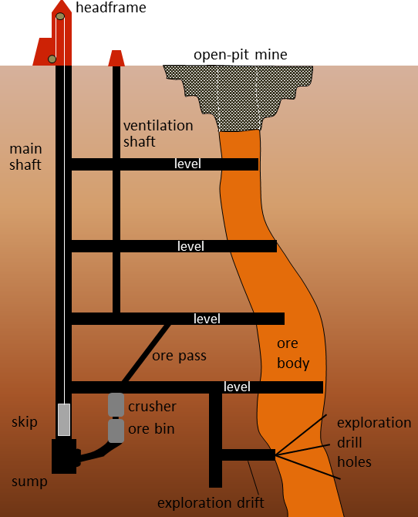
A schematic Subsurface Mine

Slide 64
Environmental concerns- general
All mining involves some damage to ecosystem
All mining involves some toxic byproducts
Mining is accessing a non-renewable resource

Slide 65
Case study- Gold mining
The process of gold extraction involves submerging the crushed rock in a cyanide solution, which dissolves the gold.
  If released into the environment, causes serious damage to ecosystem
    Relatively rare in first world countries today due to regulations
Left over rock, which is highly acidic and still usually contains cyanide, arsenic, and other toxins, is stored in a tailing pond behind a dam
  The dam can fail, releasing these into waterways. This is called acid mine drainage.
    Results in the death of most living things in the waterway.
    Cleanup is very difficult and often involves neutralizing the acid.

Slide 66
Acid mine drainage
Can be VERY acidic, lowest recorded ph: -3.6
  https://pubs.usgs.gov/publication/70022523

Slide 67
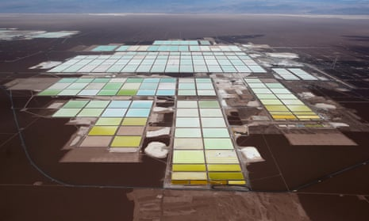
A lithium mine in Chile

Slide 68
Discussion questions

