Slide 1
Evolutionary Mechanisms

Slide 2
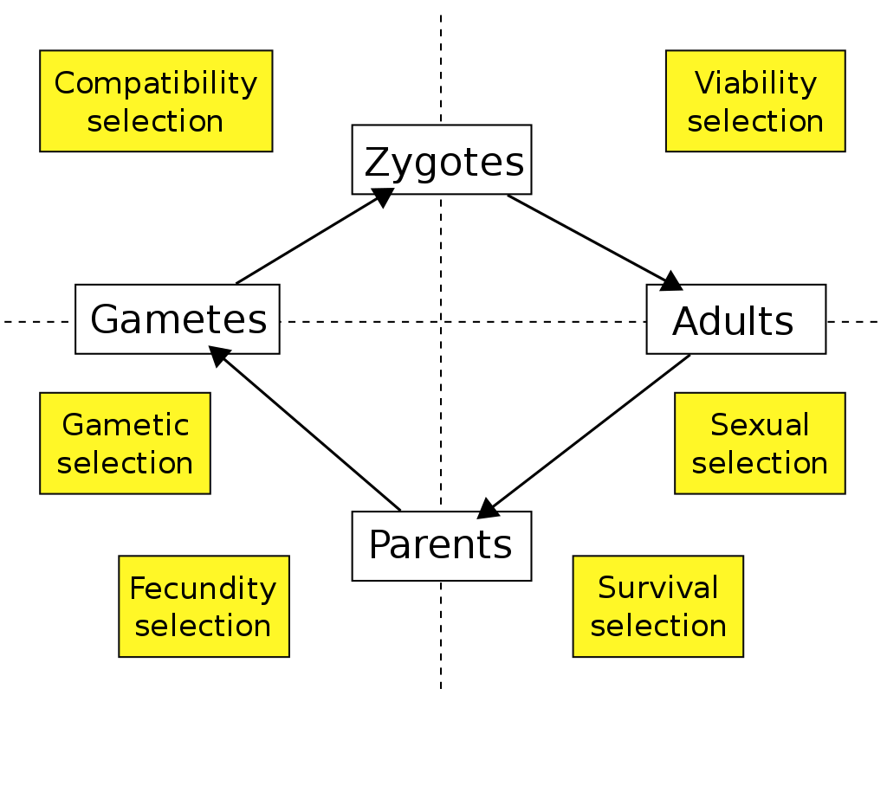
Natural selection (image: Wikipedia- Natural Selection)
Individuals more equipped to survive will be more likely to pass on genes
Works over many generations

Slide 3
Artificial selection
Intentional selection for traits in a species, usually by humans
Usually very fast compared with natural selection
Traits may not be beneficial (and may even be detrimental) to organism

Slide 4
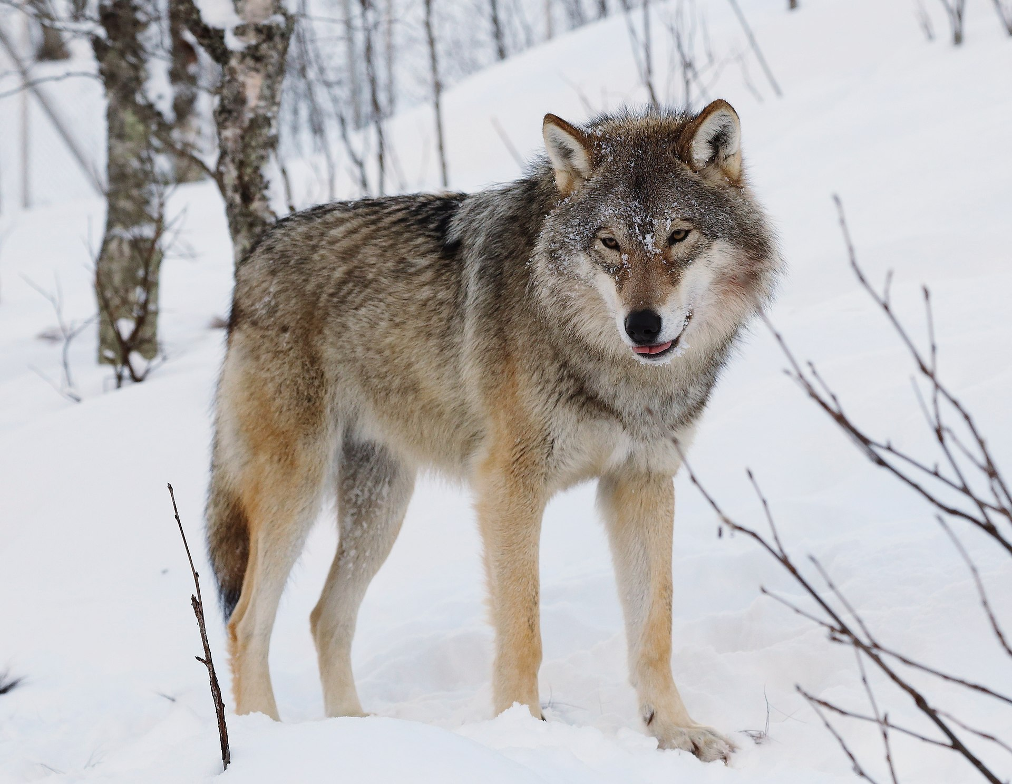
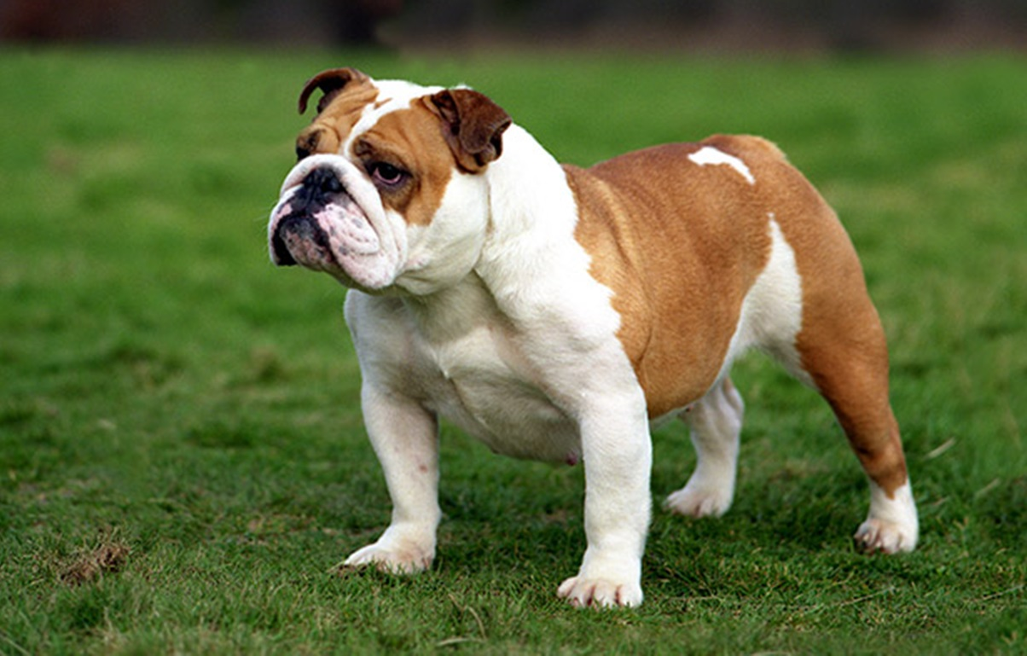
Both images: wikipedia

Slide 5
Mutation
Random process by which a new allele enters a population
Often DNA replication errors
Mutations are much more likely to be harmful than helpful

Slide 6
Genetic Drift
If no selection pressure exists for an allele, the allele frequency will change randomly
Causes: random mating, some illnesses, injury, etc

Slide 7
Gene Flow
New alleles may enter a population from another population
With large flow rates, can make two populations essentially the same

Slide 8
Bottleneck effect
If most of a population dies, alleles that were neutral or beneficial may disappear
Some bottlenecks involve strong selection for specific alleles (eg slow changes in climate)
Some bottlenecks result from events that kill nearly randomly so there is (almost) no selection (eg floods, fires)

Slide 9
Competing selection pressures
Often a trait will be very useful in some cases, but harmful in others.
Examples?

Slide 10
Founder Effect
If only a few individuals start a new population, that new population may be composed mostly or exclusively of alleles that were rare in the original population
Often happens with isolated islands.

Slide 11
Fixation and Loss
Only long term stable states for an allele are 0% and 100%
  Exception: Hetrozygote advantage (eg sickle cell anemia)
Generally genes that are more beneficial are more likely to be fixed
  Only statistically true…
    Why?

