Slide 1
Disease

Slide 2
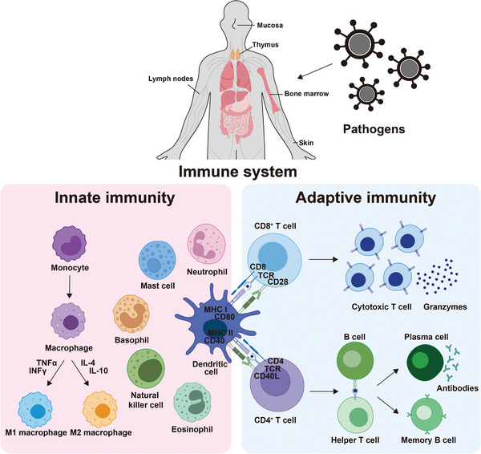
The immune system
Image: Park and Kim, Adv Healthc Mater 2025 Feb;14(5):e2304496. doi: 10.1002/adhm.202304496

Slide 3
Immunology 101 (very simplified!)
Three layers of defense
Passive barriers, chemical defense, and flushing action
Nonspecific immune system (aka innate)
  General defense against most pathogens
  Phagocytes kill bacteria and other foreign particles
  Natural Killer cells destroy compromised cells (tumor/virus cells)
Acquired immune system (aka adaptive)
  T cells look for antigens on the surface of cells
  The antigen is brought to the surface of the cell. Infected cells produce either unrecognizable antigens, or ones already known to be associated with a virus or bacteria
  Killer T cells kill other cells with incorrect antigens
  Helper T cells mediate the immune response and activate killer T cells
Read more about the immune system here https://aacijournal.biomedcentral.com/articles/10.1186/s13223-018-0278-1

Slide 4
Types of infectious disease:
Infectious (usually acute)
  Bacterial
  Viral
  Prion
  Parasitic
Non-infectious (usually chronic)
  Cancer (Usually, an exception is HPV induced cervical cancer)
  Cardiovascular (Often)
  Genetic/Epigenetic (Always?)
  Diabetes (Always?)

Slide 5
Virus Characteristics
Use the machinery of a host cell to replicate
Very small in size (typically hundreds of nm)
May be RNA or DNA based

Slide 6
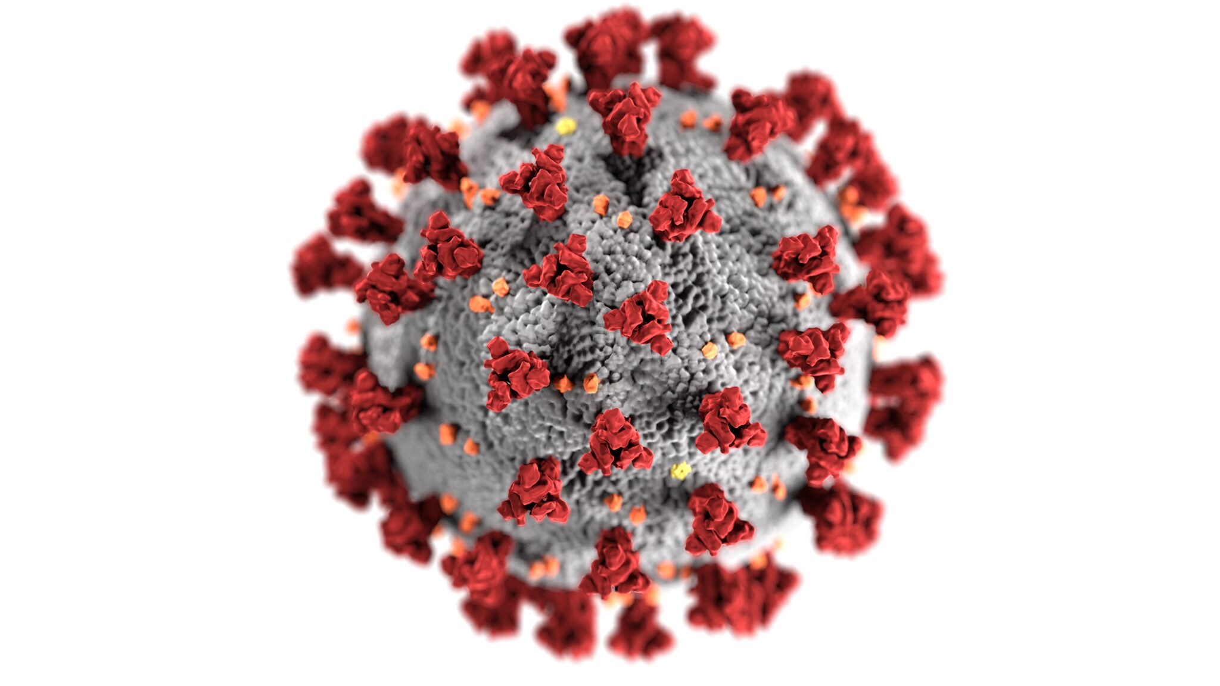
SARS-CoV-2, Eckert and Higgins, CDC

Slide 7
Coronaviruses
Rhinovirus (causes common cold)
  Plenty of more complex variations exist
Influenza (causes flu)
SARS-CoV and SARS-CoV-2 (cause SARS and COVID)
Most use a spike protein to cross cell membrane
  Structure of spike protein has some variance
Rapid mutation means that the antigen signature of the virus changes

Slide 8
Hemorrhagic fevers
Viruses that interfere with blood clotting
Many (e.g. ebola, marburg virus, yellow fever) lead to very serious disesases and have high fatality
Ebola
  Native to Africa
  Very lethal to humans and primates (about 50% fatality)
  A vaccine now exists

Slide 9
Retroviruses
HIV
  Targets macrophages and helper T cells (among others), for infection
  Results in the body slowly losing its ability to fight infection
  Uses reverse transcriptase to form a DNA strand out of RNA
  Used to be almost universally fatal
  Treated with anti-retroviral drugs e.g. RTI

Slide 10
Bacteria
Most aren’t harmful
Pathogenic strains are treated with antibiotics
  Result is that deaths from bacterial infections are relatively rare
Antibiotic resistance is increasing at an alarming rate
  https://www.cidrap.umn.edu/news-perspective/2021/04/who-report-highlights-shortage-new-antibiotics
    Finding new antibiotics has been a challenge
    Finally a totally new one may have been found in 2025

Slide 11
Prions
Abnormally formed proteins that reform proteins that they come in contact with
Poorly understood
Universally fatal, but takes years
Difficult to transmit between animals and humans, but is not killed by cooking
Some variants transmit easily through blood transfusion

Slide 12
Parasites
Usually from contaminated food/water (notably not malaria or skin parasites)
Mostly occur in developing countries

Slide 13
Toxicology terms
LD50: Dose lethal to 50% of individuals
LC50: Concentration that is lethal to 50% of individuals
ED50: Effective dose in 50% of individuals
NOAEL: No observed adverse affect level
NOEL: No observed effect level

Slide 14
Signaling mechanisms (very simplified!)
Slowest (hours to months): Hormones, receptor density changes
Medium (minutes to hours): neurotransmitters, hormones
Fastest (seconds or less): Electrochemical, neurotransmitter

Slide 15
Neurotransmitters (very simplified!)
Dopamine: Motivation
Serotonin
  In brain: attachment, well being, antidepressive effects, hallucination (5HT2A)
  Outside brain: Temperature, eating, sleep…
Acetylcholine: Muscle activation, heart rate control,

Slide 16
Hormones:
Estrogen: Female sex hormone, but also has a role regulating water retention, muscle growth and blood pressure in men
Testosterone: Male sex hormone, but also has a role regulating muscle growth, aggression, and sex drive in women
Cortisol: Mediates stress response

Slide 17
Neurotoxins
Neurotoxins are chemical agents that directly of indirectly cause damage to the nervous system. Typically they do one of the following
  There are many ways that a substance can be neurotoxic, the details vary wildly
  Many beneficial medications are neurotoxic (especially at higher doses)
  Many neurotransmitters are neurotoxic (especially at elevated concentration)

Slide 18
Chemical neurotoxins
Pesticides
  Acetylcholinesterase inhibitors: Cause damage by allowing excessive acetylcholine to build up in the synaptic cleft which leads to damage from over activation of the associated neurons. Note that the neutoroxic damage is not really responsible for the lethal effects
    The most toxic examples have LD50 of ~1mg/kg orally
Bacteria
  Botulism toxin is the most toxic substance known (LD-50 ~10ng/kg by inhalation). It works by destroying SNARE proteins associated with the release of acetylcholine. This prevents any release from occurring, leading to paralysis and death by respiratory depression.

Slide 19
Heavy Metals
Water soluble mercury compounds
  Methylmercury: Created from mercury by microbes in the ocean and bio- magnifies. Very long biological half life (~50 days) and toxicity (LD50 ~20mg/kg)
  Dimethylmercury: Extremely toxic (LD50 <50mcg/kg). Found in the ocean in very small quantities. The origin remains unknown.
  Molecular mechanism of neurotoxicity remains unknown
Lead compounds
  Mostly from action of acidic water on lead pipes
    Example: Flint, Michigan
Arsenic:
  Mostly natural sources

Slide 20
Other neurotoxins
Dopamine
  Dopamine has several breakdown products that damage dopamine and serotonin neurons
Glutamate
  In high levels, glutamate causes cells to intake too many Ca2+ ions. This results in over-activation of proteins in the cell that damage it. (called excitotoxicity)
Amphetamines
  Releases dopamine and serotonin (already involves some neurotoxicity)
  Many have metobolites that are directly neurotoxic to dopaminergic or serotonergic neurons

Slide 21
Mutagens
Mutagens change DNA structure
Many lead to increases in cancer rates
Asbestos: Common insulation material in the 1970s. Fibers are highly carcinogenic.
Radon: Naturally occurring radioactive gas that is a decay product of radioactive isotopes (notably radium).

Slide 22
Teratogens
Interfere with normal fetal development, causing birth defects.
Alcohol: Leading cause of birth defects in USA
Pharmaceuticals: Many drugs act as teratogens.
  Thalidomide: Given to pregnant women as an anti-nausea drug in the 1950s. Led to lots of birth defects.

Slide 23
Endocrine disruptors
Drugs that mimic a hormone found in the body
Very often mimic estrogen
Phthalates: Chemicals used to make some plastic more pliable
  Mimic estrogen
  Being phased out
Many insecticides and herbicides (DDT, Atrazine,…)
Probably as a result of endocrine disruptors, males testosterone levels are rapidly declining
  https://www.urologytimes.com/view/testosterone-levels-show-steady-decrease-among-young-us-men

Slide 24
Discussion Questions
How can we objectively determine and represent the risk of something?
How should risk of environmental or human harm be balanced against availability of new products and what should the threshold be for removing an existing product from the market?
How should human risk be balanced against environmental risk?

Slide 25
Design an experiment to answer each question.
How much does penicillin resistance impact resistance to methicillin? (hard)
Which of 2 viruses is more deadly to mice? (easy)
Does a vaccine for Covid work in humans? (medium)

