Slide 1
Declining Biodiversity

Slide 2
Mass extinctions
5 times before
Ordovician: about 85% of species, 440 Million years ago, caused by an ice age
Devonian: about 70% of species, 375 million years ago, cause not definitively determined (loss of oxygen, ice age, volcanoes, meteors)
Permian: 70% of terrestrial and 80% of ocean life, 250 million years ago, cause unknown
Triassic/Jurrasic: 50% of species, 200 million years ago, caused by extreme volcanic activity leading to climate change, and other factors
K-PG: 75% of species, 65 million years ago, probably an asteroid impact and resulting sudden climate change

Slide 3
Mass extinctions
Most involve multiple changes
Climate change is a reoccurring theme

Slide 4
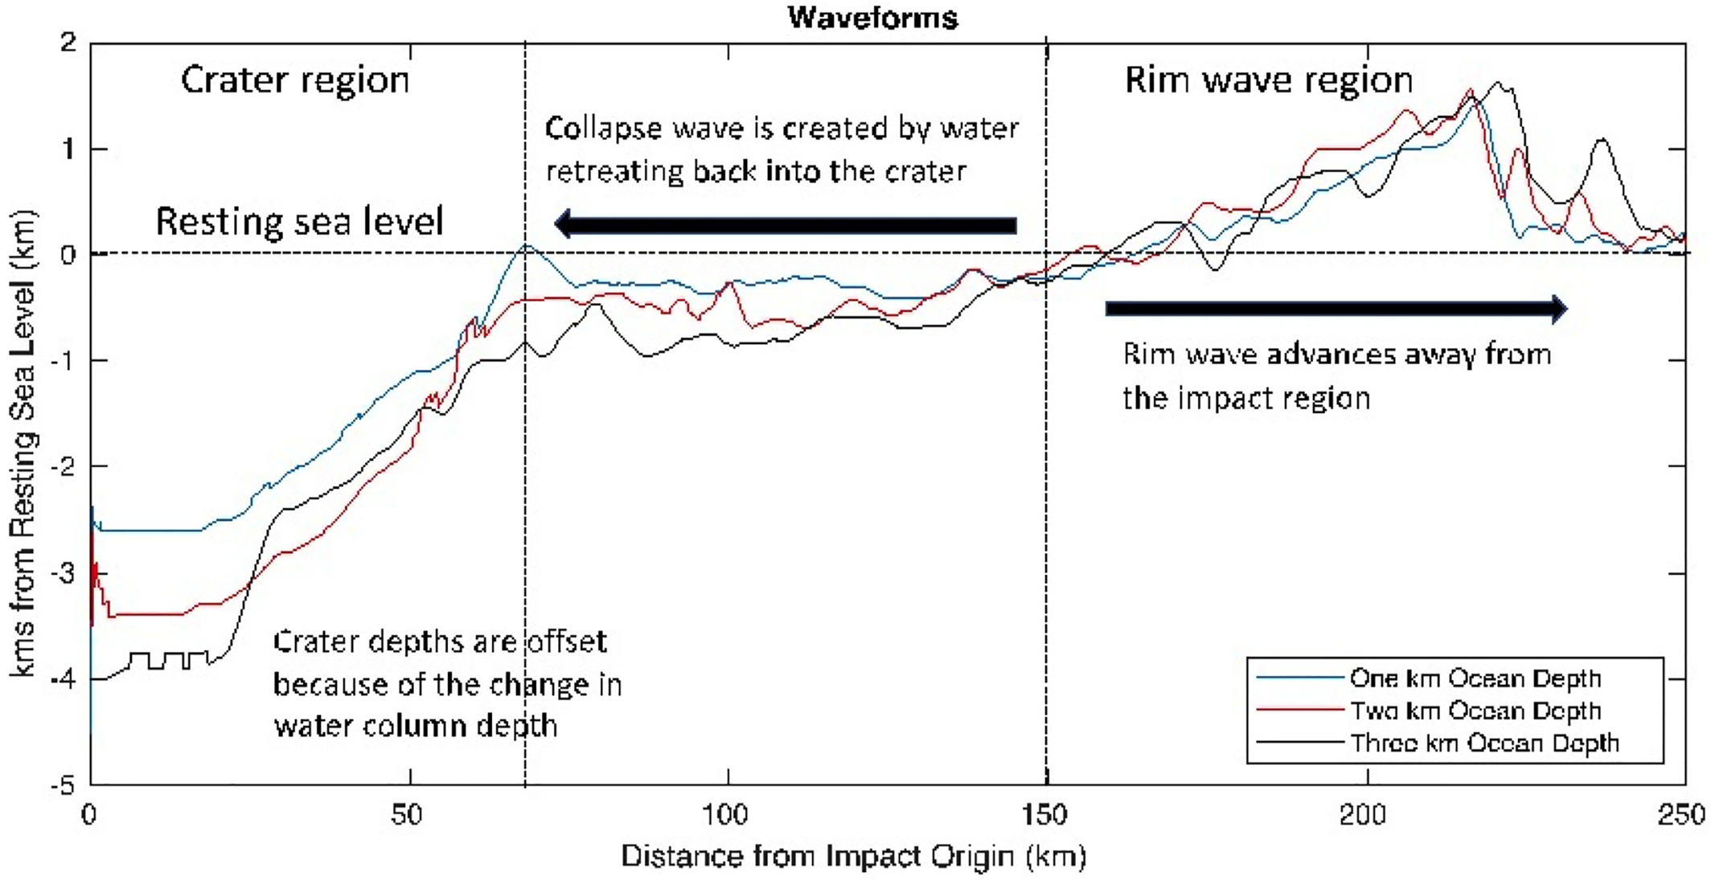
The K-PG extinction (in more detail)
10 km asteroid impact in Gulf of Mexico, releases 3E23 Joules of energy (for reference, Hiroshima was 6E13 J)
Creates a tsunami with a height of over 1 km (Range et al, 2022)

Slide 5
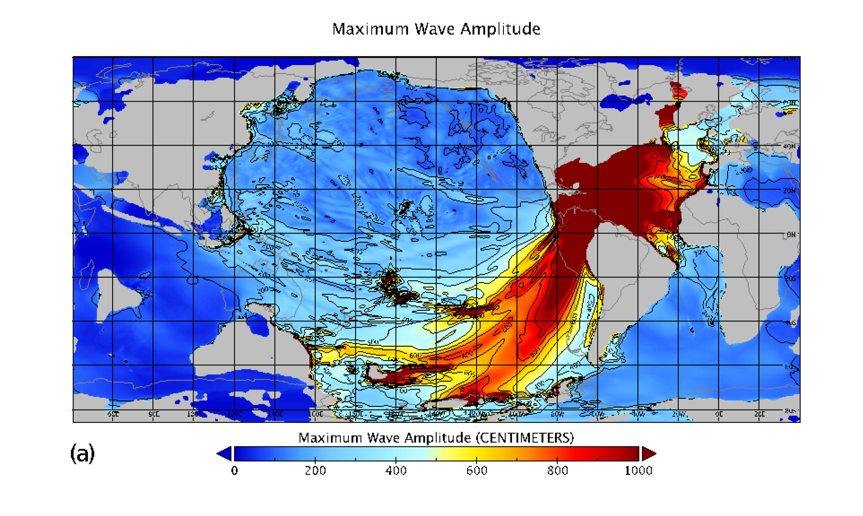
Tsunami amplitude

Slide 6
After effects
Atmospheric heating and intense IR emission burned forests at least across most of North and South America. Scientists disagree on whether this effect was worldwide
Combination of ash and ejecta would have blocked out the sun almost completely for months, dramatically lowering temperatures and killing most plant life
Climate warmed substantially after as a result of longer lived greenhouse gases and water vapor
Intense acid rain acidified the oceans

Slide 7
Issue with the main hypothesis
Other similarly sized impacts do not appear to have produced mass extinctions
Some evidence indicates a decline beginning shortly before the impact

Slide 8
Alternatives
Deccan traps may have been responsible:
  Problem: volcanism doesn’t seem sufficient to be responsible
Hybrid model
  Asteroid impact causes Deccan traps to become highly active
Multi-impact model
  Other craters appear to date to about the same time. It is possible that smaller impacts following the initial one resulted in more damage.
Asteroid impact is widely believed to have been involved

Slide 9
Permian extinction observations
Strong evidence of large shift in Carbon-12/Cabon-13 ratio
Strong evidence of an unusually slow recovery after the extinction
Extinction was probably relatively prolonged, ocean anoxia appears to have began at least 7-8 million years prior to PTB (1,2)
There were probably multiple separate anoxic events, they likely continued after the PTB (4)
Evidence of mutated tree spores during extinction era (3)
Nickel concentrations and isotropic ratios were dramatically different before and after the PTB, this could be a result of aerosolization of Ni compounds by volcanism (5)

Slide 10
Permian extinction hypotheses
Volcanism
  Cannot alone explain carbon shift
    Evidence that the volcanoes may have ignited large coal beds (1)
  Cannot explain anoxia 7 Myr before PTB
    May be longer lived
Microbial action driven warming
  Nickel is well known to be associated with increased action of methanogenic bacteria, this could have led to a period of extreme warming
Ozone depletion
  High UV flux is known to lead to mutations and sterilizations, tree spores are known to be sensitive to this (2)

Slide 11
Supervolcanoes
Definition: Has produced an eruption with at least 1000 cubic kilometers of ejecta
Cause complete devastation locally, and have major global impacts
Examples:
  Deccan Traps: giant volcanic feature in India, total volume of about 1 million cubic kilometers
  Toba: Believed to be responsible for the near extinction of early humans 70,000 years ago

Slide 12
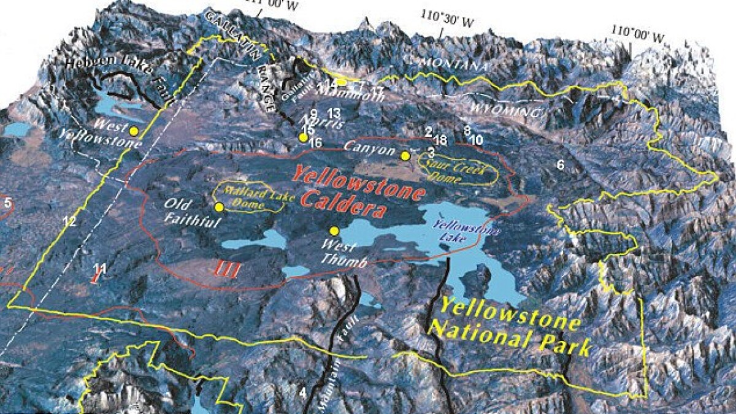
Yellowstone

Slide 13
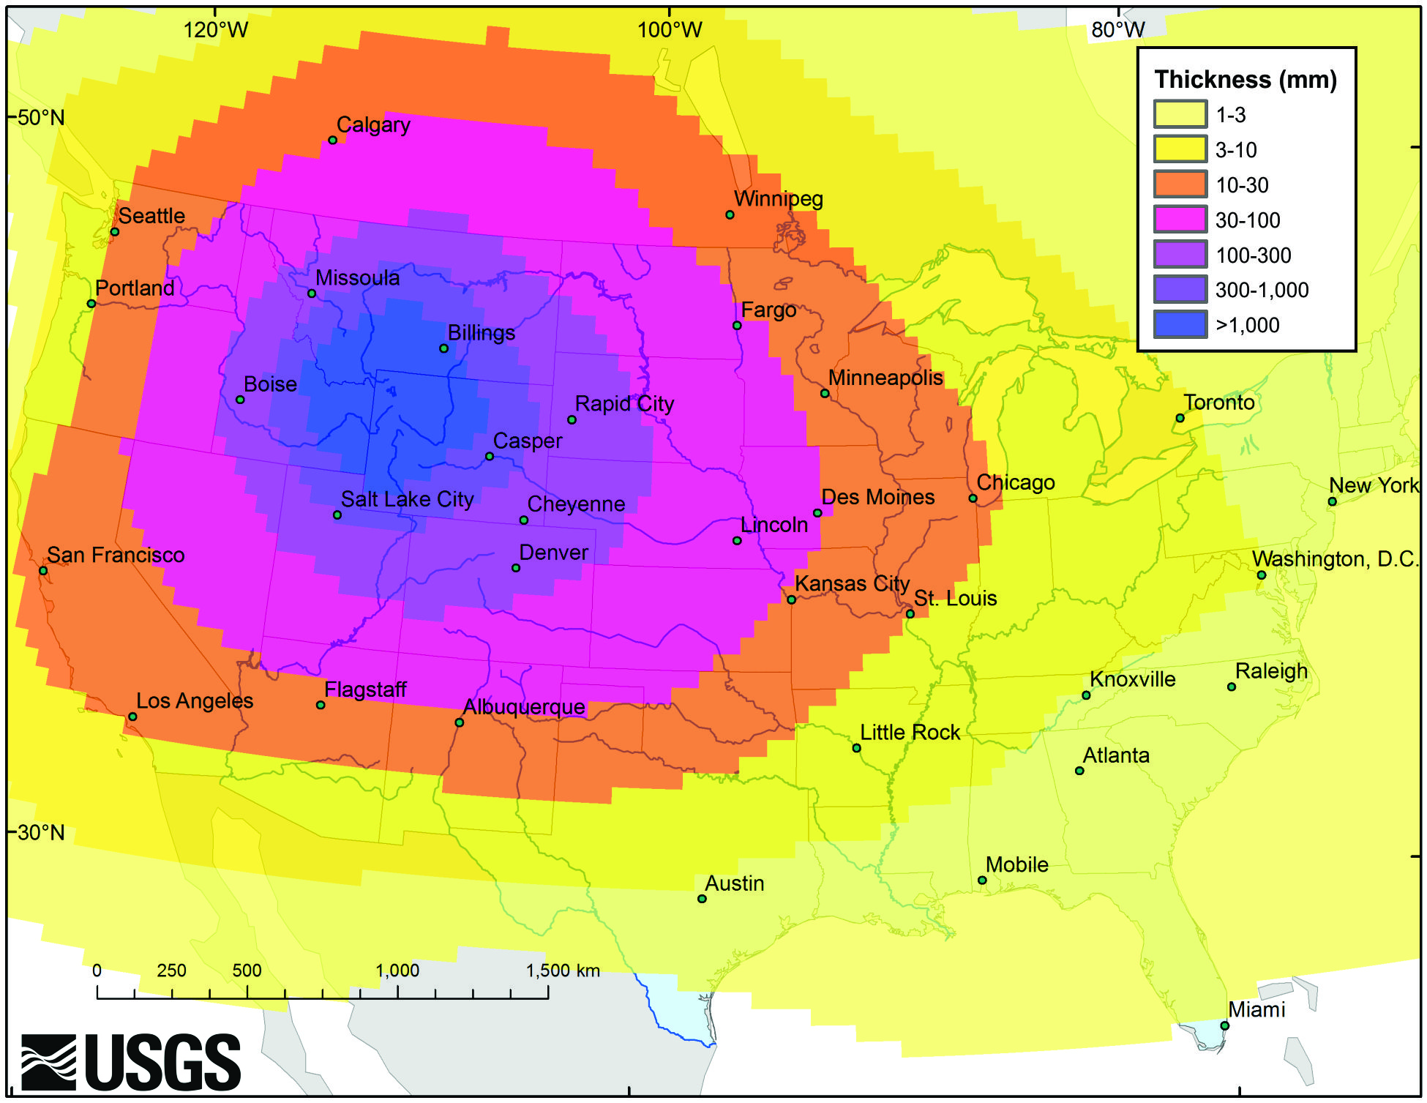
Predicted ashfall from Yellowstone
Note: Spokane received about 25mm of ash after Saint Helens and it took months to clean up

Slide 14
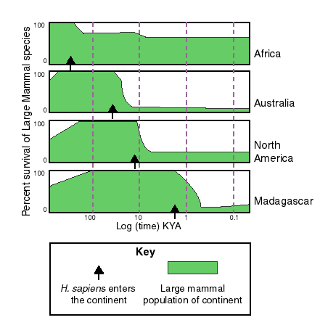
6th mass extinction (image: Wikipedia)
Many (but not all) scientists believe that the Earth is undergoing a 6th mass extinction, most would argue this is human caused
Evidence
  Genetic diversity is decreasing at a rapid rate
  Large species die-offs correspond with human activity

Slide 15
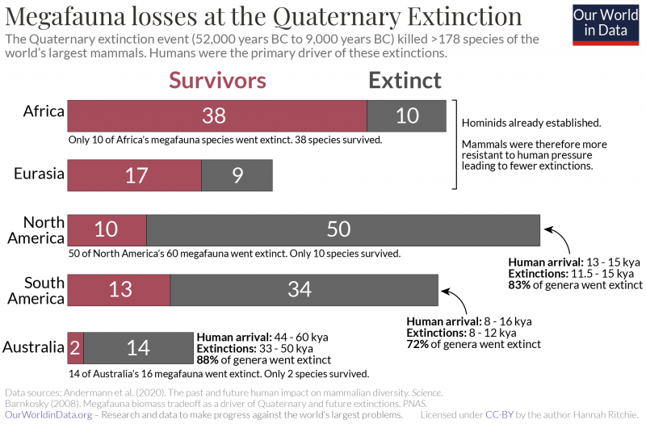
Quaternary extinction: Human caused?

Slide 16
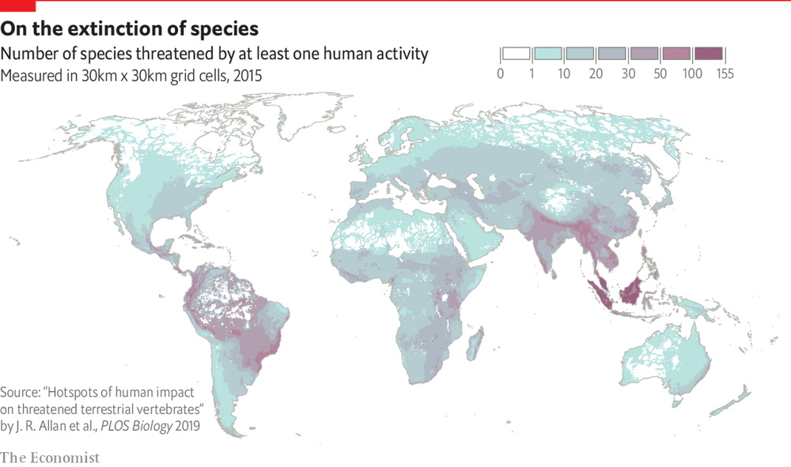
Animals are threatened all over the world

Slide 17
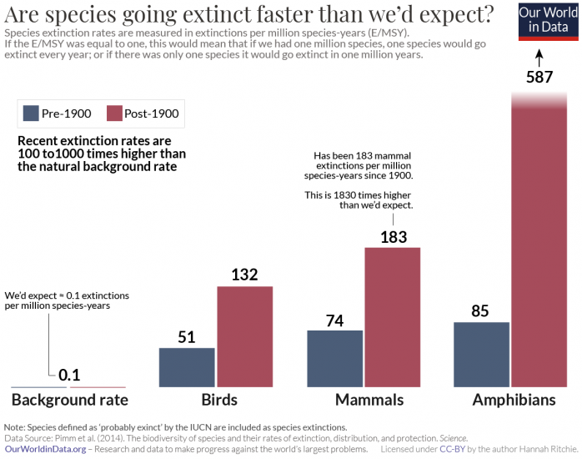

Slide 18
Reasons
Habitat loss/Change
  Melting sea ice
  Deforestation
  Dams
  Expansion of cities
  Mostly favor generalist species
Overharvesting
  Buffalo
  Atlantic salmon
Poaching
  Elephants
  Rhino

Slide 19
Reasons, continued
Pesticide toxicity
  Amphibians
  Fish
  Birds
Other pollution
  Acid rain lowers PH of water
  Air pollution has the same effects it does on humans
  Plastics
Natural factors

Slide 20
Nonlinear effects
Something that happens to one species will alter the fate of others
  Example: Bison
  High variability in great plains climate
  Large changes in carrying capacity
  Humans hunting
  Population plummeted
  Grass started to take over
  Reduced other biodiversity
    We don’t fully know the extent of this change
  Bison numbers are recovering
    Minimum number: 500
    Current number: 30,000

Slide 21
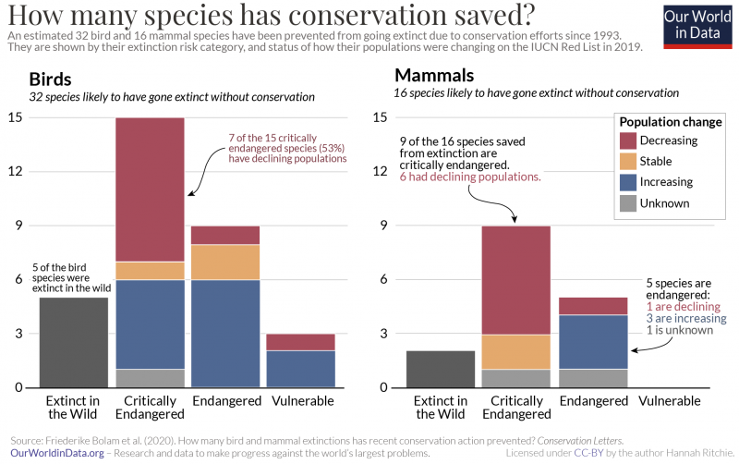
Conservation works… sort of

Slide 22
Further information
https://ourworldindata.org/extinctions
  Most of the graphs are taken from here. They did an excellent job at providing visualizations for data taken from research papers

Slide 23
The future
???
The future of Earth’s ecosystem is ultimately up to us.

