Slide 1
C,N,S Cycles

Slide 2
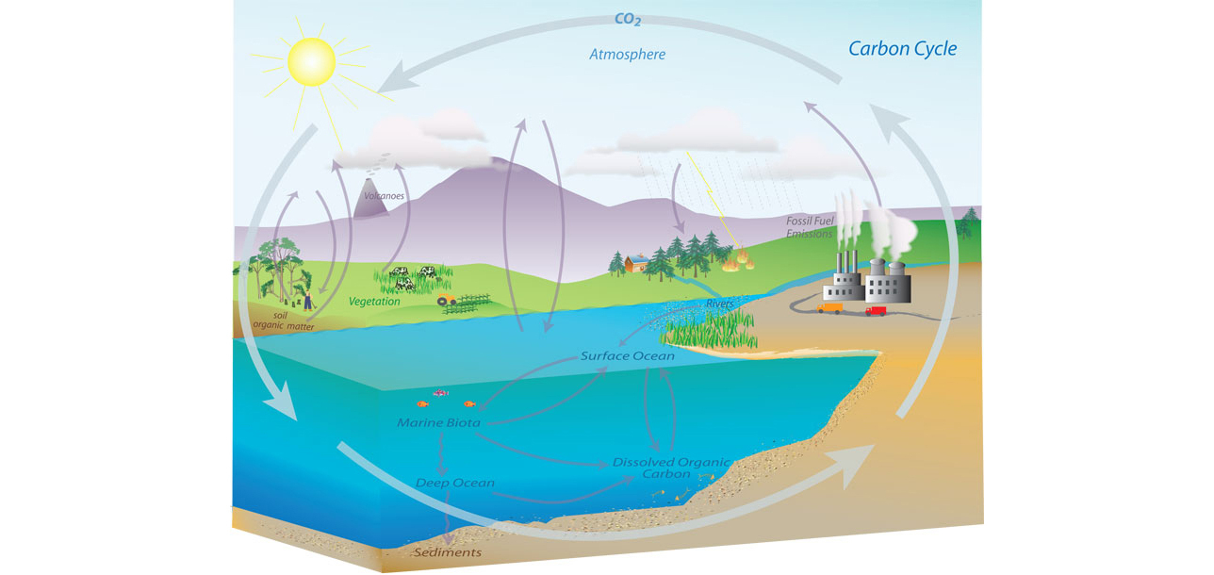
Carbon Cycle: Broad Overview (Image: NOAA)

Slide 3
Carbon Cycle: Components
Atmosphere: Carbon in the atmosphere
Terrestrial biosphere: carbon in living things
Ocean: carbon dissolved in the oceans
Geosphere: carbon stored in rocks

Slide 4
Terrestrial Biome/Atmosphere exchange
Photosynthesis
  Sun provides energy
  Atmosphere provides carbon dioxide
Cell respiration
  Glucose provides fuel
  Atmosphere supplies oxygen
Also possible for plants and animals to die and decay. Microbes will release the carbon in this instance, but it might be stored in soil for a while

Slide 5
Geological Carbon Exchange
Carbon dioxide combines with rain
Acid slowly dissolves rocks
  Most importantly calcium containing rocks, since this forms soluble calcium bicarbonate
Ca and Carbonate are used by marine organisms to form shells
When organisms die, carbon moves to sea floor
Some of that carbon is thrust back into the mantle

Slide 6
Other geologic carbon exchange
Geologic
  Fossil fuel formation can take carbon out of circulation for very long intervals of time
    Takes at least thousands of years
  Volcanoes can inject large amounts geological carbon into the atmosphere
Human caused
  Fossil fuels
  Net deforestation

Slide 7
Oceanic carbon cycle
Oceans absorb carbon dioxide from the atmosphere
  As of 2022, NOAA estimates 30% of CO2 released in atmosphere
Upper layer maintains (approximate) equilibrium with atmosphere on average, but not locally
The thermohaline circulation spreads inorganic carbon throughout the oceans, but acts on long timescales (100s to 1000s of years)
Solubility of carbon dioxide is moderately INVERSELY proportional to water temperature

Slide 8
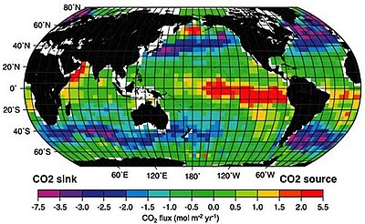
Oceanic carbon cycle (continued)
Like on land, cell respiration adds to the inorganic dissolved carbon in the oceans
Like on land, photosynthesis converts inorganic carbon into organic, which is then consumed
Animal wastes and decaying plants add to organic carbon components, which can be broken down into inorganic compounds again
Ocean surface constantly exchanges with atmosphere
  Image: wikipedia-oceanic carbon cycle

Slide 9
Questions
What is the implication of different exchange timescales for atmospheric CO2 budget?
Is burning fossil fuels different from burning a tree? Why or why not?
Do feedback mechanisms exist here? If so, what are they, and how might humans be modifying them?

Slide 10
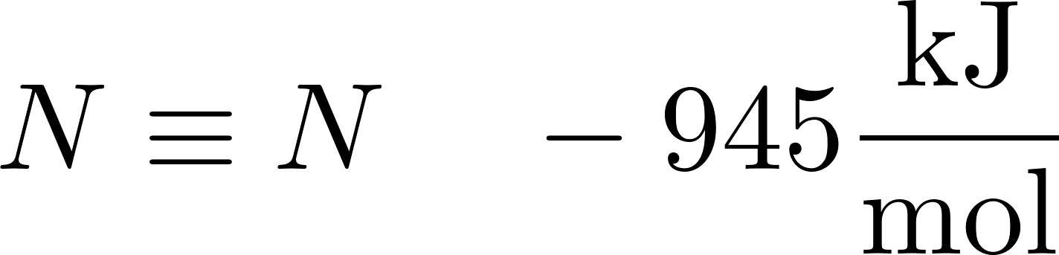
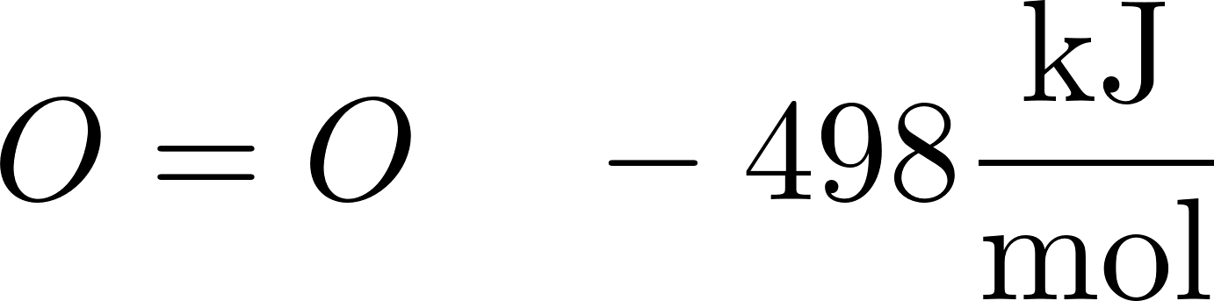
Nitrogen Cycle
All organisms need nitrogen
Bond energy of
  For comparison

Slide 11
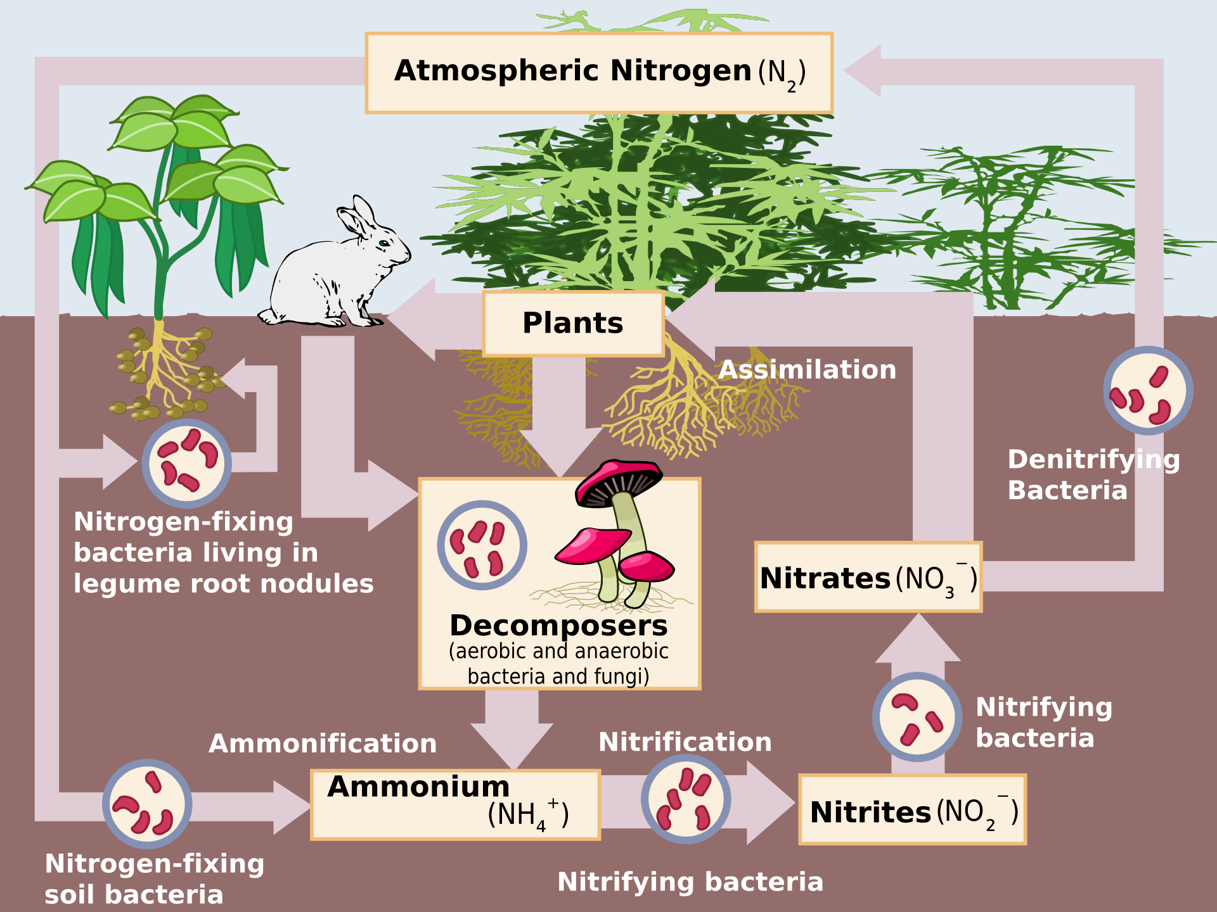

Slide 12
Nitrogen cycle: Fixation
Almost 80% of the air is Nitrogen
Plants need nitrogen to produce proteins/enzymes
Plants cannot absorb atmospheric nitrogen
Some bacteria (eg cyanobacteria) and archaea have nitrogenase
  Turn nitrogen into ammonia
  Ancient enzymes (predate modern atmospheric oxygen levels)
  Is permanently destroyed by oxygen exposure
Some plants have a symbiosis with nitrogen fixing bacteria
As of 2024, nitroplast organelles found in algae

Slide 13
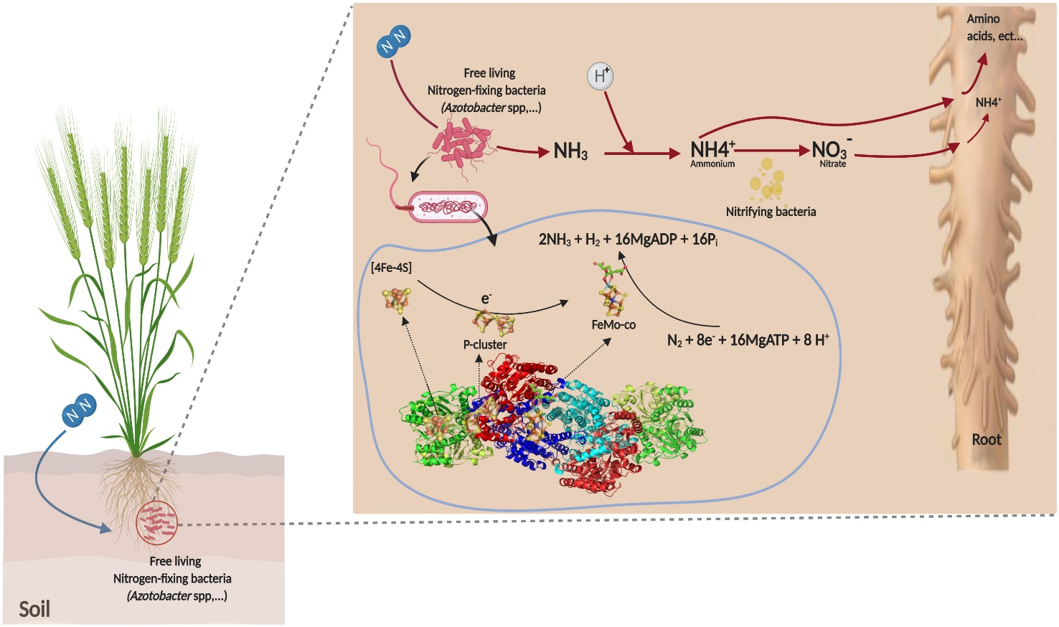
Nitrogenase in action (area of active research, very non-testable)
Image: REVIEW article Front. Microbiol., 25 February 2021
Sec. Microbiotechnology
Volume 12 - 2021 | https://doi.org/10.3389/fmicb.2021.628379

Slide 14
Synthetic Nitrogen fixation: Haber Process
Extract hydrogen, usually from methane
Extract and purify nitrogen from air
React hydrogen and nitrogen to produce ammonia
  Requires oxygen sensitive catalysts
  Ideally need very high temperatures (for reaction rate) and pressures (for equilibrium condition) to improve efficiency
  Hydrogen embrittlement accelerates at high temperatures and pressures
  Reaction is still inefficient and must be performed repeatedly with recycled gasses
Ammonia production accounts for about 2% of global energy use and 3% of carbon dioxide emissions

Slide 15
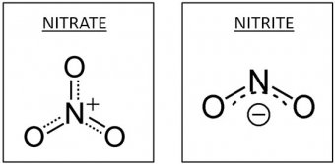
Nitrogen Cycle: nitrification
Ammonia is oxidized into nitrite
  Archea and bacteria (archea discovered 2005)
    Relevant Archea have larger populations in both terrestrial and aquatic regions.
      It is suspected, but not confirmed that their contribution to ammonia oxidation is larger
Nitrite is oxidized into nitrate
  Bacteria
Some bacteria do both in one step
  Discovered 2015
Image: California office of environmental hazard assessment (oehha.ca.gov)

Slide 16
Nitrogen cycle: Assimilation
Plants uptake the nitrate from soil and convert it back to ammonia. Nitrate is charged…

Slide 17
Nitrogen cycle: Assimilation
Plants uptake the nitrate from soil and convert it back to ammonia. Nitrate is charged, they must either
  Expel hydroxide ions
  Neutralize with acid and uptake metal ion
Nitrogen is used to synthesize proteins/enzymes
Plants die or are eaten and pass through animal
Proteins are broken down into ammonia and excreted as urea or uric acid

Slide 18
Nitrogen Cycle: Denitrification
Some bacteria can use nitrate instead of oxygen for cell respiration
The result produces nitrogen gas (and nitrous oxide)
A second mechanism involves anaerobic bacteria which are able to convert ammonia and nitrite into nitrogen gas and water
  Produces nitrogen gas
  The main mechanism of nitrogen removal from the oceans

Slide 19
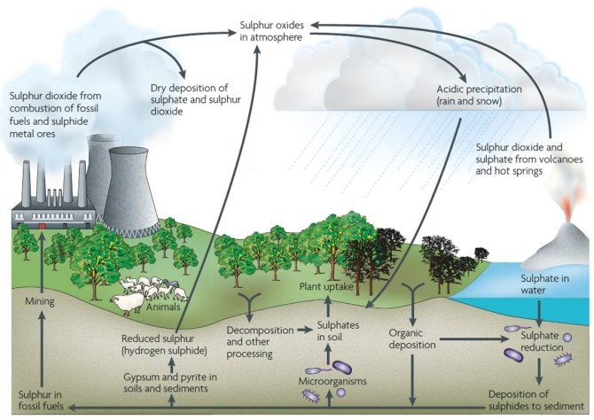
Image: Wageningen University, NL

Slide 20
Sulfur cycle (in brief)
Most sulfur in atmosphere is sulfur dioxide (somewhat poisonous)
  Or mixed with water as sulfuric acid
Sulfur enters atmosphere from
  Volcanoes
  Decaying material (as hydrogen sulfide)
    Poisonous
  Fossil fuels
  Oceans (as DMS)
DMS eventually becomes sulfur dioxide
Sulfur dioxide leads to cloud nucleation
Rain washes sulfur compounds into ocean, where phytoplankton can get to it
Some sulfur is deposited onto rocks and mineralizes, leaving circulation

Slide 21
Some Details
Some microbes can use sulfur (elemental, gypsum, or various oxides) as an electron acceptor, reducing it to form H₂S
  H₂S can react with metal ions to make insoluble metal sulfides
Other microbes can use sulfur as an electron donor to form sulfates

Slide 22
More sulfur stuff (optional…)
Sulfate to cysteine (plants, bacteria)
Cysteine to methionine
Methionine (from eg rotting stuff) to DMSP (by phytoplankton, bacteria)
DMSP to DMS (by phytoplankton, bacteria)
DMS to atmosphere (diffusion) or to DMSO (photochemical, or bacterial)
DMSO to DMS (bacteria) and to other products by poorly understood pathways
Atmospheric DMS to Sulfur dioxide (oxidation)
Atmospheric sulfur dioxide to sulfate (oxidation)

Slide 23
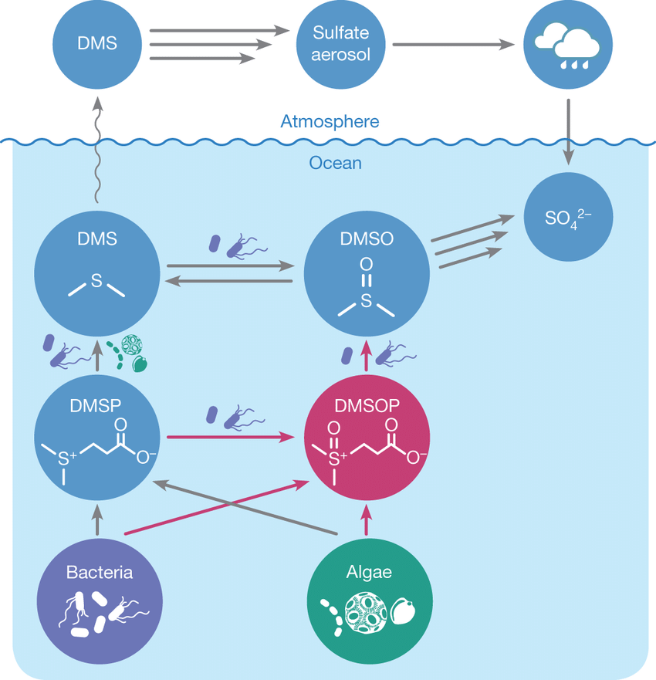
Sulfur in oceans (Thume et al, 2018)

Slide 24
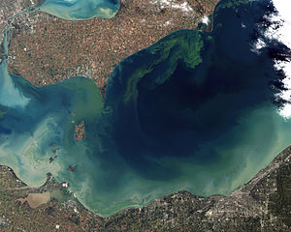
Phosphorus
No significant atmospheric effect (but dust storms seem to play a role in spreading)
Used for making DNA, ATP
Usually the limiting nutrient in pristine ecosystems
An algal bloom from space:
  (image from NOAA)

Slide 25
Atmospheric
Main component
  Carbon dioxide
Sources:
  Fires
  Volcanism
  Respiration
  Oceans (sometimes)
  Humans
Sinks
  Oceans (sometimes)
  Photosynthesis

Slide 26
Carbon cycle: atmospheric
Normally sources and sinks balance
Currently

