Slide 1
Localized Changes

Slide 2
Stability and Equilibrium
Equilibrium may be
  unstable (top of mountain)
  Locally Stable (crater at top of mountain)
  Globally stable (Marianas trench)
Ecological systems
  Global stability is rare or impossible
  More species -> better stability
    Some other species can likely take over if something happens

Slide 3
Ecological Tolerance
The range of conditions (temperature, rainfall…) that an organism can tolerate
Generalists have large ranges
Specialists have small ranges
  So… Why are their specialists?

Slide 4
Ecological Tolerance
The range of conditions (temperature, rainfall…) that an organism can tolerate
Generalists have large ranges
Specialists have narrow ranges, but usually outperform generalists when conditions stay close to what they evolved for

Slide 5
Tolerance and Change
No changes: Heavily favors specialists for the exact conditions present
Frequent, dramatic changes: Heavily favors generalists
Conclusion?

Slide 6
Disturbances: Thought experiment
Imagine a world that was in a perfectly constant state
  No change in weather, no viruses, no invasive species, no seasons, no days…
What would the species diversity look like?

Slide 7
Tolerance and Change
No changes: Heavily favors specialists for the exact conditions present
Frequent, dramatic changes: Heavily favors generalists
Intermediate levels of disturbance are likely optimal (usually… probably…)

Slide 8

Life is interconnected
https://www.nature.com/scitable/knowledge/library/food-web-concept-and-applications-84077181/

Slide 9
Habitat changes
Deforestation:
  Removes habitat
Flooding
  Changes habitat
What else can you think of?

Slide 10
Eliminating a species
Eliminating a single species may have anywhere from almost no effect to dramatic effect
Generally species with higher populations are more important for the balance of a given system
What attributes of a species might increase or decrease risk?

Slide 11
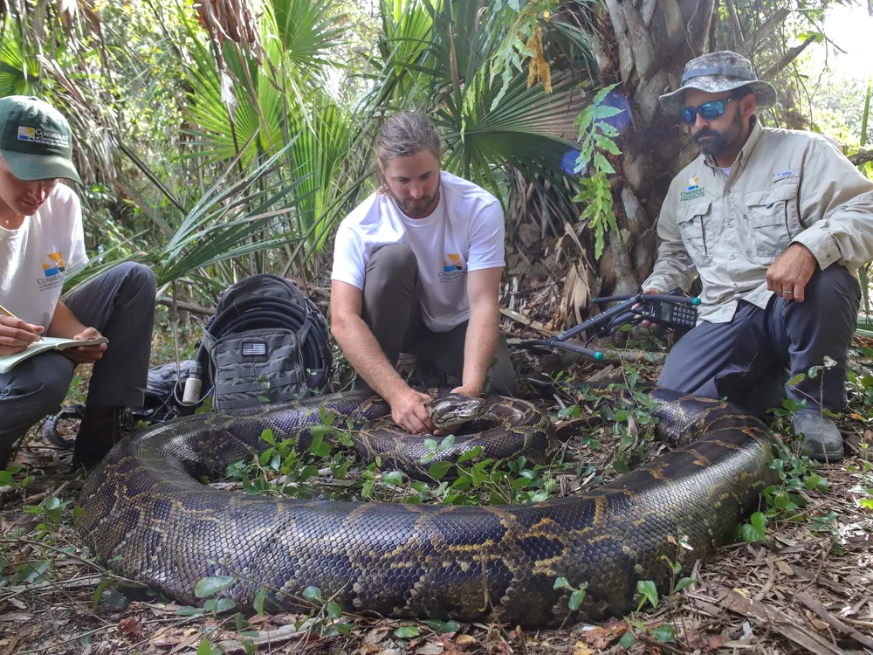
Adding a Species
May have no predators
Local fauna may have no defense against it
Pythons in Florida

Slide 12
Dealing with invasive species
Inserting a predator
  Hawaii introduced mongoose to combat rats
  Mongoose became a problem
  Modern predator control is better
Genetic modification
  Malaria containing mosquitos
What else might work?

Slide 13
Keystone Species
Generally small in number, but large in effect
Think: what if we eliminate a keystone species?

Slide 14
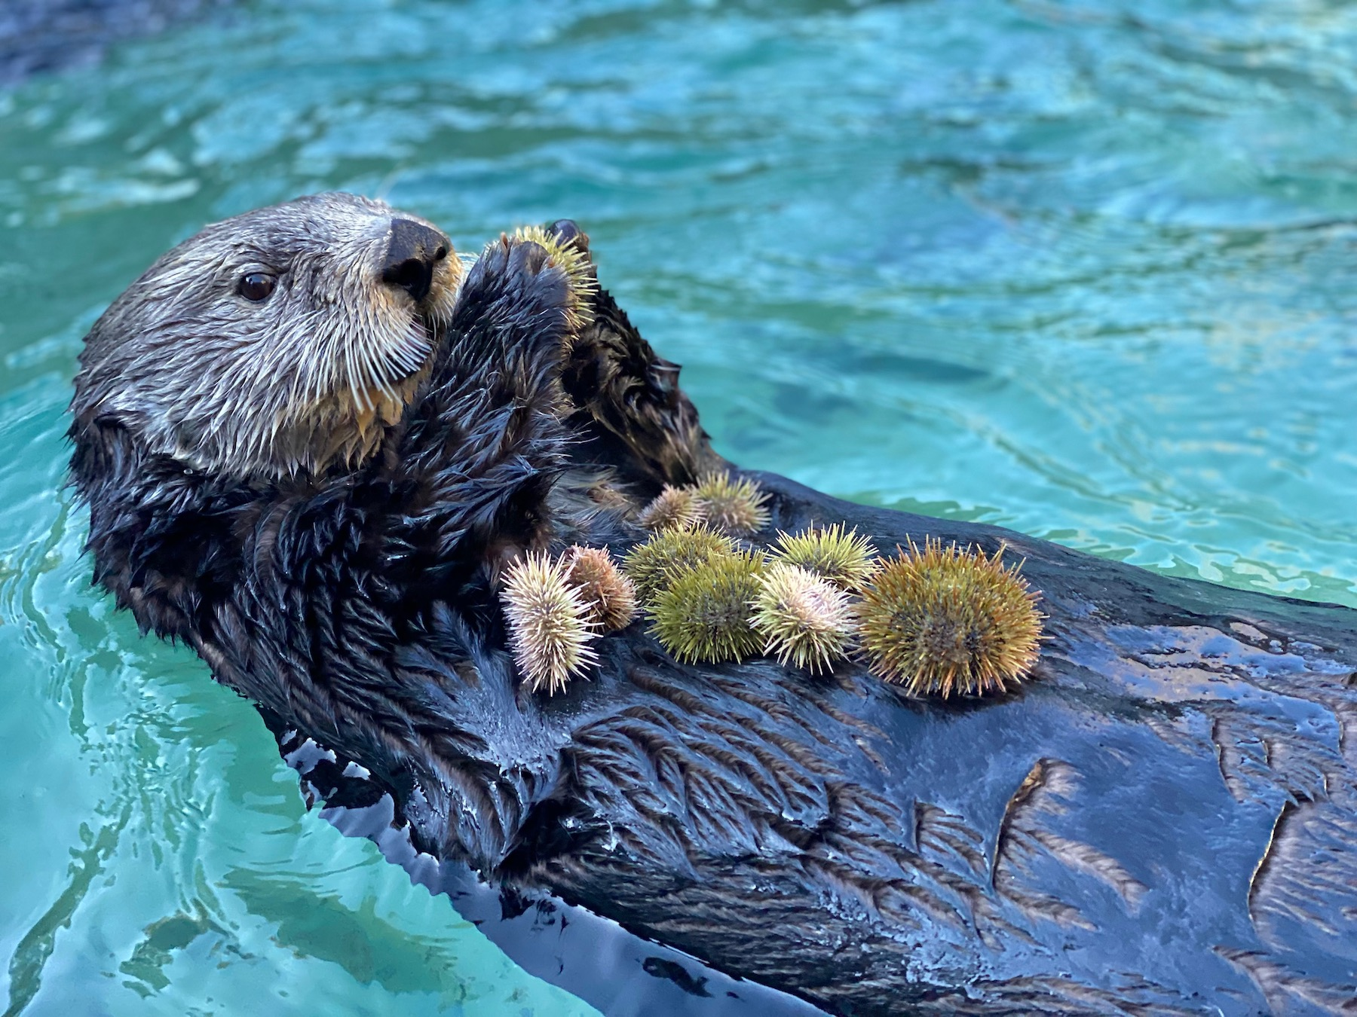
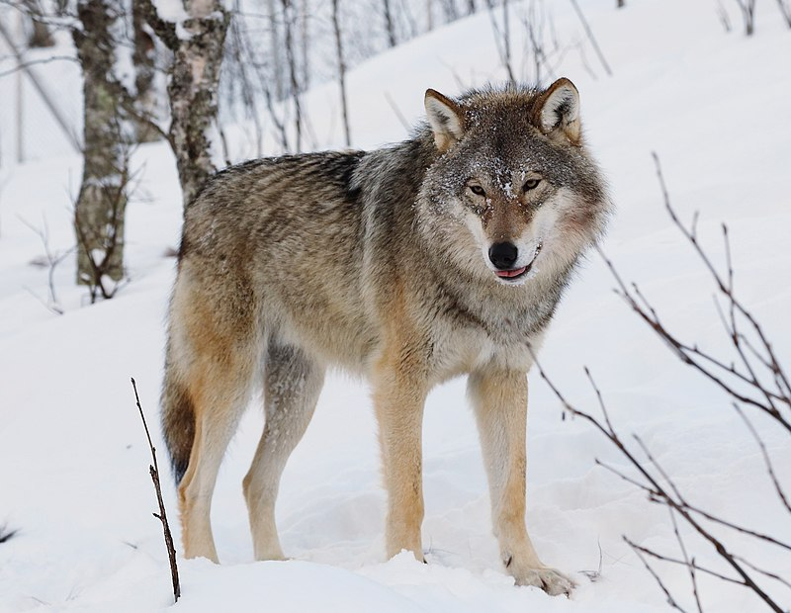
Keystone Predators: some species must be eaten…
Image: Juliana Kirkelie-Kim, UBC-Vancouver
Image: Wikipedia

Slide 15
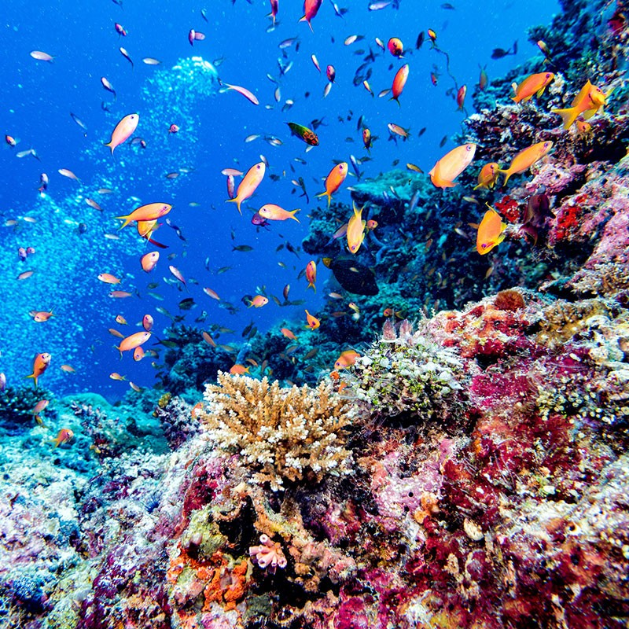
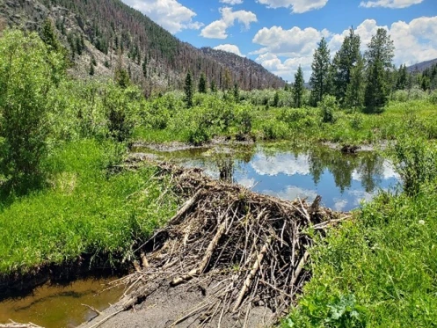
Ecosystem Engineers
Sarah Dunn, Geological Society of America
Image: Andrea Izzotti, London NHM

Slide 16
Species Richness
Definition: count of number of species
Generally high richness is good.
Time: Regions that have been relatively unchanged for longer times have more richness
Proximity: Especially for islands, distance from other sources of species for colonization

Slide 17
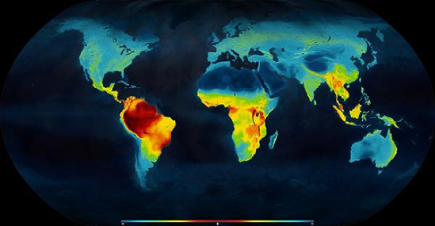
Species richness
Image Credit
What else might be important?

Slide 18
Other metrics
What other things might we like to know?

Slide 19
Other metrics
Species evenness: Relative abundance of species
  Generally a single organism having a very high relative abundance is bad
Net primary productivity
  Amount of new carbon added to plants per area per time
  https://neo.gsfc.nasa.gov/view.php?datasetId=MOD17A3H_Y_NPP
Amount of available nutrients per area
Extinction rate
Species diversity: metric for a combination of evenness and richness

Slide 20
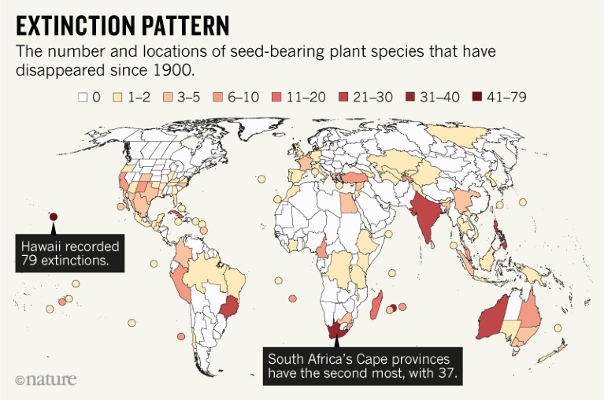
Extinction rate (image from Nature Magazine)

Slide 21
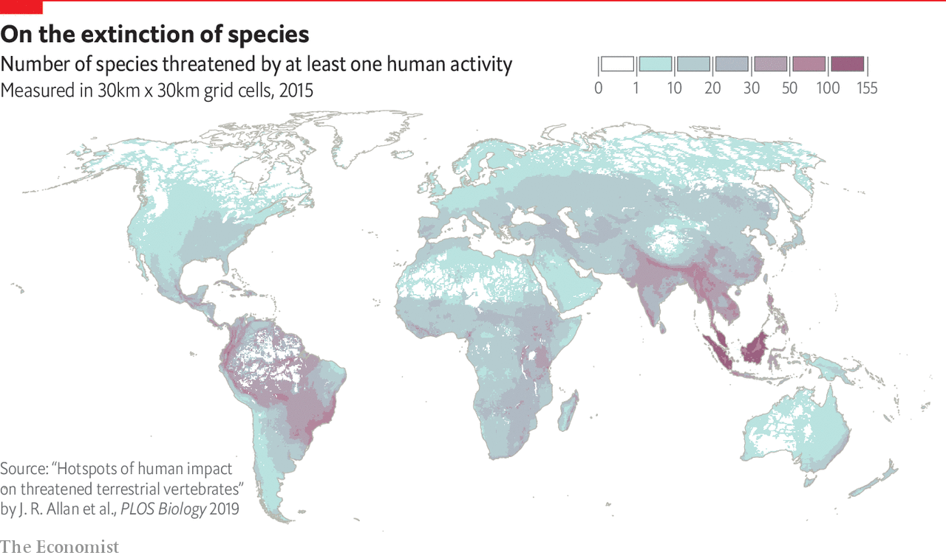
Currently threatened species

Slide 22
Preserving biodiversity
Some regions have very high densities of unique species
  Hawaii
  Madagascar
Some argue that these regions should be priority targets for environmental efforts.

Slide 23
Seminar Day
A city has a surplus of deer that are eating too many farmed crops. What should the city do?
The USA has one of the highest ecological footprints in the world. What, if anything should be done about this?
You are interested in the effect of increasing elevation on species diversity.
  What would you hypothesize the relationship to be and why?
  How would you test your hypothesis?
  What would be some confounding variables

